Slide 2
Psalm 118:19-24
¹⁹ Open to me the gates of righteousness; I will go through them, and I will praise the Lord. ²⁰ This is the gate of the Lord, through which the righteous shall enter. ²¹ I will praise You, for You have answered me, and have become my salvation. ²² The stone which the builders rejected has become the chief cornerstone. ²³ This was the Lord’s doing; it is marvelous in our eyes. ²⁴ This is the day the Lord has made; we will rejoice and be glad in it.

Slide 5
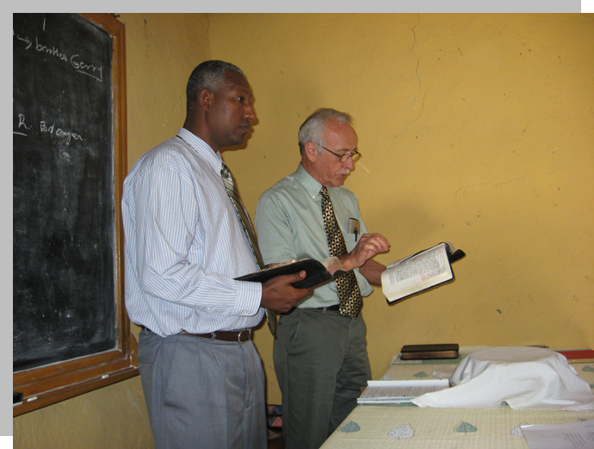
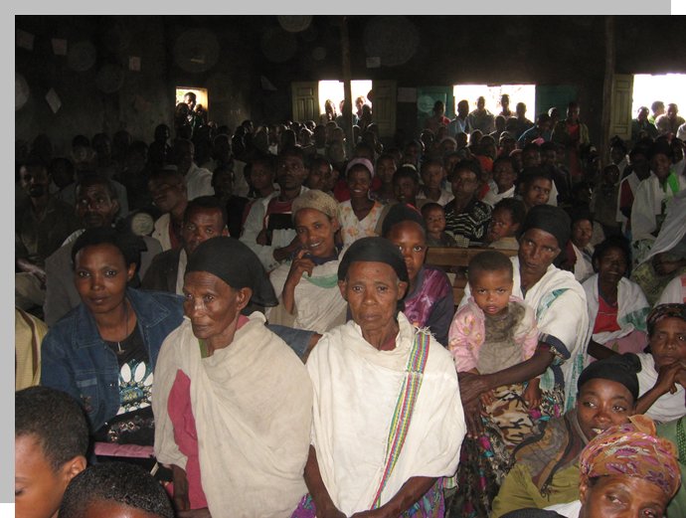
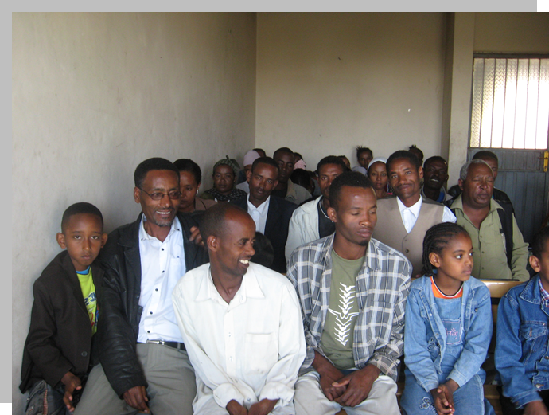
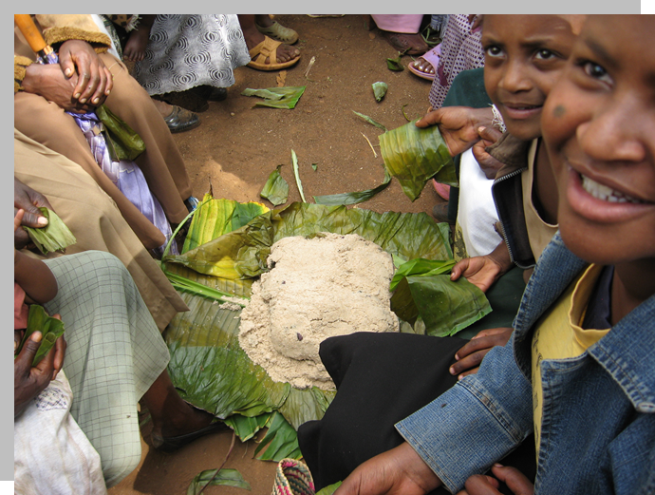
Ethiopia
Nigeria
Philippines
Believers meet on Sunday,
and joined in:
Lord’s Supper
Preaching
Prayer
Singing
Contribution
Yes they also met on other days—as did believers in the 1st century (Acts 2:46).
But on Sunday—they especially meet and participate in an out of the ordinary collective worship.
Usually an all day event!

Slide 6
The stone which the builders rejected has become the chief cornerstone. This was the Lord’s doing; it is marvelous in our eyes. This is the day the Lord has made; we will rejoice and be glad in it
(Psa 118:22-24).
Jesus said to them, have you never read in the Scriptures: The stone which the builders rejected has become the chief cornerstone. This was the Lord’s doing, and it is marvelous in our eyes?
(Matt 21:42).
Let it be known to you all, and to all the people of Israel, that by the name of Jesus Christ of Nazareth, whom you crucified, whom God raised from the dead, by Him this man stands here before you whole. This is the stone which was rejected by you builders, which has become the chief cornerstone.’
(Ac 4:10-11).

Slide 7
The stone which the builders rejected has become the chief cornerstone. This was the Lord’s doing; it is marvelous in our eyes. This is the day the Lord has made; we will rejoice and be glad in it
(Psa 118:22-24).
The stone which the builders rejected has become the chief cornerstone. This was the Lord’s doing; it is marvelous in our eyes. This is the day the Lord has made; we will rejoice and be glad in it
(Psa 118:22-24).
Now on the first day of the week, very early in the morning, they, and certain other women with them, came to the tomb bringing the spices which they had prepared. But they found the stone rolled away from the tomb. Then they went in and did not find the body of the Lord Jesus.
(Lk 24:1-3).
Now behold, two of them were traveling that same day to a village called Emmaus, which was seven miles from Jerusalem . . . the chief priests and our rulers delivered Him to be condemned to death, and crucified Him. But we were hoping that it was He who was going to redeem Israel. Indeed, besides all this, today is the third day since these things happened.
(Lk 24:13-21).

Slide 8
Sunday:
Jesus fulfilled His promise to defeat death (Matt 16:21)
Jesus was confirmed to be the son of God (Rom 1:4)
Jesus was enthroned as King of kings (Acts 2:30-31)
The Holy Spirit came upon the apostles (Acts 2:1-4)
The church came into existence (Acts 2:37-47)
John received the Revelation vision (Rev 1:10)
The early church met to worship (Acts 20:7; 1 Cor 16:1-2)

Slide 9
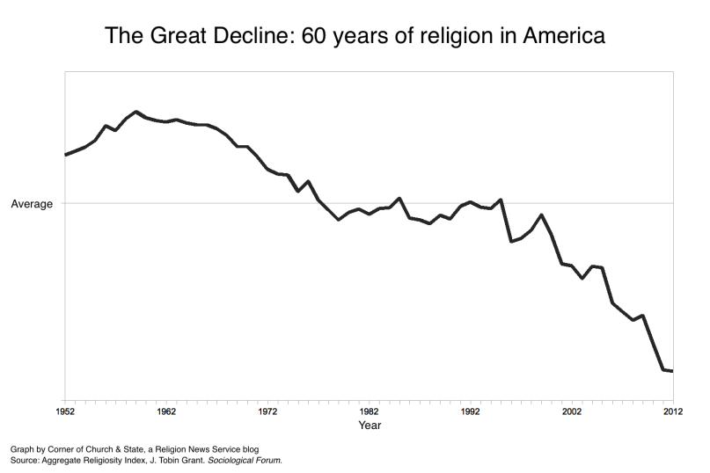
What’s Happened to the Lord’s Day?
20 % Attend church once each week,
80% of Americans do not!
Between 4,000—7,000 churches close their doors permanently each year.

Slide 10
Just Another Work Day

Slide 11
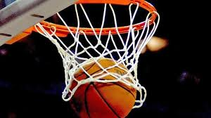
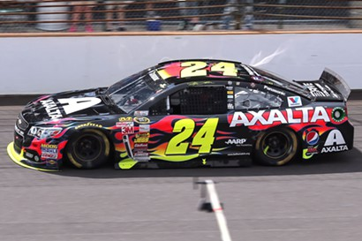
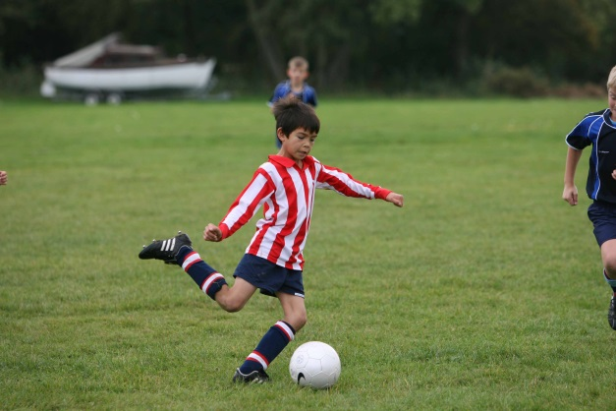
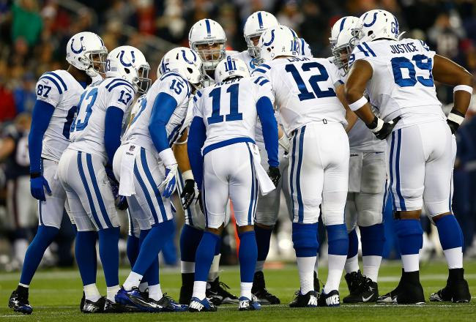
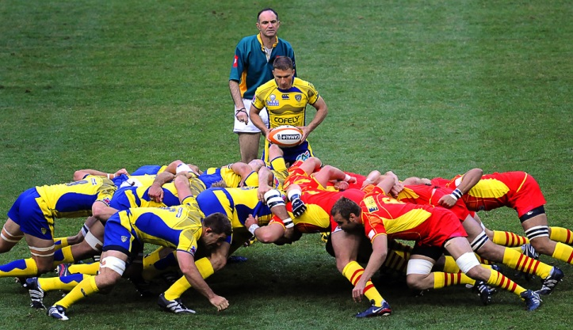
A Day of Sports

Slide 12
A Recreation Day

Slide 13
A Day of Shopping

Slide 14
Day of Rest

Slide 15
Day for Yard Work

Slide 16
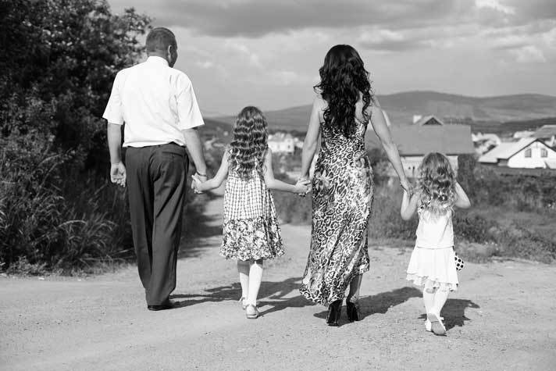
What’s Happened to the Lord’s Day?
Make AM Worship a one-hour non-intrusive experience!
Downgrade the “stoic” to a more casual feel—afterwards we are going to the track!
Move the PM service to 11:30 AM so as to get it out of the way!
Eliminate the PM altogether—this is only “tradition.”

Slide 17
We will rejoice and be glad in it.

