Slide 2
Malachi 2:1-4
¹ And now, O priests, this commandment is for you. ² If you will not hear, and if you will not take it to heart, to give glory to My name, says the Lord of hosts, I will send a curse upon you, and I will curse your blessings. Yes, I have cursed them already, because you do not take it to heart. ³ Behold, I will rebuke your descendants and spread refuse on your faces, the refuse of your solemn feasts; and one will take you away with it. ⁴ Then you shall know that I have sent this commandment to you, that My covenant with Levi may continue, says the Lord of hosts.

Slide 4
You have wearied the Lord with your words; Yet you say, in what way have we wearied Him? In that you say, everyone who does evil is good in the sight of the Lord,
(Malachi 2:17).

Slide 5
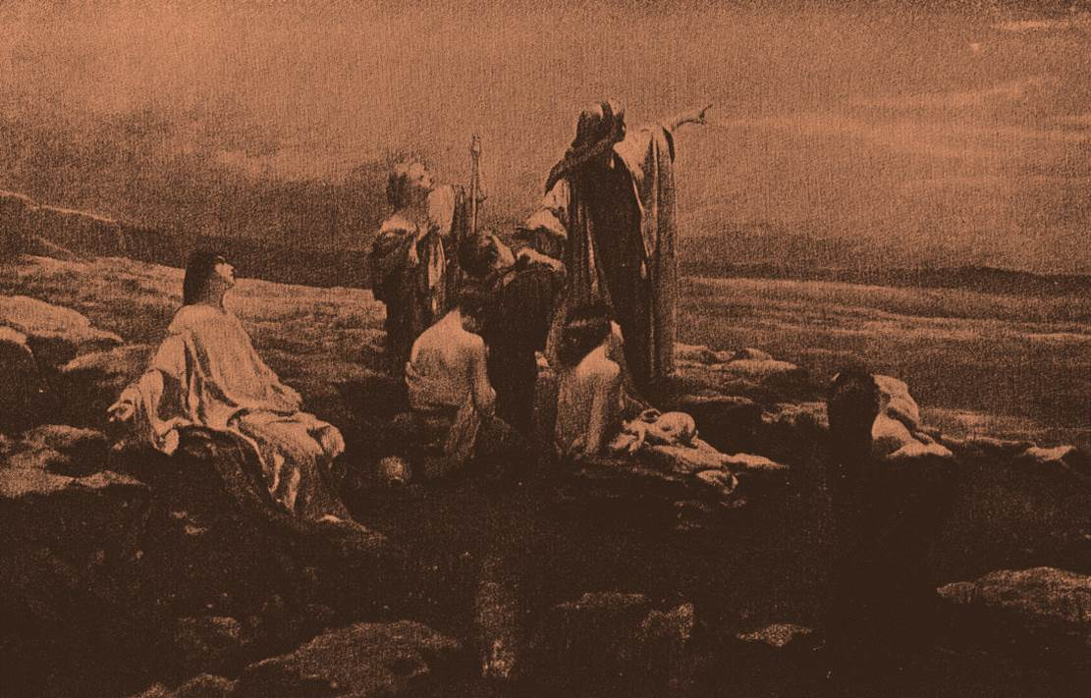
Convince them of God’s Love (1:2).
Convict them of sins (3:4-5).
Show them they were dishonoring God (1:6).
Prove they were exhausting God (2:17).
Illustrate the seriousness of sin (2:1-4).

Slide 6
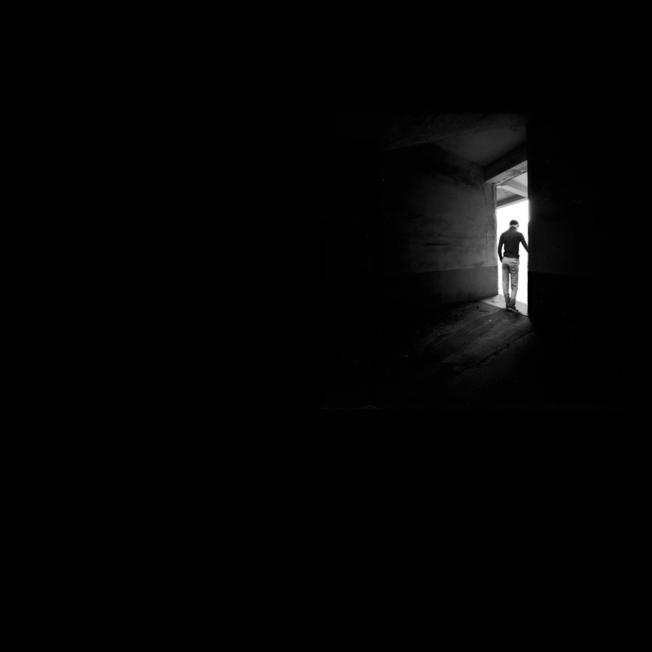
A Total Disregard
. . . for Godly Reverence (3:16; 4:2)
. . . for Moral Purity (2:10; 3:5-6)
. . . for the Covenant of Marriage (2:11; 2:14; 2:16)
. . . for the Sanctity of Worship (1:2-8; 3:3)

