Slide 2
Acts 1:1-3
¹ The former account I made, O Theophilus, of all that Jesus began both to do and teach, ² until the day in which He was taken up, after He through the Holy Spirit had given commandments to the apostles whom He had chosen, ³ to whom He also presented Himself alive after His suffering by many infallible proofs, being seen by them during forty days and speaking of the things pertaining to the kingdom of God.

Slide 4
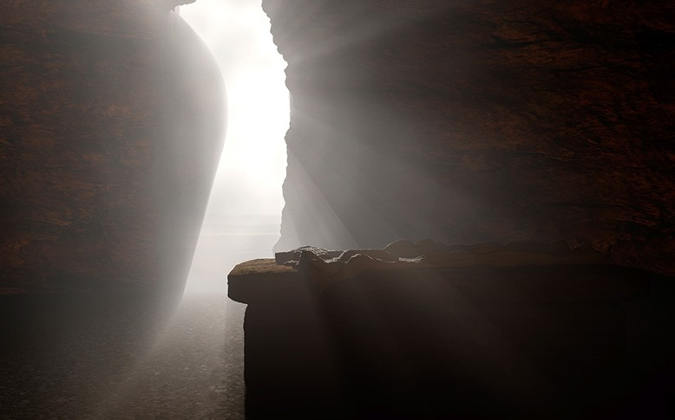

Slide 5
Do “Christians” Really Believe In. . .
. . . Attending Worship Always (Heb 10:25)?
. . . Seeking First God’s Kingdom (Matt 6:33)?
. . . Giving each Sunday (1 Cor 16:1-2)?
. . . Partaking of the Lord’s Supper each Sunday (Acts 20:7)?
. . . Guarding our Language (Col 3:8)?
. . . Being careful about what We See (Psa 101:3)?
. . . Dressing Modestly (1 Tim 2:9-10)?
. . . Controlling our temper/tongue (Eph 4:31)?
. . . Loving others (Mk 12:31; Matt 5:44)?
. . . Forgiving others (Matt 6:14-15)?

Slide 6
If So, then Why . . .
. . . Is There such a “drop-off” in Attendance from AM to PM to Wed PM?
. . . Are parents seeking the secular rather than the spiritual for their children?
. . . Churches struggling to have enough money to operate?
. . . Are so many believers using “euphemisms”?
. . . Regularly viewing “R-rated movies?
. . . 70% of professed believers (50% male/20% female) viewing Pornography?
. . . Wear skimpy swimming attire on public beaches, and swimming pools?
. . . Are so many willing to verbally rip to shreds those who angered them?
. . . Is the divorce rate still high among professed Christians?
. . . Are church pews filled with alcohol and drug users?

Slide 7
Do “Christians” Really Believe In. . .
The Resurrection of Christ?

Slide 8
Jesus said He would be raised (Matt 16:21; 26:32).
The Tomb was Empty (Matt 27:62—28:1-8).
There were multiple eyewitnesses (Acts 1:3).
The Transformation of the disciples (Matt 26:56; Acts 4:19-20).
The Existence of and Growth of the church (1 Cor 2:1-5; Acts 17:3, 30-31).
This Means: We will be Raised & Judged (1 Cor 15:20-23; Acts 17:31).

Slide 9
Belief in the Resurrection Changes Us:
We purge sins from our lives (Col 3:1-9; Eph 4:22; Rom 6:4).
We put on characteristics of Righteousness (Col 3:10: Eph 4:24; Rom 6:13).

