Slide 2
1 Corinthians 6:9-11
⁹ Do you not know that the unrighteous will not inherit the kingdom of God? Do not be deceived. Neither fornicators, nor idolaters, nor adulterers, nor homosexuals, nor sodomites, ¹⁰ nor thieves, nor covetous, nor drunkards, nor revilers, nor extortioners will inherit the kingdom of God. ¹¹ And such were some of you. But you were washed, but you were sanctified, but you were justified in the name of the Lord Jesus and by the Spirit of our God.

Slide 4
1 Corinthians 6:9-11
⁹ Do you not know that the unrighteous will not inherit the kingdom of God? Do not be deceived. Neither fornicators, nor idolaters, nor adulterers, nor homosexuals, nor sodomites, ¹⁰ nor thieves, nor covetous, nor drunkards, nor revilers, nor extortioners will inherit the kingdom of God. ¹¹ And such were some of you. But you were washed, but you were sanctified, but you were justified in the name of the Lord Jesus and by the Spirit of our God.
homosexuals
sodomites
malakos (KJV, effeminate)
“a catamite (Greco-Roman—a boy kept for sexual purposes, a younger male lover), a male who submits his body to unlawful lewdness.” [Thayer’s Greek-English Lexicon, pg 387].
arsenokoites (KJV, abusers of themselves with mankind)
“one who lies with a male as with a female, a sodomite.”
[Thayer’s Greek-English Lexicon, pg 75].

Slide 5
Homosexuality in Rome
Homosexuality had spread like a cancer through Rome from the Greek culture.
Fourteen out of the first fifteen Roman Emperors were homosexual.
Nero “married” a boy named Sporus and lived with him as his “wife.”
Christianity was born during this very degrading culture.
Some Corinthians had engaged in these unnatural sins.
Jesus Christ can change hearts and lives (“such were some of you” 1 Cor 6:11).

Slide 6
In determining the meaning of any Act of Congress, or of
any ruling, regulation, or interpretation of the various administrative bureaus and agencies of the United States, the word ‘marriage’ means only a legal union between one man and one woman as husband and wife, and the word ‘spouse’ refers only to a person of the opposite sex who is a husband or a wife.
Defense of Marriage Act
1996

Slide 7
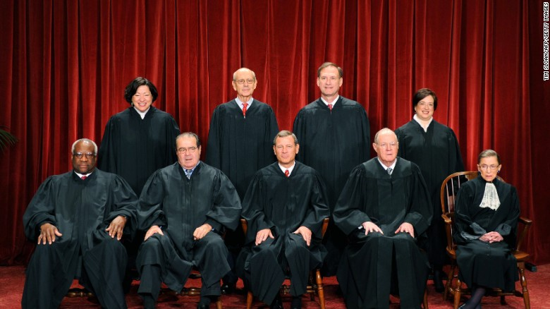
Homosexual “Marriage” is LAW
37 States Legalized

Slide 8
“This ruling is a victory for America . . . We’ve made our union a little more perfect . . . America should be very proud.” (Barack H. Obama)
Pride goes before destruction, and a haughty spirit before a fall. (Proverbs 16:18)

Slide 9
Change has come
to America

Slide 10
God Has Not Changed
“For I am the Lord, I do not change” (Mal 3:6).
“The counsel of the Lord stands forever” (Psa 33:11).
“. . . My words will by no means pass away” (Matt 24:35).

Slide 11
God’s Definition of Marriage Remains
Unchanged
God’s View of Homosexuality Remains
Unchanged
Our Loyalty and Preaching Must Remain
Unchanged

