Slide 2
Surely they busy themselves in vain . . .
(Psalm 39:6)
Monday:
This morning I had to get up early to make Benji and me bologna sandwiches, because I was going with him on his class field trip.
When we came home I had to go back to the school because Amy was seeing a sex education class and she wanted me to be there, she was nervous about seeing it by herself,
I hurried home before school was out and made a couple of pumpkin pies, because Bill had invited some people over for dinner,
I rushed back to school to pick the kids up, then went home and put dinner on the table and we visited with our company for the evening.
Then it was TUESDAY,
All day Tuesday we worked on a musical we had to finish,
Then I remember to go to the grocery because we were out of everything,
But before I went to the grocery I had to run by the drug store to get Amy a Scholl’s thing to put on the bottom of her foot because she has this wart on the bottom of her foot, and I had to remember to get Benji a new kick ball because he kicked his other one into the thorn tree and put a hole in it,
Then after school I had to pick up Suzanne and take her to the eye doctor because she has new contacts and they had to be checked,
That night I went home and we played some badminton because it was family night.
On WEDNESDAY:
I worked on some songs we were writing,
Then I went and picked up the kids at school, because Wednesday is our piano lesson day, I had to remember to take Suzanne first to Oboe, because she can take her Oboe lesson while Amy’s taking her first piano lesson, and after Amy takes her piano lesson she has to go to flute lesson, and so I take her to flute and Benji takes his second piano lesson, while I go pick up Suzanne from Oboe, and before I take her there I stop at McDonalds and get Benji a hamburger before he faints,
And after we got done with music lessons we rushed home and in my spare time—I picked up the Bible and read . . . Deuteronomy 6:4-9!
I had said
nothing
to my children
about Jesus!

Slide 3
Jesus: The Healer of Sin
Jesus: The Healer of the Brokenhearted
Jesus: The Healer of Relationships
Jesus: The Healer of Churches
Jesus: The Healer of Nations

Slide 4
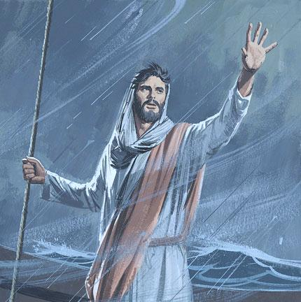
Who can this be,
that even the wind
and the sea obey Him?

Slide 5
What did He look like?
What was His personality like?
Why were so many drawn to Him?
Why was He rejected and crucified?

Slide 7
John 1:6-13
⁶ There was a man sent from God, whose name was John. ⁷ This man came for a witness, to bear witness of the Light, that all through him might believe. ⁸ He was not that Light, but was sent to bear witness of that Light. ⁹ That was the true Light which gives light to every man coming into the world. ¹⁰ He was in the world, and the world was made through Him, and the world did not know Him. ¹¹ He came to His own, and His own did not receive Him. ¹² But as many as received Him, to them He gave the right to become children of God, to those who believe in His name: ¹³ who were born, not of blood, nor of the will of the flesh, nor of the will of man, but of God.

Slide 9
What did He look like?
What was His personality like?
Why were so many drawn to Him?
Why was He rejected and crucified?
Would I have been attracted to Him?

Slide 10
Because I believe in God (Rom 1:20; Jn 5:37; Jn 14:1-3)
Because I believe in the Bible (Jn 5:39, 45-47)
Because I believe in the miracles recorded in the Bible (Jn 5:36)
Because I believe in the testimony of John (Jn 5:33-35; Matt 11:7-14)
Because of the change He has made in me (2 Cor 5:17; 1 Cor 6:9-11)

Slide 11
Today, I went down to the place where I used to go, today I saw the same old crowd I knew before. And when they asked me what had happened, I tried to tell them, Thanks to Calvary, I don't come here anymore.
Thanks to Calvary I am not the man I used to be, thanks to Calvary things are different than before. And as the tears ran down my face I tried to tell them, Thanks to Calvary, I don't live here anymore.
Then we went down to the house where we used to live, My little girl ran behind the door, like so many times before; And I said Honey you don't need to be afraid, you've got a new daddy now, Thanks to Calvary we don't live here anymore.

Slide 12
Jesus is The Healer of Sin
Jesus is The Healer of the Brokenhearted
Jesus is The Healer of Relationships
Jesus is The Healer of Churches
Jesus is The Healer of Nations

