Slide 2
1 Timothy 5:17-22
¹⁷ Let the elders who rule well be counted worthy of double honor, especially those who labor in the word and doctrine. ¹⁸ For the Scripture says, you shall not muzzle an ox while it treads out the grain, and, the laborer is worthy of his wages. ¹⁹ Do not receive an accusation against an elder except from two or three witnesses. ²⁰ Those who are sinning rebuke in the presence of all, that the rest also may fear. ²¹ I charge you before God and the Lord Jesus Christ and the elect angels that you observe these things without prejudice, doing nothing with partiality. ²² Do not lay hands on anyone hastily, nor share in other people’s sins; keep yourself pure.

Slide 4
Laying on of Hands
Signifies the appointment to a work/office:
Deacons/Servants (Ac 6:1-6)
Preaching (Ac 13:1-3; 1 Tim 4:14)
Elders (1 Tim 5:17-21)
Imparting gifts of the Spirit (Ac 8:18)
The Laying on of Hands

Slide 5
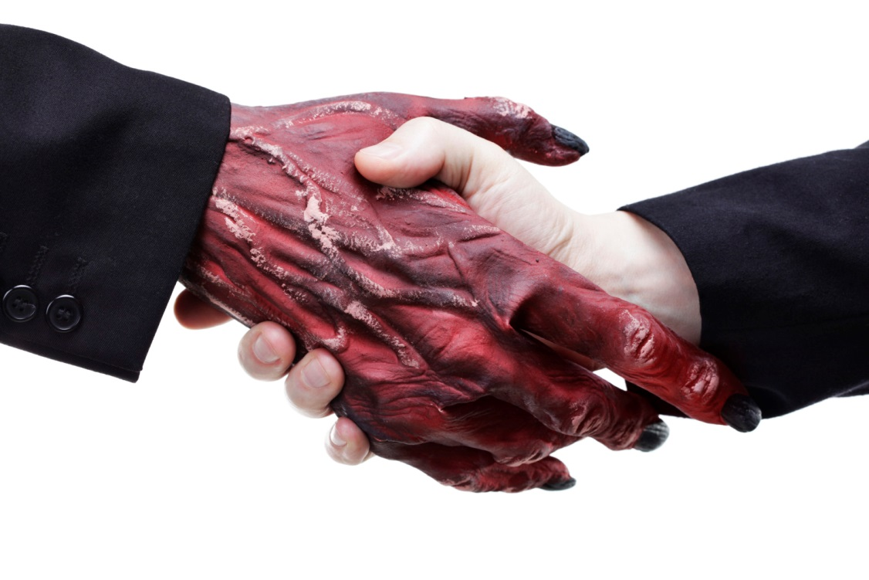
Do not lay hands on anyone hastily, nor share in other people’s sins; keep yourself pure.
(1 Tim 5:22)
WARNING
The Laying on of Hands
Do not Share in the sins of Others!

Slide 6
. . . refusing to rebuke the sin
. . . consenting to the sin
. . . arrange for the sin to be committed
. . . repeating the same sin
Sharing in the sins of Others by:
Do not Share in the sins of Others!
. . . agreeing to sin together

