Slide 2
Revelation 20:7-10
⁷ Now when the thousand years have expired, Satan will be released from his prison ⁸ and will go out to deceive the nations which are in the four corners of the earth, Gog and Magog, to gather them together to battle, whose number is as the sand of the sea. ⁹ They went up on the breadth of the earth and surrounded the camp of the saints and the beloved city. And fire came down from God out of heaven and devoured them. ¹⁰ The devil, who deceived them, was cast into the lake of fire and brimstone where the beast and the false prophet are. And they will be tormented day and night forever and ever.

Slide 4
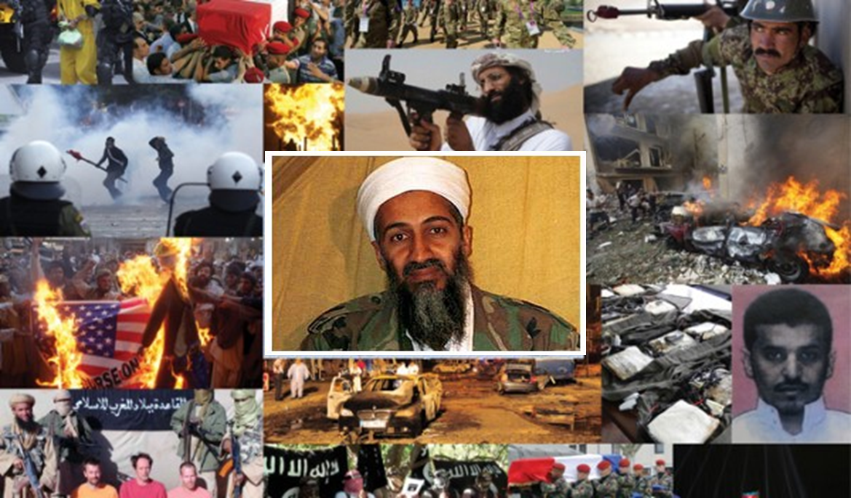
9-11-01

Slide 5
Islam is the youngest of the 5 major religions of the world. There are 1.6 billion Muslims world-wide (Second only to Christendom—2.2 billion).
More than 20 million Muslims live in Europe. There are now more than 2000 mosques in England!
Russia has about 16,500,000 Muslims (all nations included in the former Soviet Union has 53 million Muslims).
Currently, there are 48 nations where adherents of Islam are in the majority.
Nigeria (50%), Ethiopia (33.8%).
U.S.A. (2,595,000, 2,106 mosques). More than Churches of Christ: 1.6 million members.

Slide 6
Islam was founded by Muhammad who was born in 570 A.D. in a small village (Mecca) in what is today known as Saudi Arabia.
Orphaned at age 8 Muhammad was raised by a wealthy uncle. Muhammad learned his uncle’s business and became very successful.
He had an intense interest in religion. The prevailing religion at this time in Arabia was one of polytheism and animism (belief in spirits & angels).
He investigated both Judaism and “Christianity.” (An apostate Christianity entering the Dark Ages).
At about 25 years old Muhammad married a wealthy widow 40 years of age.
This wealth gave him time for religious meditation, fasting and dreams. He had a profound dissatisfaction with the polytheism and superstition of his day.
He claimed to receive his first of many "revelations" when he was about 40 years old, and thought at first he was possessed by a demon.

Slide 7
Later he claimed he was visited by the angel Gabriel who informed him to warn the people. This marked the beginning of his claim to be “The Prophet.”
At first he told only his family and close friends about these “revelations,” but, during the next three years the message of Muhammad quietly spread among the people of Mecca, especially among the young.
Muhammad next begin to claim he received instructions from Allah to go public with his message and openly condemn the paganism and idolatry of Mecca.
At this early stage, Islam was weak and persecutions caused many Muslims to flee to Ethiopia. Muhammad continued to preach his message, and his following slowly increased.
A change was about to occur! In 621 AD, a group of delegates from Medina made a covenant with Muhammad and declared themselves to be Muslim.

Slide 8
Then a year later, some seventy people from Medina did the same and vowed to fight in order to protect Muhammad against any and all enemies.
This was a turning point for the religion of Islam. It provided Muslims with a secure base of operations and allowed them to expand from it. Muhammad commanded the Muslims in Mecca to migrate to Medina (a city in western Saudi Arabia).
For 13 years, Muhammad had preached in Mecca with very little success, in part because he followed a quiet, nonpolitical approach and merely preached his beliefs. But, then his tactics changed.
He established himself as a religious, political, and a military leader. Under Muhammad, the community of Muslims became more important than family or tribe. Islam then began to be spread through intimidation and force. Entire tribes and cities were “converted” under threat of war or by conquest. This “success” led to greater successes—and continues today.

Slide 9
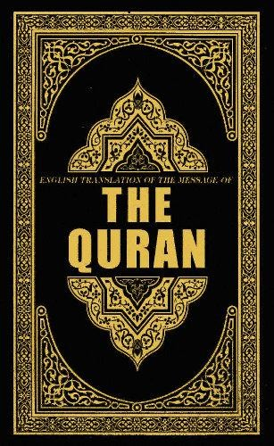
Islam’s Beliefs
“The common thing observed from the above verses is: Jesus (peace be upon him) prays to the Lord to save him from the anticipated persecution at the hands of the Jews; yet not as Jesus wishes but as the Lord wills. Do you realize what Jesus is stating at this moment? He subdues his wishes and submits himself to the will of Allah. In other words, Jesus declares his Islam, submission, at that moment . . . A Muslim is one who has submitted to the will of Allah.”
SHAHADAH (Recitation of Muslim creed): “There is no god but Allah and Muhammad is the messenger of Allah.”
SALAH (Prayer worship): 5 times a day facing Mecca. Before Salah Muslims must perform Ablution (washing hands, face, arms, head, feet).
SAWM (Fasting): Sunrise to sunset during the month of Ramadan. (Abstain from all food & drink for 28 days—only during the day.
ZAKAH (almsgiving / tithing): 2% to 10% for the poor and for the advancement of Islam.
HAJJ (Pilgrimage): A Muslim, at least once in a lifetime is expected to make a pilgrimage to Mecca, if money and health permit. For those unable to physically go, they can secure a substitute to go in their place.

Slide 10
Islam’s Beliefs
What is involved in becoming a Muslim? Current Mullah’s and Muslim holy men say there is no ceremony or ritual involved when a person wants to become a Muslim. All one has to do is to believe and say: “There is no god but Allah and Muhammad is the messenger of Allah.” But after making this confession the person is then obligated to do all the duties of Islam.
Islam has historically developed in countries in four stages.
Evangelism. Peaceful proselyting continues until persecution arises or Muslims have developed a large power base. This stage is characterized by great tolerance of others and their beliefs. This is what’s happening in the United States now.
Consolidation. This is when they become established. After they have become established, a power base is now organized and tolerance diminishes and greater demands are placed upon followers.
Revolution. That is, all opposition, no matter what kind it is, is challenged and either eliminated or subdued.
Islamic State. Such as Afghanistan, Saudi Arabia and Iran.

Slide 11
Sharia Law
In an Islamic state, when Muslims become strong enough in any country, whether Saudi Arabia or America, they will demand the implementation of “Sharia.”
Sharia is Islamic law based upon the Koran and Ahadith (sayings).
This is the law that makes women virtual prisoners in a man’s house, causes them to wear the Burqa, and makes them second class citizens.
It’s the law that demands the execution of those who blaspheme Muhammad, Islam or the Koran.
This is the law that will not allow Christians to evangelize a Muslim and will imprison or execute a Muslim convert unless he recants.
This is the law that required United States soldiers in Arab countries to hide their Bibles. This is the law that Muslims want to see replace the constitution of the United States.
If Muslims can overcome by peaceful means, then that is the avenue that they will take, but if they cannot win by peaceful means, “jihad,” or holy war: “Allahu Akbar!”

Slide 12
“And whoever will not receive you nor hear your words, when you depart from that house or city, shake off the dust from your feet.” (Matt 10:14).
“But I say to you, love your enemies, bless those who curse you, do good to those who hate you, and pray for those who spitefully use you and persecute you, that you may be sons of your Father in heaven” (Matt 5:44-45).
Judas hanged himself—Matt 27:5.
“Then the soldiers of the governor took Jesus . . . (Matt 27:27).
“They crucified Him” (Matt 27:35.
“Jesus . . . yielded up His spirit” (Matt 27:50).
“For when we were still without strength, in due time Christ died for the ungodly.” (Rom 5:6).
“By that will we have been sanctified through the offering of the body of Jesus Christ once for all.” (Heb 10:10).
JESUS WAS NOT CRUCIFIED: “And their saying: we killed christ Jesus, son of Mary, The messenger of Allah - but they killed him not, nor crucified him, but it was made to appear to them so; and those who disagree concerning it are full of doubts; they have no knowledge thereof save pursuit of a conjecture; For surely they killed him not; but Allah took him up unto Himself; and Allah is ever mighty, wise.” (Koran)
JESUS WAS NOT CRUCIFIED: From the sayings of Muhammad, we get a more detailed account.
The Muslim belief is that Allah changed the face of the person who betrayed Jesus, showing to the rulers the place where he was hiding, into a face resembling Jesus. So, they crucified that betrayer instead of Jesus.
“Kill those who join other gods with God (Allah) wherever ye shall find them; and seize them, besiege them, and lay wait for them with every kind of ambush.”
“For there are three that bear witness in heaven: the Father, the Word, and the Holy Spirit; and these three are one.” (1 John 5:7)
“Jesus is not more than a servant whom we favored, and proposed as an instance of divine power to the children of Israel.”
“Jesus said to him, I am the way, the truth, and the life. No one comes to the Father except through Me.” (John 14:6)
A pamphlet entitled: Prophethood in Islam states, “The Koranic account of Jesus emphatically rejects the concept of his divinity and divine sonship.”
“Now the birth of Jesus Christ was as follows: After His mother Mary was betrothed to Joseph, before they came together, she was found with child of the Holy Spirit.” (Matt 1:18)
The Koran states anyone who says “God is the Messiah, Mary’s Son, God shall prohibit him entrance into Paradise and his refuge shall be the fire. They are unbelievers who say God is the Third of Three.”
“Jesus heard that they had cast him out; and when He had found him, He said to him, do you believe in the Son of God? He answered and said, who is He, Lord, that I may believe in Him? And Jesus said to him, you have both seen Him and it is He who is talking with you. Then he said, Lord, I believe! And he worshiped Him. (John 9:35-38)

Slide 13
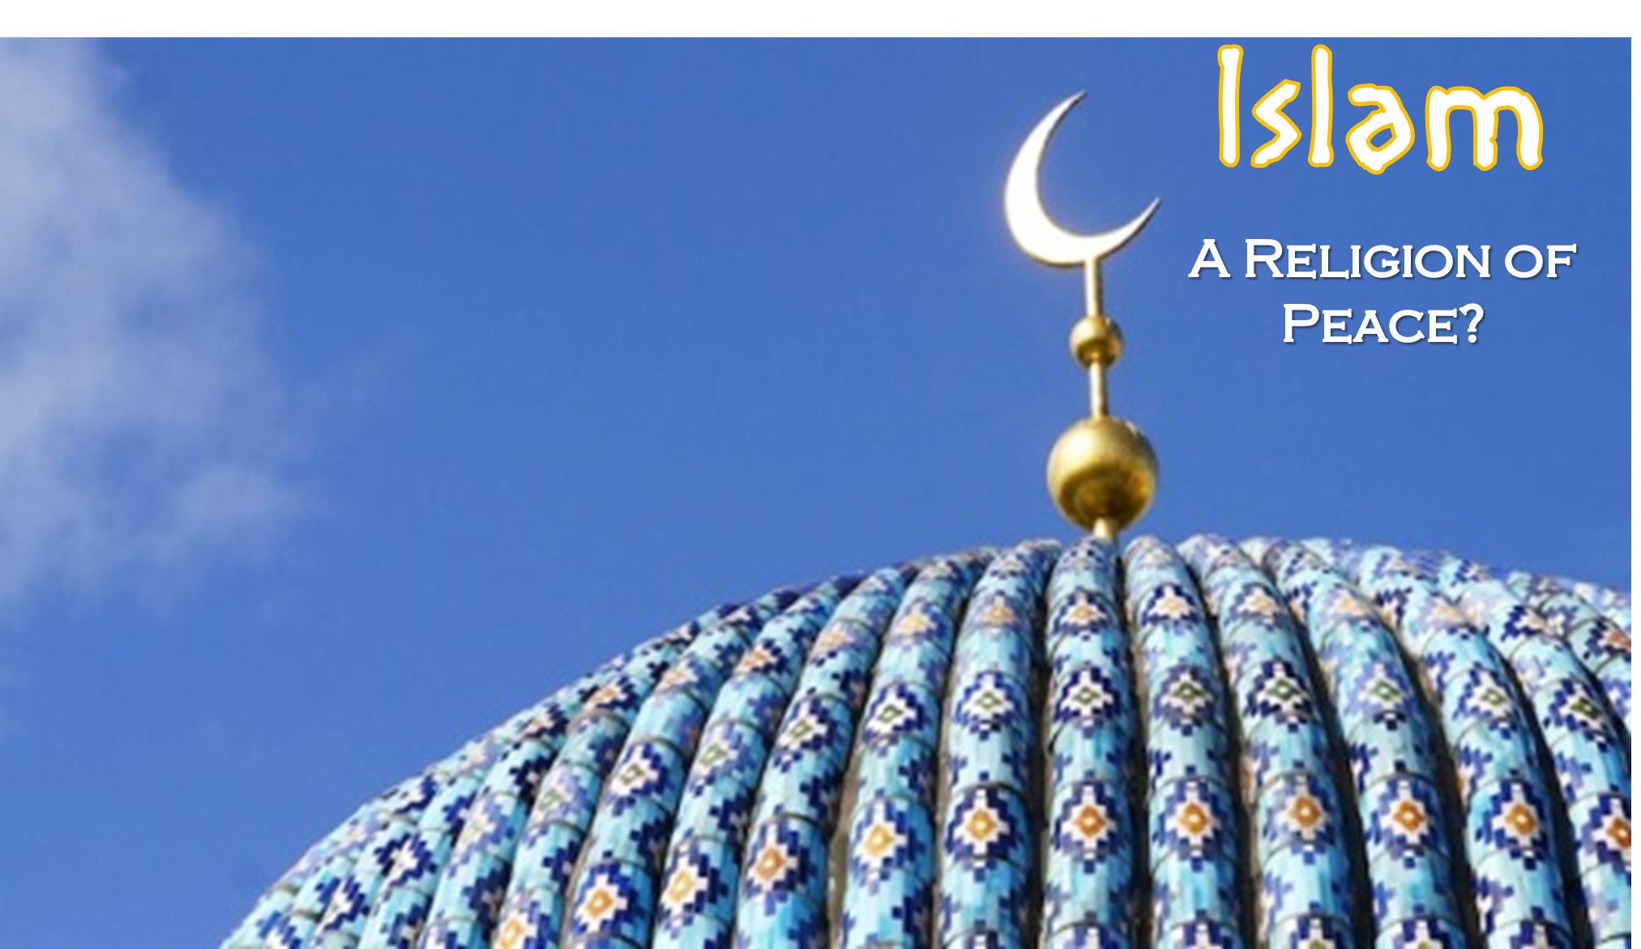
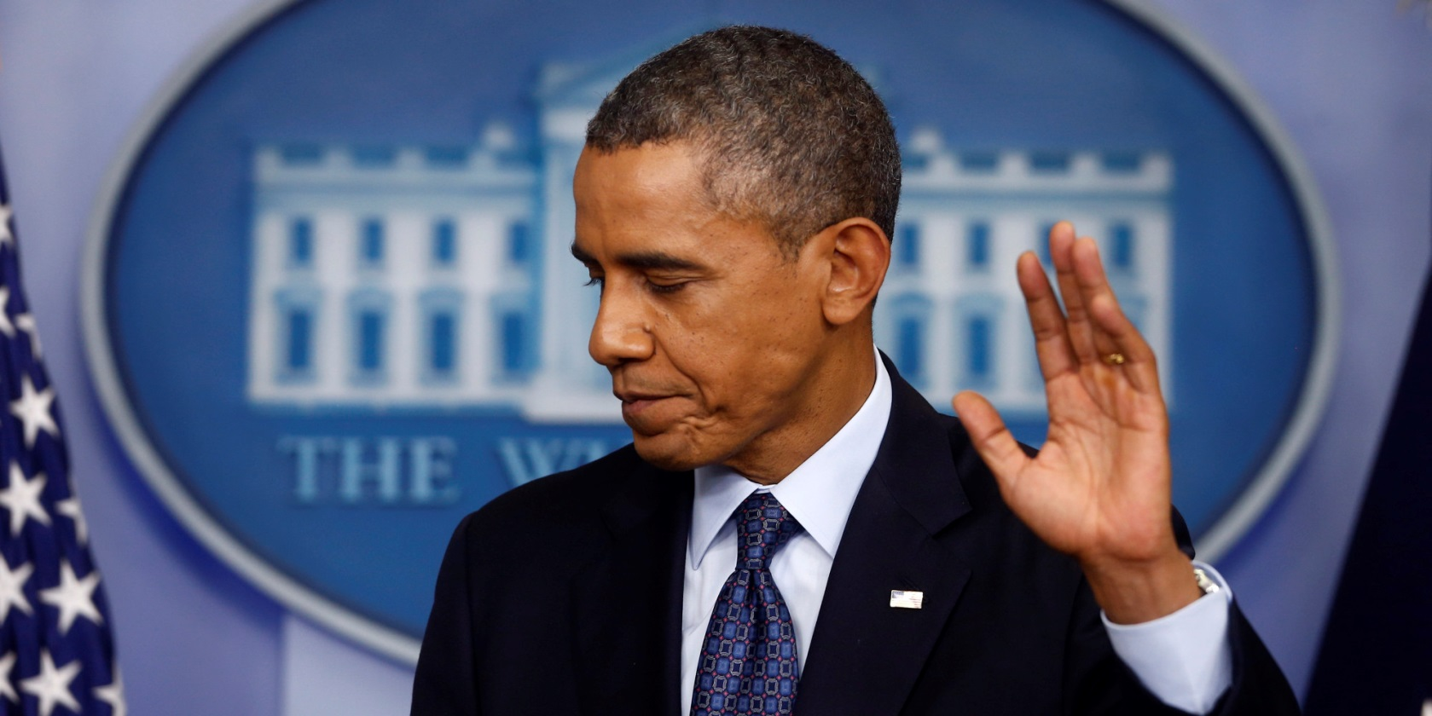
The future must not belong to those who slander the Prophet of Islam.
The sweetest sound I know is the Muslim call to prayer.
Islam has a proud tradition of tolerance.
Islam has always been part of America.
Throughout history, Islam has demonstrated through words and deeds the possibilities of religious tolerance and racial equality.
“Fight in the cause of God, those who fight you, but do not transgress limits; for God loveth not transgressors. And slay them wherever ye catch them, and turn them out from where they have turned you out: For tumult and oppression are worse than slaughter; But fight them not at the sacred Mosque unless they first fight you there; But if they fight you, Slay them. Such is the reward of those who suppress faith.”
JIHAD [a war or struggle against unbelievers]. (“fight with them . . . whoever then acts aggressively against you, inflict injury on him according to the injury he has inflicted on you . . .”
(“Crucifixion or Cruci-fiction” by Ahmed Deedat )“In the battle for the hearts and minds of mankind, ‘Cruci-FICTION’ is the only card the Christian holds. Free him from his infatuation and you will have freed the Muslim world from missionary aggression and harassment.”
“When ye encounter unbelievers, strike off their heads until ye have made a great slaughter among them, and bind them in bonds.”
“those who fight against you, kill them wherever ye shall find them . . . You Allah are our protector. Give us victory therefore over the infidel nations.”

Slide 14
Jesus died for the Muslim too

