Slide 2
Luke 18:1-8
¹ Then He spoke a parable to them, that men always ought to pray and not lose heart, ² saying: there was in a certain city a judge who did not fear God nor regard man. ³ Now there was a widow in that city; and she came to him, saying, get justice for me from my adversary. ⁴ And he would not for a while; but afterward he said within himself, though I do not fear God nor regard man, ⁵ yet because this widow troubles me I will avenge her, lest by her continual coming she weary me. ⁶ Then the Lord said, hear what the unjust judge said. ⁷ And shall God not avenge His own elect who cry out day and night to Him, though He bears long with them? ⁸ I tell you that He will avenge them speedily. Nevertheless, when the Son of Man comes, will He really find faith on the earth?

Slide 5
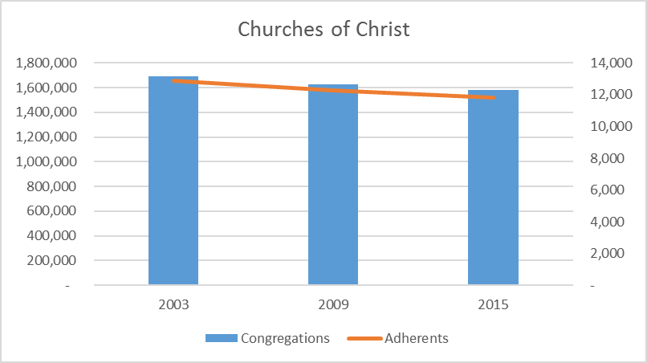
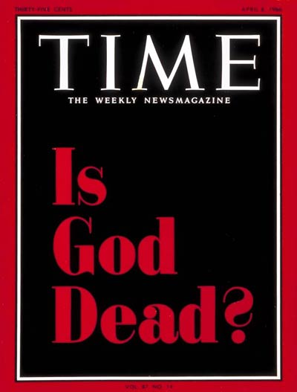
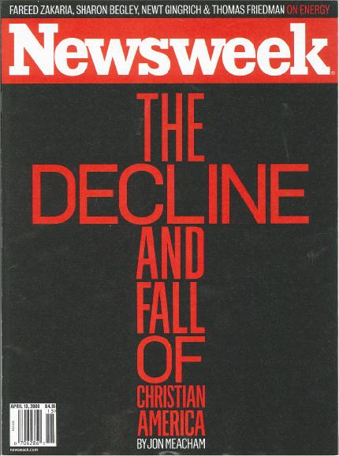
Builders - Born 1926-1945 Church Attendance: Some 60% of the Builders attend church today.
Boomers - Born 1946 – 1964 Church Attendance: Some 42-44% of the Boomers attend church today.
GenXers - Born 1965 – 1983 Church Attendance: Some 18-22% of the GenXers attend church today.
Millennials - Born 1984-2000 Attendance in Church Today: Less than 10%
Nexters - Born 1001– (?)

Slide 13
What’s The Problem?
Response from the Left:
“If people weren't so dogmatic, legalistic, and pharisaical churches would not be shrinking. If we could get past our obsession with doctrine and begin focusing on grace we wouldn't be in this decline.”
Response from the Right:
“If people would simply stick to the ‘old paths’ and stop going after all the new and unscriptural innovations we wouldn't be in this mess. We used to be the fastest growing group in America.”

Slide 14
What’s The Problem?
Too Much Worldliness in the Church
Too Much Complacency in the Church
Too Much Quarreling about Opinions
Belief is a Choice not a Conviction

