Slide 2
Philippians 1:1-11
¹ Paul and Timothy, bondservants of Jesus Christ,
To all the saints in Christ Jesus who are in Philippi, with the bishops and deacons: ² Grace to you and peace from God our Father and the Lord Jesus Christ. ³ I thank my God upon every remembrance of you, ⁴ always in every prayer of mine making request for you all with joy, ⁵ for your fellowship in the gospel from the first day until now, ⁶ being confident of this very thing, that He who has begun a good work in you will complete it until the day of Jesus Christ;

Slide 3
⁷ just as it is right for me to think this of you all, because I have you in my heart, inasmuch as both in my chains and in the defense and confirmation of the gospel, you all are partakers with me of grace. ⁸ For God is my witness, how greatly I long for you all with the affection of Jesus Christ. ⁹ And this I pray, that your love may abound still more and more in knowledge and all discernment, ¹⁰ that you may approve the things that are excellent, that you may be sincere and without offense till the day of Christ, ¹¹ being filled with the fruits of righteousness which are by Jesus Christ, to the glory and praise of God.

Slide 6
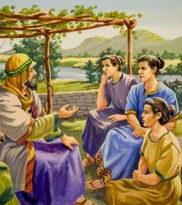
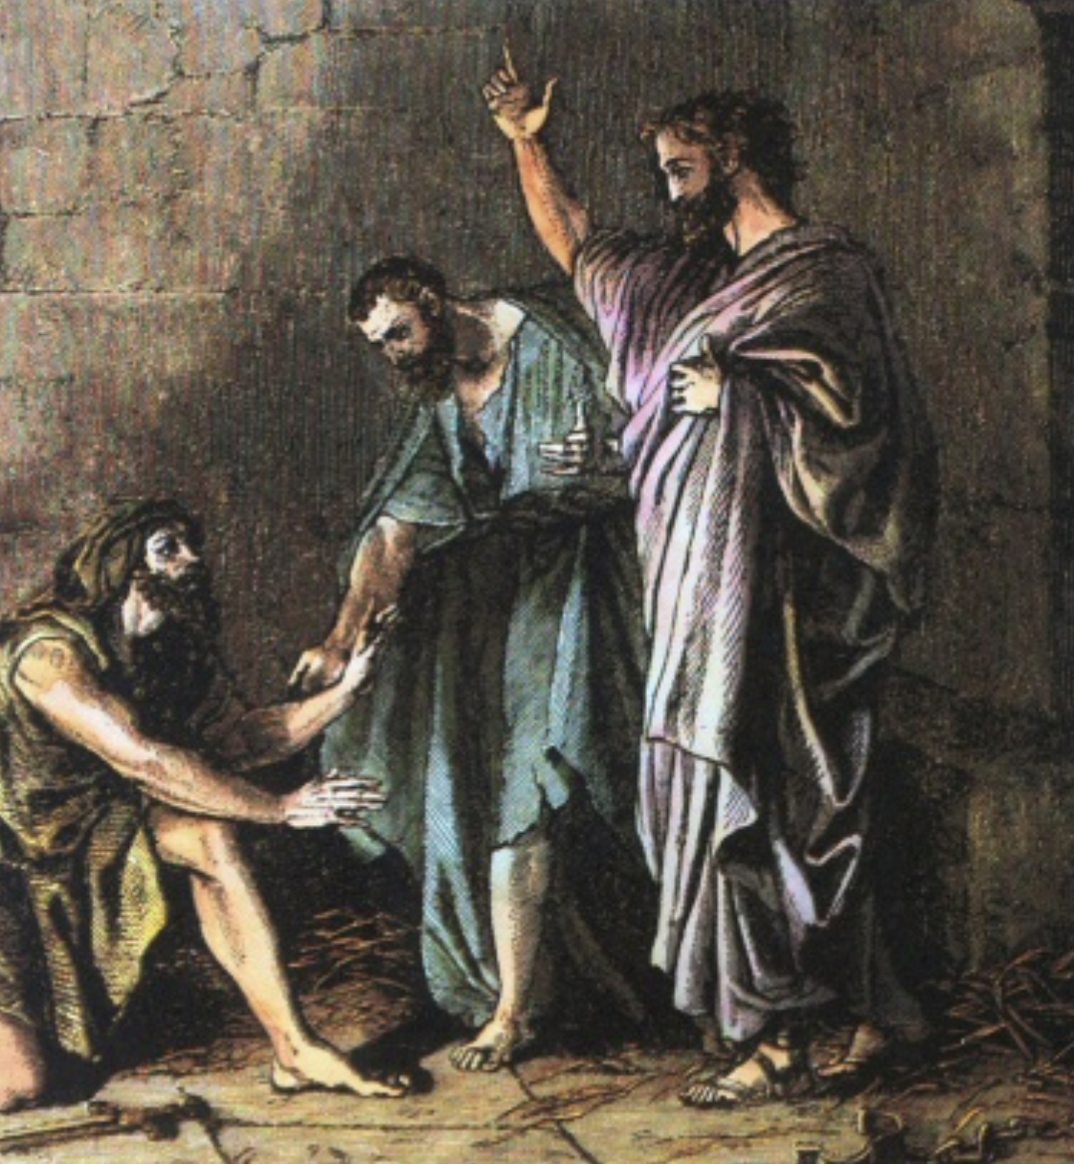
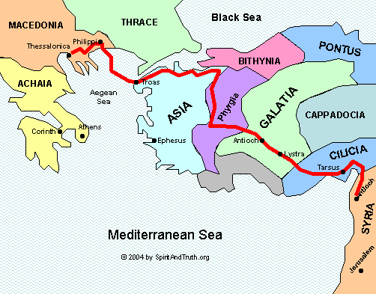
The Macedonian Call
Acts 16:1-34

