Slide 2
Luke 2:1-7
¹ And it came to pass in those days that a decree went out from Caesar Augustus that all the world should be registered. ² This census first took place while Quirinius was governing Syria. ³ So all went to be registered, everyone to his own city. ⁴ Joseph also went up from Galilee, out of the city of Nazareth, into Judea, to the city of David, which is called Bethlehem, because he was of the house and lineage of David, ⁵ to be registered with Mary, his betrothed wife, who was with child. ⁶ So it was, that while they were there, the days were completed for her to be delivered. ⁷ And she brought forth her firstborn Son, and wrapped Him in swaddling cloths, and laid Him in a manger, because there was no room for them in the inn.

Slide 4
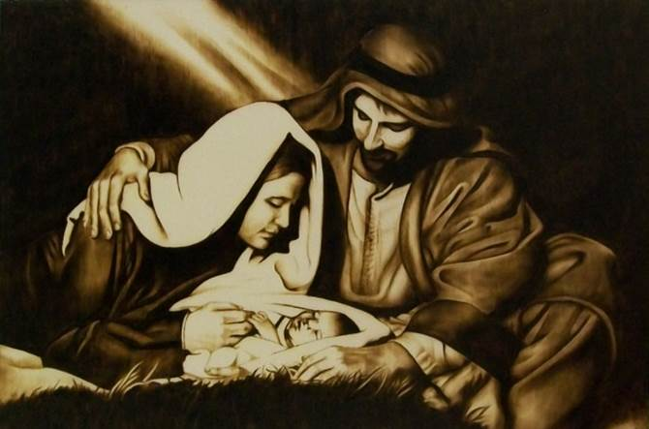
The
Birth of
Jesus

Slide 5
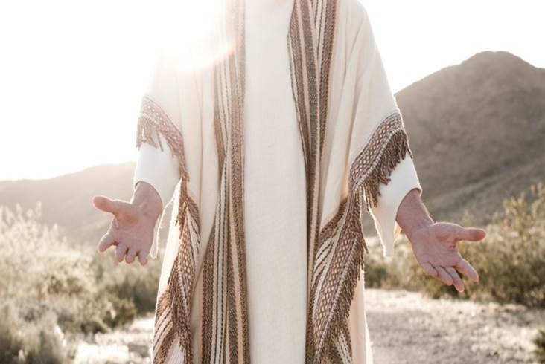
Misunderstanding Jesus: He came . . .
NOT to destroy the (Old Testament) Law of Moses
NOT to bring a Peaceful Utopia on the Earth
NOT to remove Human Suffering
NOT to form a Divine Red Cross

Slide 6
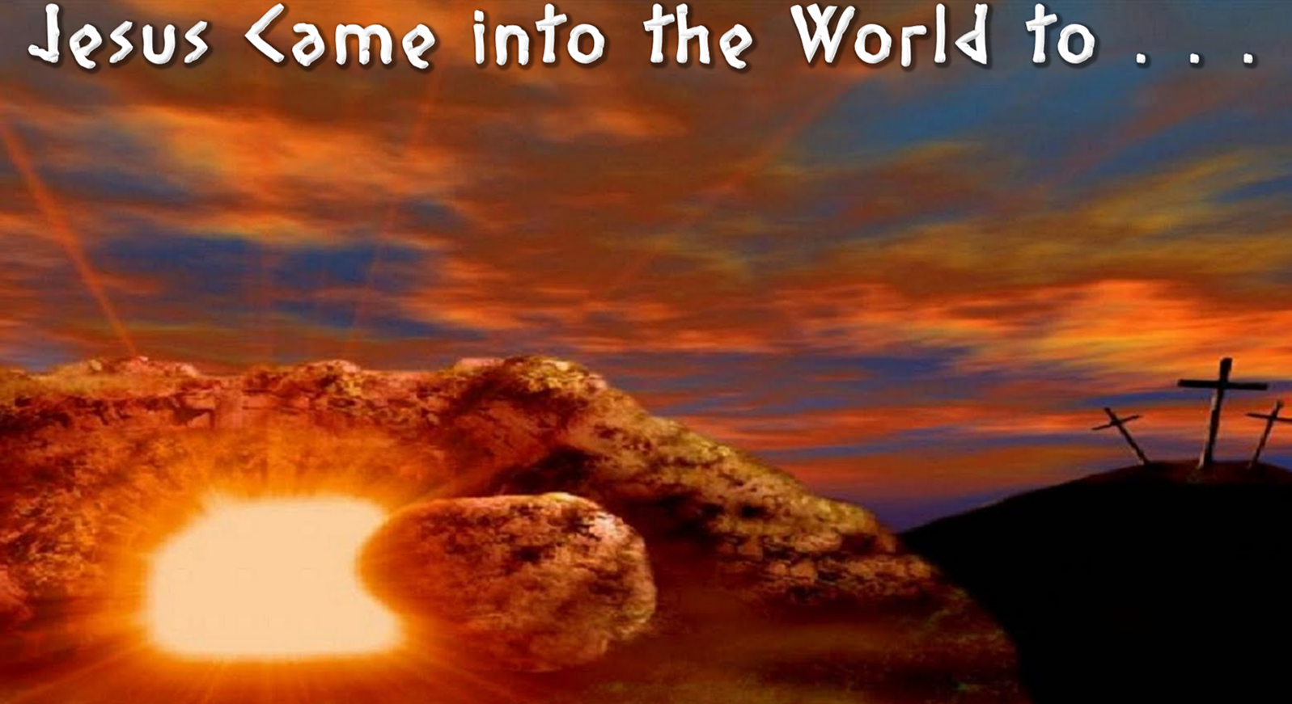
Save us from our Sins
Destroy the Works of the Devil
Give us an Abundant Life

