Slide 2
Exodus 8:1-11
¹ And the Lord spoke to Moses, go to Pharaoh and say to him, thus says the Lord: Let My people go, that they may serve Me. ² But if you refuse to let them go, behold, I will smite all your territory with frogs. ³ So the river shall bring forth frogs abundantly, which shall go up and come into your house, into your bedroom, on your bed, into the houses of your servants, on your people, into your ovens, and into your kneading bowls. ⁴ And the frogs shall come up on you, on your people, and on all your servants. ⁵ Then the Lord spoke to Moses, say to Aaron, stretch out your hand with your rod over the streams, over the rivers, and over the ponds, and cause frogs to come up on the land of Egypt. ⁶ So Aaron stretched out his hand over the waters of Egypt, and the frogs came up and covered the land of Egypt. ⁷ And the magicians did so with their enchantments, and brought up frogs on the land of Egypt. ⁸ Then Pharaoh called for Moses and Aaron, and said, entreat the Lord that He may take away the frogs from me and from my people; and I will let the people go, that they may sacrifice to the Lord. ⁹ And Moses said to Pharaoh, accept the honor of saying when I shall intercede for you, for your servants, and for your people, to destroy the frogs from you and your houses, that they may remain in the river only. ¹⁰ So he said, tomorrow. And he said, let it be according to your word, that you may know that there is no one like the Lord our God. ¹¹ And the frogs shall depart from you, from your houses, from your servants, and from your people. They shall remain in the river only.

Slide 4
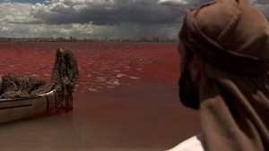
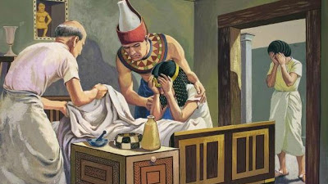

Slide 5
I’ve Always
Wondered . . .
How long a time period was involved?
How did the magicians duplicate some of the plagues?
Why did Pharaoh keep changing his mind?
Why wait until “tomorrow”? (Exod 8:10)

Slide 6
Tomorrow

Slide 7
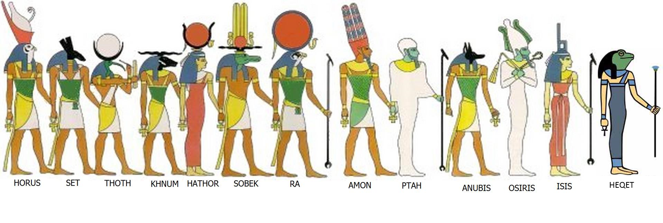
Heqet was goddess of childbirth and fertility in Egypt. She was depicted as a frog, or a woman with the head of a frog. Frogs symbolized fruitfulness and new life, and her priestesses were trained midwives.
Pregnant women wore amulets depicting Heqet for protection, and clappers inscribed with her name were used to ward off evil during childbirth.
She was also involved in the resurrection of the deceased. In the pyramid texts she assists the pharaoh as he makes his way to the eternal stars, and is depicted beneath the funeral bier of the deceased Osiris.
The frog was considered the theophany (appearance) of the goddess Heqet. Frogs were so sacred in Egypt that even the involuntary slaughter of one was often punished with death.

Slide 20
Obviously he had no concern for his people!
Perhaps he thought God would change His mind!
He was an unmistakably arrogant man!
He was an extremely stubborn and hardened man!

Slide 21
“I’m going to break this habit—TOMORROW.”
“I’m going to overcome my mediocrity—TOMORROW.”
“I’m going to begin controlling my temper—TOMORROW.”
“I’m going to stop worrying and start trusting God—TOMORROW.”
“I’m going to begin the reconciliation and healing of broken relationships—TOMORROW.”
“I’m going to renounce this world of sin and take up my cross and follow Jesus—TOMORROW.”

