Slide 2
1 Corinthians 1:18-25
¹⁸ For the message of the cross is foolishness to those who are perishing, but to us who are being saved it is the power of God. ¹⁹ For it is written: I will destroy the wisdom of the wise, and bring to nothing the understanding of the prudent. ²⁰ Where is the wise? Where is the scribe? Where is the disputer of this age? Has not God made foolish the wisdom of this world? ²¹ For since, in the wisdom of God, the world through wisdom did not know God, it pleased God through the foolishness of the message preached to save those who believe. ²² For Jews request a sign, and Greeks seek after wisdom; ²³ but we preach Christ crucified, to the Jews a stumbling block and to the Greeks foolishness, ²⁴ but to those who are called, both Jews and Greeks, Christ the power of God and the wisdom of God. ²⁵ Because the foolishness of God is wiser than men, and the weakness of God is stronger than men.

Slide 4
Ever Wonder Why . . .
Enter by the narrow gate; for wide is the gate and broad is the way that leads to destruction, and there are many who go in by it. Because narrow is the gate and difficult is the way which leads to life, and there are few who find it. (Matt 7:14-15)
Hearing you will hear and shall not understand, and seeing you will see and not perceive; For the hearts of this people have grown dull. Their ears are hard of hearing, and their eyes they have closed, lest they should see with their eyes and hear with their ears, lest they should understand with their hearts and turn, so that I should heal them. (Matt 13:14-15)
For you see your calling, brethren, that not many wise according to the flesh, not many mighty, not many noble, are called. (1 Cor 1:26)

Slide 5
MWRIA (mo-ree‘-ah): “silliness, absurdity”
Moron (usually offensive: a person affected with mild mental retardation).
To the world—Christ and His gospel message is MORONIC!

Slide 6
“For My thoughts are not your thoughts, nor are your ways My ways, says the Lord.” (Isa 55:8)
Born a Jew (hated, persecuted minority), Gal 4:4)
Born to an unwed woman, Matt 1:18; Jn 8:41
Born in a barn / stable, Lk 2:7
Rejected by brothers & countrymen, Jn 1:11; Jn 7:5
Betrayed by a “friend,” Matt 26:14-16, 47-50
Condemned and convicted unlawfully, Lk 23:4
Beaten without mercy, Matt 27:26
Crucified (a cursed death), Lk 23:33, Gal 3:13
“. . . Christ Jesus, who, being in the form of God, did not consider it robbery to be equal with God, but made Himself of no reputation, taking the form of a bondservant, and coming in the likeness of men.” (Phil2:5-7)

Slide 7
The meek not the mighty will inherit the earth (Mt 5:4)
Deny yourself not look out for “number one” (Lk 9:23)
The last are not last -- but will be first (Mt 19:30)
Don’t hit back, but turn the other cheek (Mt 5:39)
Love, do not hate your enemies (Mt 5:43-44; Rm 12:20)
You will be hated not loved by men (Mt 10:22)
Give away your fortune (Mt 19:21)
Count trials as a reason for rejoicing (Jas 1:2)
Joyfully accept the seizure of property (Heb 10:34)
Take a wrong instead of a lawsuit (1 Cor 6:1-7)
Lose your life, not save it (Mt 16:25)
Greatness is being a servant not a ruler (Mt 20:26)
All receive the same “wages” (Mt 20:1-16)
Matthew 13:57
Matthew 15:12

Slide 8
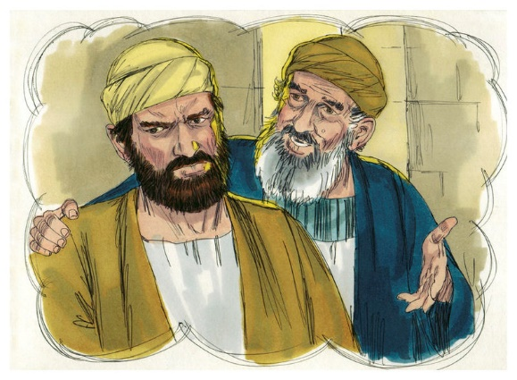
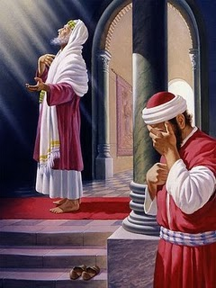
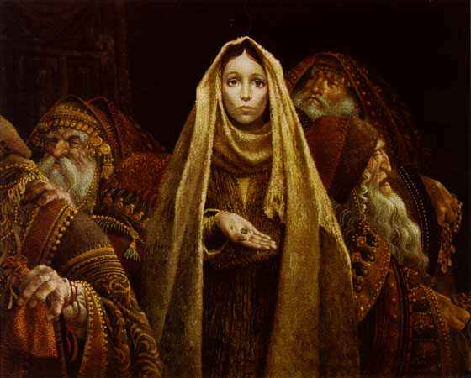
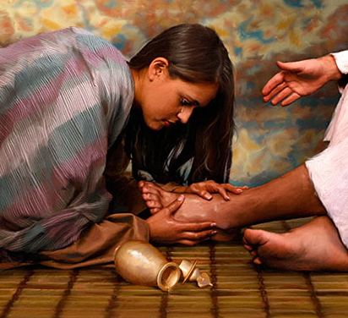
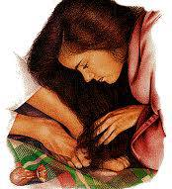
The rebel son not the one who stayed on the farm, Lk 15:11-32
The tax collector not the Pharisee, Lk 18:9-14
The sinful woman not Simon the Pharisee, Lk 7:36-50
The “wasteful” woman not the thrifty, Mk 14:3-9
The poor widow not the rich who gave, Mk 12:41-44

Slide 9
No one is beyond redemption.
Must devise a different way of thinking.
Trusting God when it doesn’t make sense.
Showing the world we’re “fools” for Christ.

