Slide 2
Philippians 3:17-21
¹⁷ Brethren, join in following my example, and note those who so walk, as you have us for a pattern. ¹⁸ For many walk, of whom I have told you often, and now tell you even weeping, that they are the enemies of the cross of Christ: ¹⁹ whose end is destruction, whose god is their belly, and whose glory is in their shame—who set their mind on earthly things. ²⁰ For our citizenship is in heaven, from which we also eagerly wait for the Savior, the Lord Jesus Christ, ²¹ who will transform our lowly body that it may be conformed to His glorious body, according to the working by which He is able even to subdue all things to Himself.

Slide 4
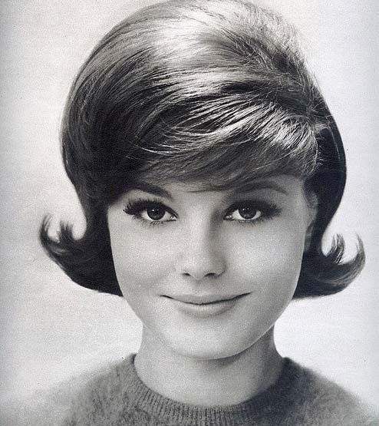
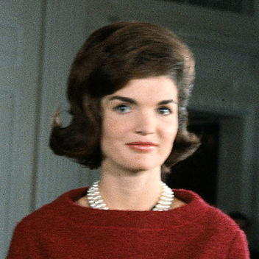
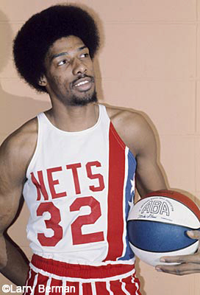
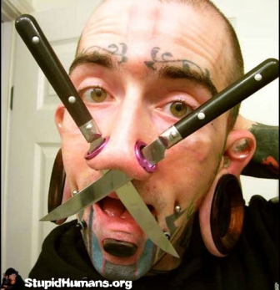
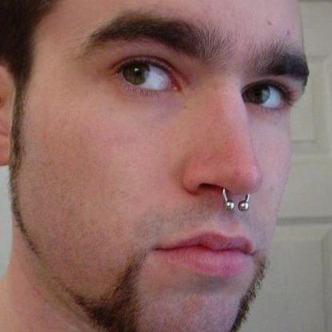
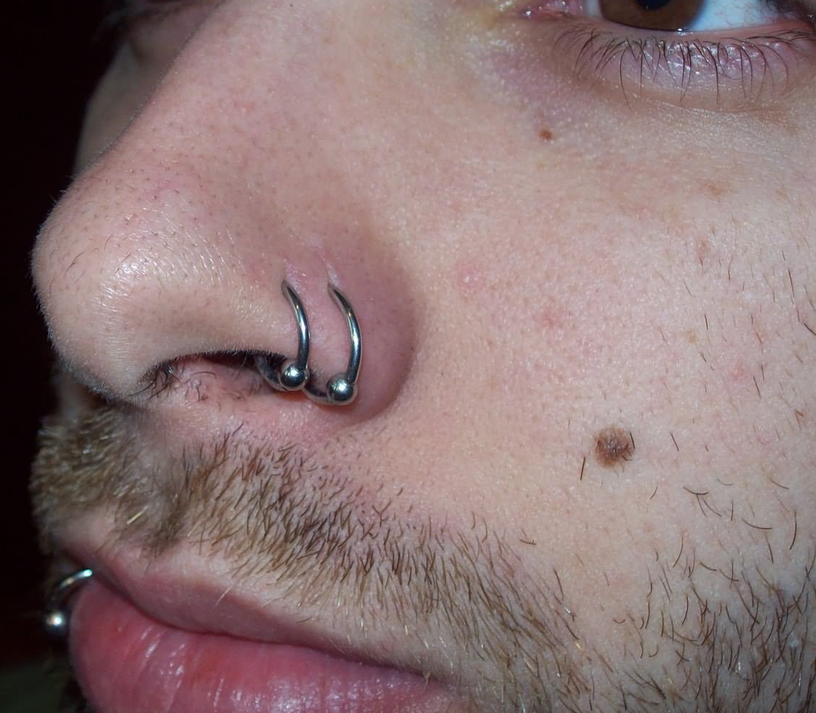
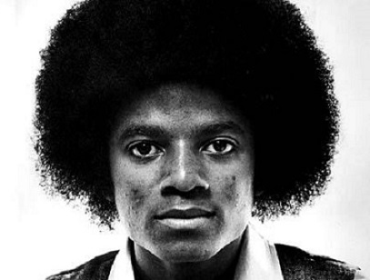

Slide 5
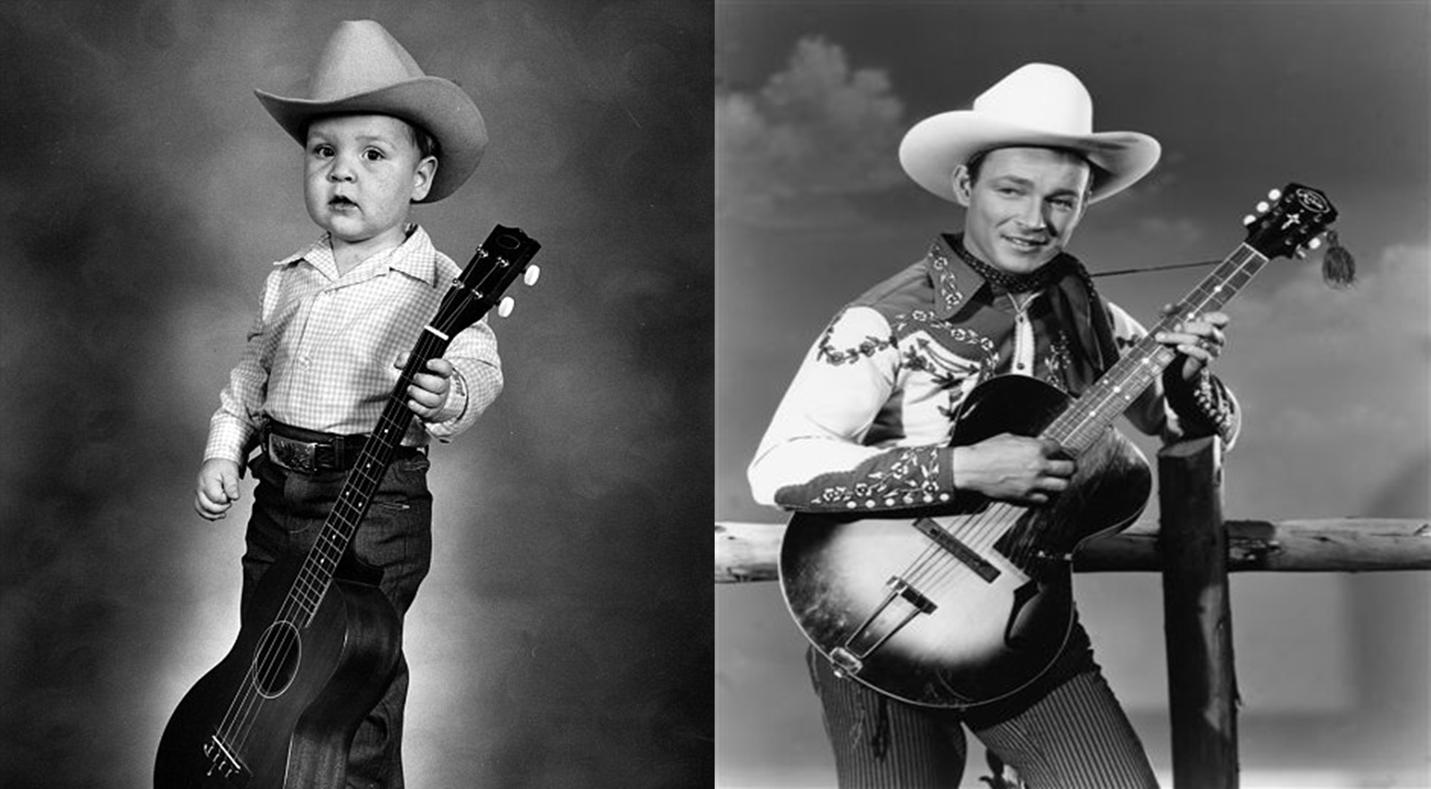
A “role model” is a person whose behavior, example, or success is or can be emulated by others, especially by younger people.

Slide 6
Paul the Apostle (1 Cor 11:1)
Barnabas (Acts 4:36-37)
Aquila & Priscilla (Rom 16:3-5)
Gaius (3 Jn 5-8)
Philemon (Phm 1-7)
Peter & John (Acts 4:19-20; 5:29)

Slide 7
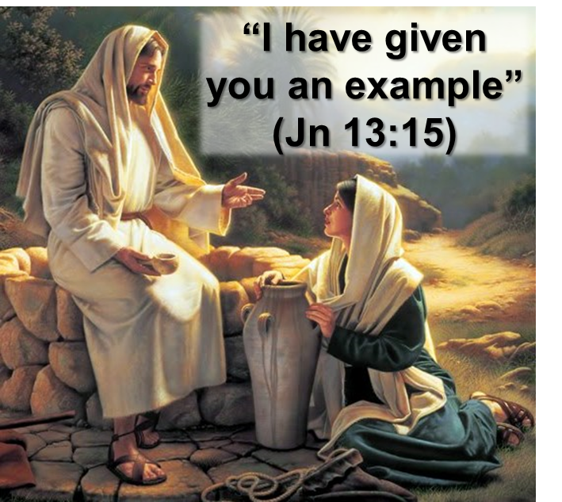
Role Models For Today
Godly Elders (1 Pet 5:3)
Godly Preachers (Rom 10:15)
Godly Women (1 Pet 3:1-6)
Godly Men (Titus 2:2, 6-7)
Godly Parents (2 Tim 1:5)
Godly Young People (1 Tim 4:12)
“note those who so walk, as you have us for a pattern” (Phil 3:17)

