Slide 2
Psalms 119:9-16
⁹ How can a young man cleanse his way? By taking heed according to Your word. ¹⁰ With my whole heart I have sought You; oh, let me not wander from Your commandments! ¹¹ Your word I have hidden in my heart, that I might not sin against You. ¹² Blessed are You, O Lord! Teach me Your statutes. ¹³ With my lips I have declared all the judgments of Your mouth. ¹⁴ I have rejoiced in the way of Your testimonies, as much as in all riches. ¹⁵ I will meditate on Your precepts, and contemplate Your ways. ¹⁶ I will delight myself in Your statutes; I will not forget Your word.

Slide 4
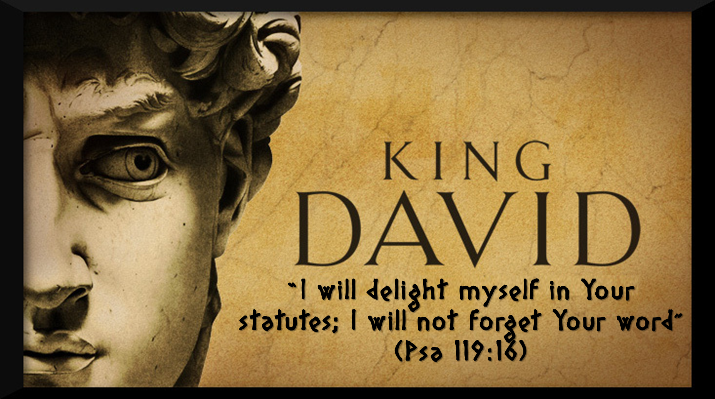

Slide 5


Slide 6

DESIRE TO KNOW THE BIBLE
DILIGENTLY WORK AT IT
HANDLE IT CORRECTLY

