Slide 2
Acts 16:6-10
⁶ Now when they had gone through Phrygia and the region of Galatia, they were forbidden by the Holy Spirit to preach the word in Asia. ⁷ After they had come to Mysia, they tried to go into Bithynia, but the Spirit did not permit them. ⁸ So passing by Mysia, they came down to Troas. ⁹ And a vision appeared to Paul in the night. A man of Macedonia stood and pleaded with him, saying, come over to Macedonia and help us. ¹⁰ Now after he had seen the vision, immediately we sought to go to Macedonia, concluding that the Lord had called us to preach the gospel to them.

Slide 5
The Letter to The Philippians
The Church at Philippi
The City of Philippi

Slide 6
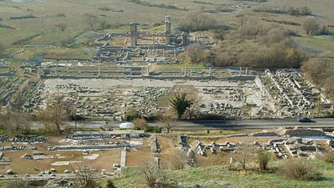
Philippi was named after Philip of Macedon, father of Alexandra the Great
Philippi was the site of a strategic battle during Rome’s civil war
Philippi was granted the status of a Roman Colony by Octavius
History of Philippi

Slide 7
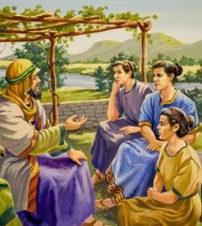
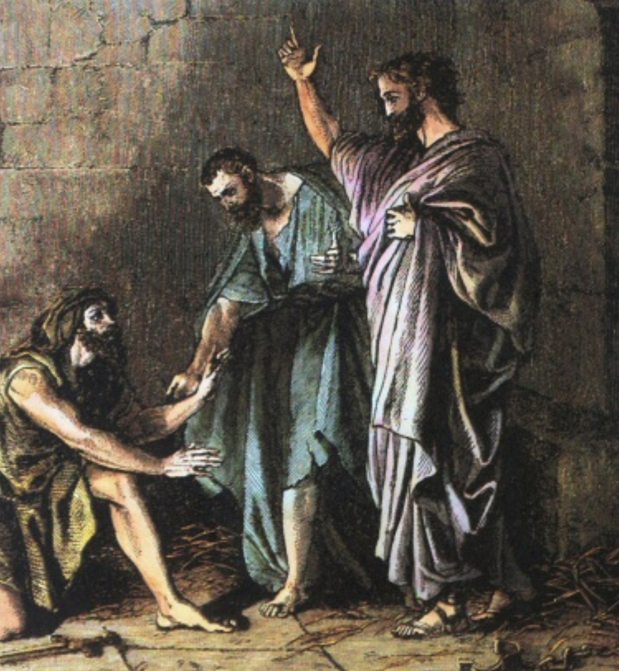
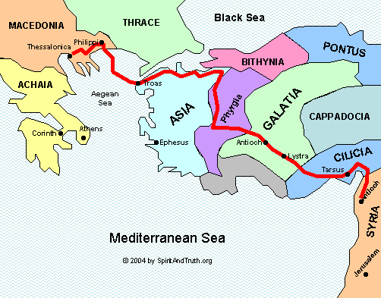
The Macedonian Call

Slide 8
Greece
Turkey
To Comfort them about his & Epaphroditus’ welfare.
To thank them for their support of the gospel.
To urge them to remain united.
To warn them about those who would harm the church.
To reveal to them the true source of joy.

Slide 9
What kind of letter would you have written?
This is so depressing . .
This is so not fair . . .
I may as well quit . . .
Nothing more I can do .
Where is God now . . .

