Slide 2
1 John 3:10-17
¹⁰ In this the children of God and the children of the devil are manifest: Whoever does not practice righteousness is not of God, nor is he who does not love his brother. ¹¹ For this is the message that you heard from the beginning, that we should love one another, ¹² not as Cain who was of the wicked one and murdered his brother. And why did he murder him? Because his works were evil and his brother’s righteous. ¹³ Do not marvel, my brethren, if the world hates you. ¹⁴ We know that we have passed from death to life, because we love the brethren. He who does not love his brother abides in death. ¹⁵ Whoever hates his brother is a murderer, and you know that no murderer has eternal life abiding in him. ¹⁶ By this we know love, because He laid down His life for us. And we also ought to lay down our lives for the brethren. ¹⁷ But whoever has this world’s goods, and sees his brother in need, and shuts up his heart from him, how does the love of God abide in him?

Slide 4

Hebrews 13:1

Slide 5

Disciples, Acts 6:7
Sheep, John 10:15
Soldiers, 2 Timothy 2:3
Branches, John 15:2
Stones, 1 Peter 2:5
Pilgrims, 1 Peter 2:11
Members, 1 Corinthians 12:27

Slide 6

We know that we have passed from death to life, because we love the brethren. (1 John 3:14)

Slide 7


Slide 8


Slide 9
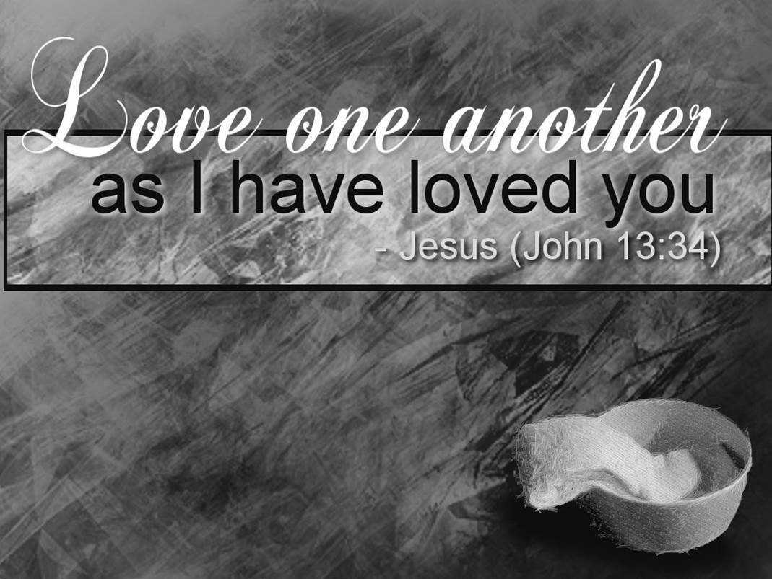

Slide 10


