Slide 2
James 2:1-9
¹ My brethren, do not hold the faith of our Lord Jesus Christ, the Lord of glory, with partiality. ² For if there should come into your assembly a man with gold rings, in fine apparel, and there should also come in a poor man in filthy clothes, ³ and you pay attention to the one wearing the fine clothes and say to him, you sit here in a good place, and say to the poor man, you stand there, or, sit here at my footstool, ⁴ have you not shown partiality among yourselves, and become judges with evil thoughts? ⁵ Listen, my beloved brethren: Has God not chosen the poor of this world to be rich in faith and heirs of the kingdom which He promised to those who love Him? ⁶ But you have dishonored the poor man. Do not the rich oppress you and drag you into the courts? ⁷ Do they not blaspheme that noble name by which you are called? ⁸ If you really fulfill the royal law according to the Scripture, you shall love your neighbor as yourself, you do well; ⁹ but if you show partiality, you commit sin, and are convicted by the law as transgressors.

Slide 4
Ever heard—or said?
“Women drivers? They are the worst!”
“Blacks are better athletes.”
“Jews sure know how to make money.”
“All Mexicans are just naturally lazy!”
“Whites are naturally smarter!”

Slide 5
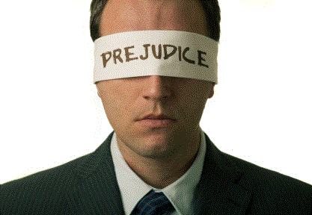
“Preconceived opinion that is not based on reason or actual experience.”
Substitute for
Thinking
“(1) : preconceived judgment or opinion (2) an adverse opinion or leaning formed without just grounds or before sufficient knowledge .”

Slide 6
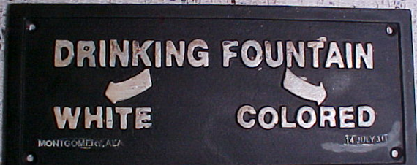
Prejudice

Slide 7
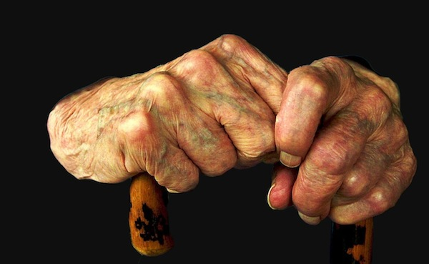
Prejudice
For the Lord does not see as man sees; for man looks at the outward appearance, but the Lord looks at the heart.
(1 Samuel 16:7)
Then Miriam and Aaron spoke against Moses because of the Ethiopian woman whom he had married; for he had married an Ethiopian woman. (Num 12:1)
For Jews have no dealings with Samaritans. (John 4:9)
For if there should come into your assembly a man with gold rings, in fine apparel, and there should also come in a poor man in filthy clothes, and you pay attention to the one wearing the fine clothes and say to him, you sit here in a good place . . . (Jas 2:1-4)
Now when they saw the boldness of Peter and John, and perceived that they were uneducated and untrained men . . . (Acts 4:13)
And the Jews marveled, saying, how does this Man know letters, having never studied? (John 7:15)
Then he (Elisha) went up from there to Bethel; and as he was going up the road, some youths came from the city and mocked him, and said to him, go up, you baldhead! Go up, you baldhead! (2 Kings 2:23)
Philip found Nathanael and said to him, we have found Him of whom Moses in the law, and also the prophets, wrote—Jesus of Nazareth, the son of Joseph. And Nathanael said to him, can anything good come out of Nazareth? (John 1:45-46)
And he had a choice and handsome son whose name was Saul. There was not a more handsome person than he among the children of Israel. From his shoulders upward he was taller than any of the people (1 Samuel 9:2).

Slide 8
Prejudice
Contrary to the Nature of God (Genesis 1:26; Acts 10:34; Romans 2:11; Galatians 2:6).
Contrary to the Gospel of Christ (Galatians 2:11-14; Romans 1:16; Galatians 3:26-29).
Contrary to the Royal Law (James 2:8; Luke 10:25-37).
Contrary to the System of Grace (Matthew 20:1-16; 1 Timothy 1:15-16).

Slide 9
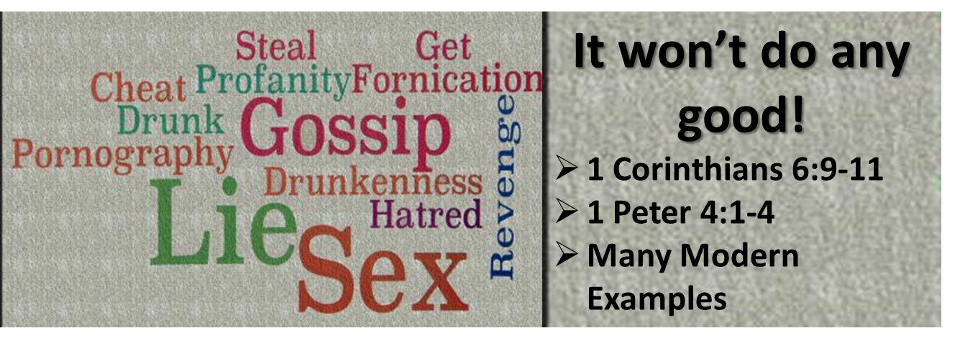
Prejudice
in the 21st century

