Slide 2
Jeremiah 6:11-15
¹¹ Therefore I am full of the fury of the Lord. I am weary of holding it in. I will pour it out on the children outside, and on the assembly of young men together; For even the husband shall be taken with the wife, the aged with him who is full of days. ¹² And their houses shall be turned over to others, fields and wives together; For I will stretch out My hand against the inhabitants of the land, says the Lord. ¹³ Because from the least of them even to the greatest of them, everyone is given to covetousness; and from the prophet even to the priest, everyone deals falsely. ¹⁴ They have also healed the hurt of My people slightly, saying, peace, peace! when there is no peace. ¹⁵ Were they ashamed when they had committed abomination? No! They were not at all ashamed; Nor did they know how to blush. Therefore they shall fall among those who fall; at the time I punish them, they shall be cast down, says the Lord.

Slide 4
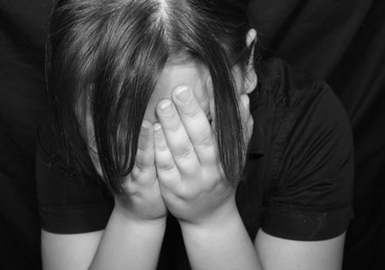
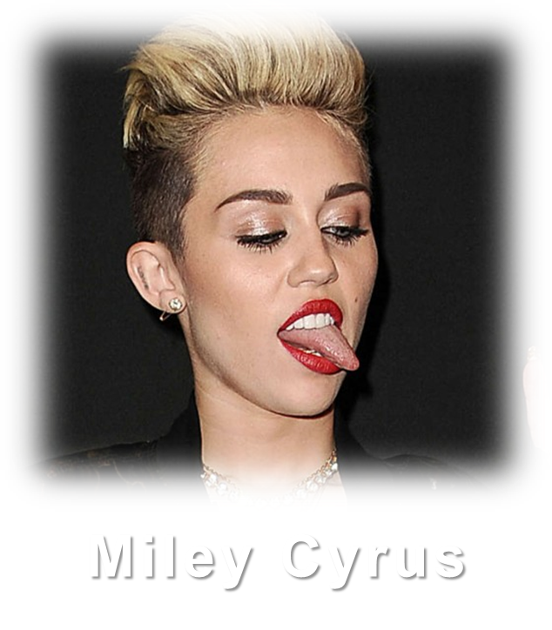
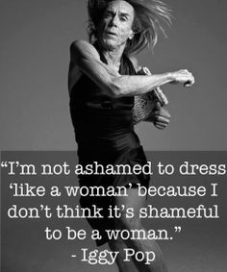
Not at all Ashamed
Were they ashamed when they had committed abomination? No! They were not at all ashamed; Nor did they know how to blush.
Bruce Jenner
“A painful emotion caused by the awareness of having done something wrong . . .”
“Respect for propriety or morality.”
Brian Williams
Tiger Woods
Richard Sherman
Lena Dunham

Slide 5
The Death of Shame
The Causes of Death
Alcohol / Drugs
Sex w/out Marriage
Nudity
Divorce

Slide 6
Do Not Lower The Standards
Seek To Change Your Heart
Never Compare Yourself With Others

