Slide 2
Acts 7:51-60
⁵¹ You stiff-necked and uncircumcised in heart and ears! You always resist the Holy Spirit; as your fathers did, so do you. ⁵² Which of the prophets did your fathers not persecute? And they killed those who foretold the coming of the Just One, of whom you now have become the betrayers and murderers, ⁵³ who have received the law by the direction of angels and have not kept it. ⁵⁴ When they heard these things they were cut to the heart, and they gnashed at him with their teeth. ⁵⁵ But he, being full of the Holy Spirit, gazed into heaven and saw the glory of God, and Jesus

Slide 3
Acts 7:51-60
standing at the right hand of God, ⁵⁶ and said, look! I see the heavens opened and the Son of Man standing at the right hand of God! ⁵⁷ Then they cried out with a loud voice, stopped their ears, and ran at him with one accord; ⁵⁸ and they cast him out of the city and stoned him. And the witnesses laid down their clothes at the feet of a young man named Saul. ⁵⁹ And they stoned Stephen as he was calling on God and saying, Lord Jesus, receive my spirit. ⁶⁰ Then he knelt down and cried out with a loud voice, Lord, do not charge them with this sin. And when he had said this, he fell asleep.

Slide 7
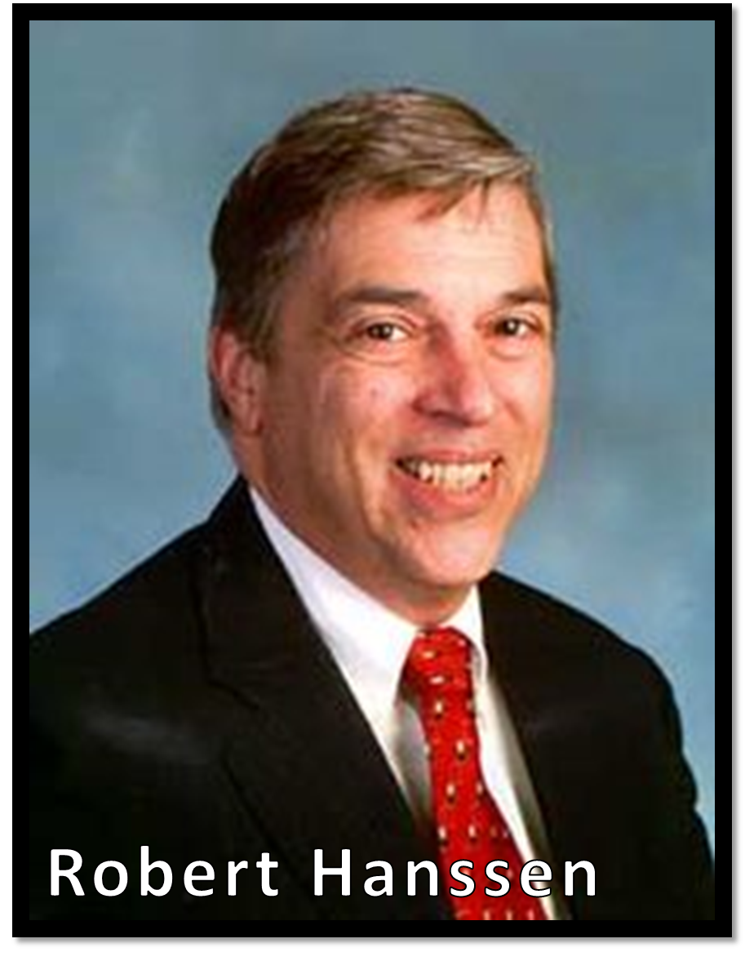
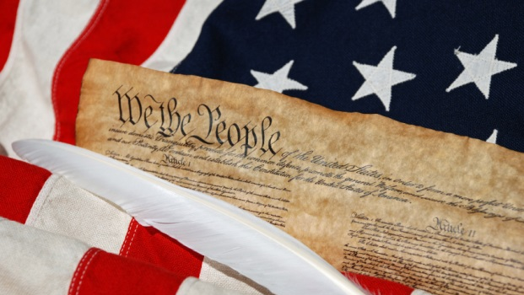
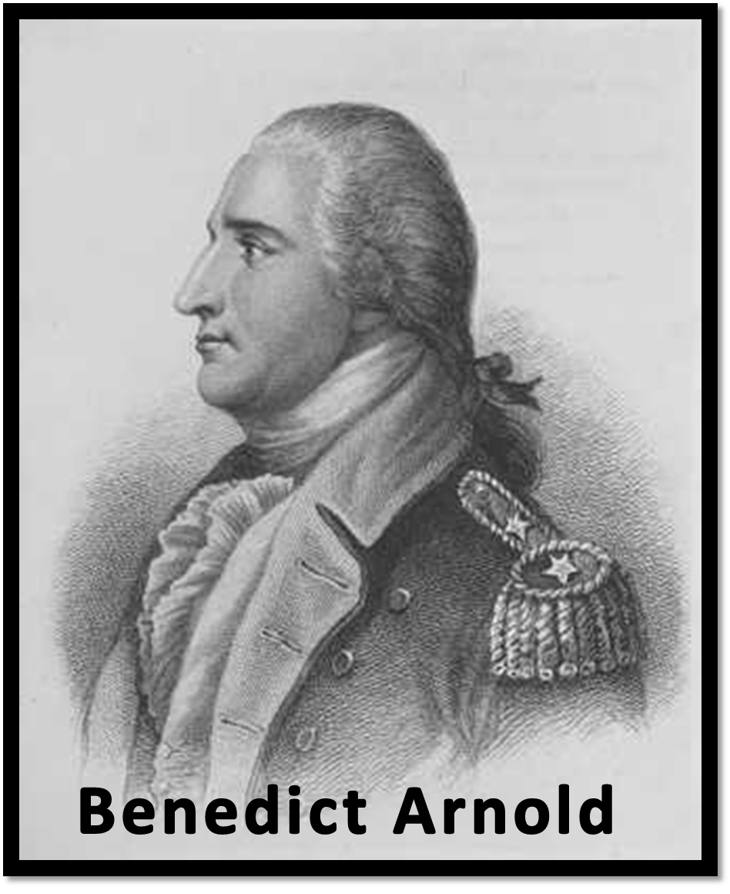
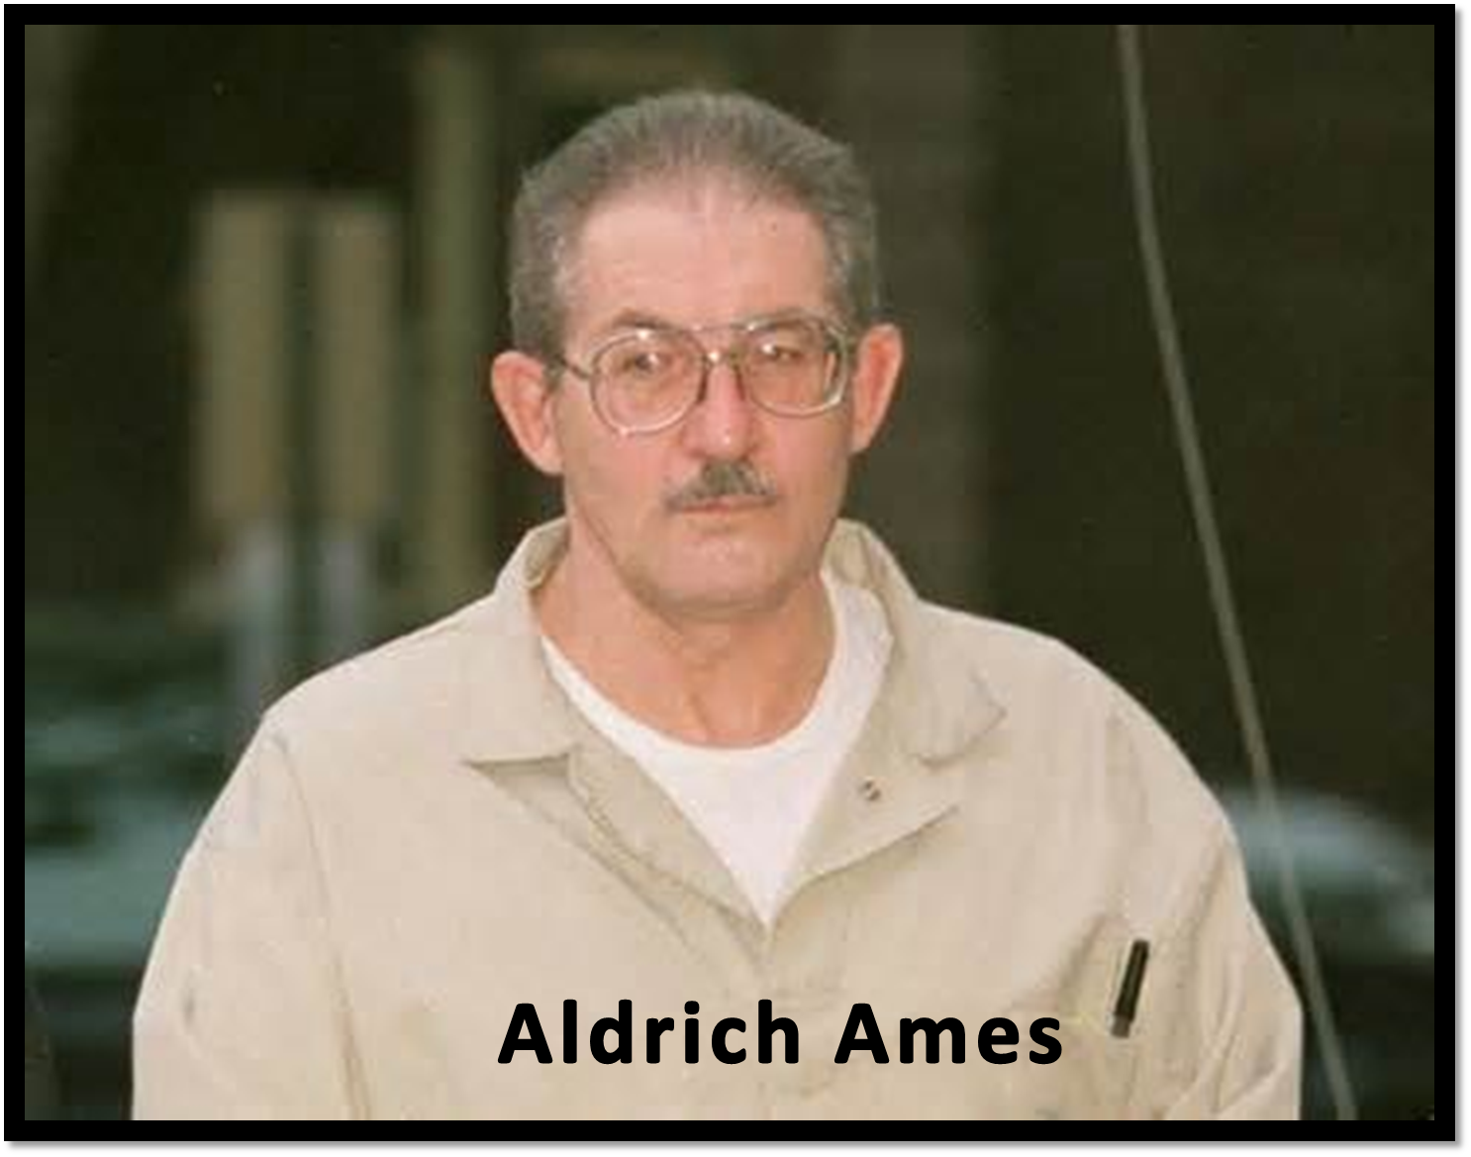
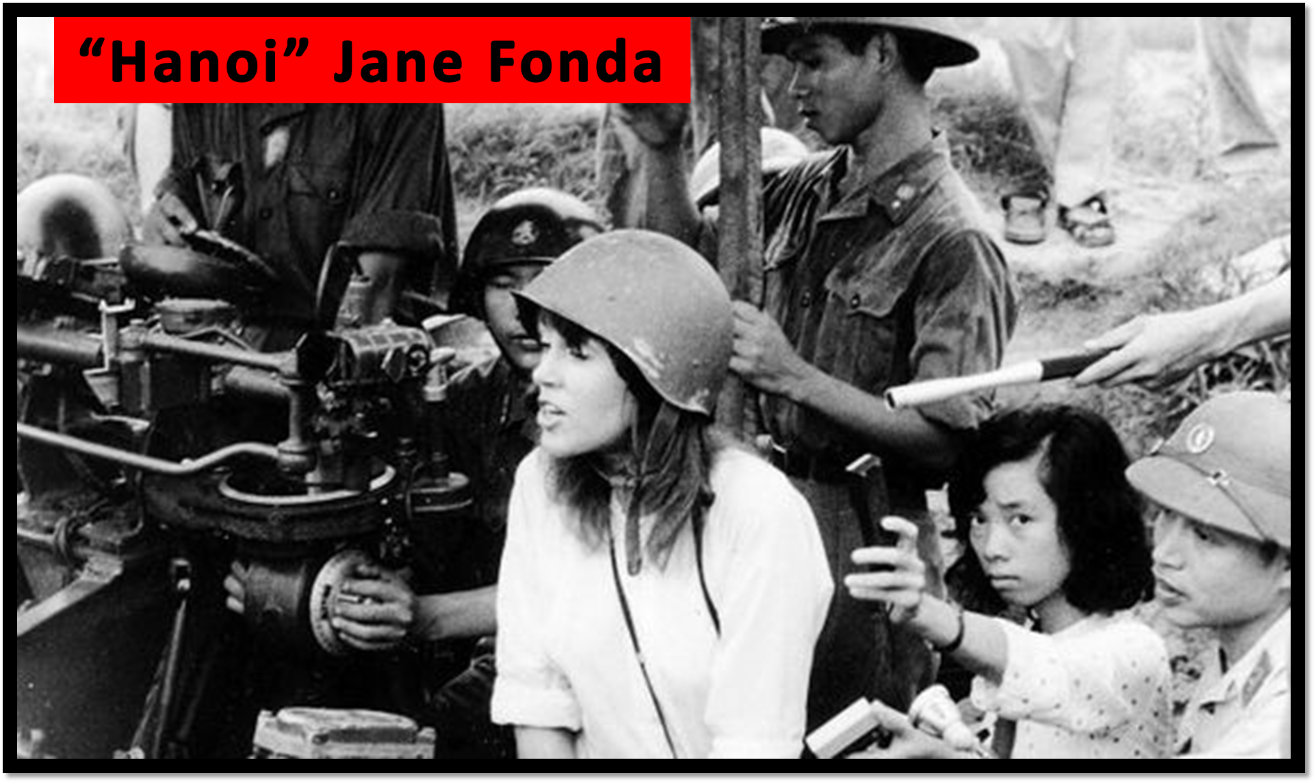

Slide 8
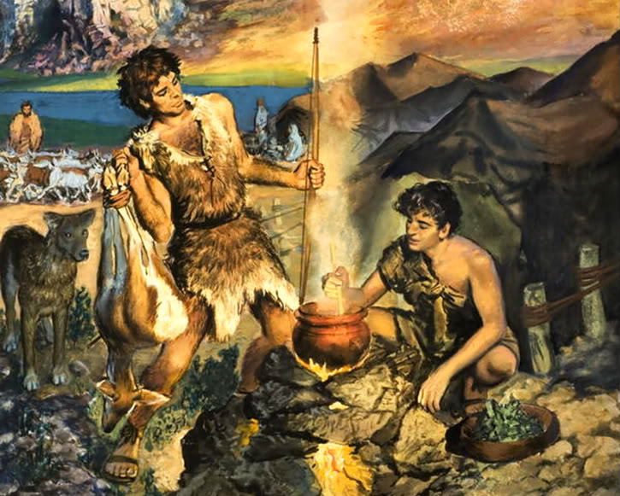
The High Cost of Selling Out
Esau sold out for a
“Bowl of Stew”
Genesis 25:29-34

Slide 9
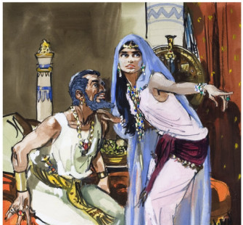
The High Cost of Selling Out
Ahab sold out for
“Political Compromise”
1 Kings 21:25-26

Slide 10
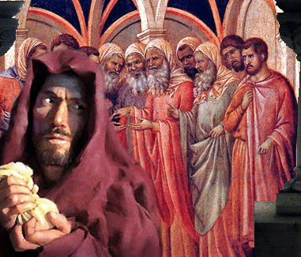
The High Cost of Selling Out
Judas sold out for
“Money”
Matthew 26:14-16

