Slide 2
Revelation 3:14-22
¹⁴ And to the angel of the church of the Laodiceans write, these things says the Amen, the Faithful and True Witness, the Beginning of the creation of God: ¹⁵ I know your works, that you are neither cold nor hot. I could wish you were cold or hot. ¹⁶ So then, because you are lukewarm, and neither cold nor hot, I will vomit you out of My mouth. ¹⁷ Because you say, I am rich, have become wealthy, and have need of nothing—and do not know that you are wretched, miserable, poor, blind, and naked— ¹⁸ I counsel you to buy from Me gold refined in the fire, that you may be rich; and white garments, that

Slide 3
Revelation 3:14-22
you may be clothed, that the shame of your nakedness may not be revealed; and anoint your eyes with eye salve, that you may see. ¹⁹ As many as I love, I rebuke and chasten. Therefore be zealous and repent. ²⁰ Behold, I stand at the door and knock. If anyone hears My voice and opens the door, I will come in to him and dine with him, and he with Me. ²¹ To him who overcomes I will grant to sit with Me on My throne, as I also overcame and sat down with My Father on His throne. ²² He who has an ear, let him hear what the Spirit says to the churches.

Slide 7
What is your
Temperature?

Slide 8
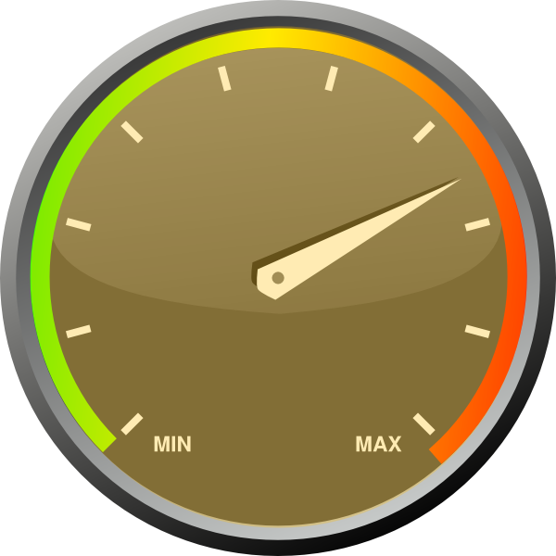
Read my Bible
Pray Often
Teach Classes
“Good” Person
Worship
Teach Lost

Slide 10
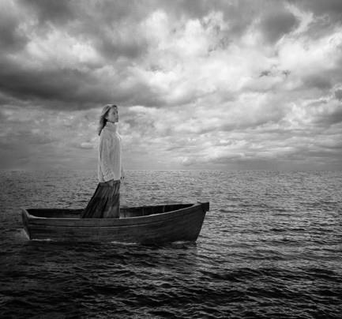
Lukewarm Believers
Have no direction,
they just drift along

Slide 11
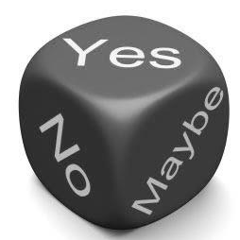
Lukewarm Believers
Have no commitment,
just neutrality

Slide 12
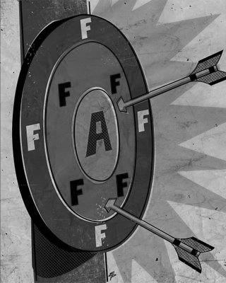
Lukewarm Believers
Do not strive for excellence,
just mediocrity

Slide 13
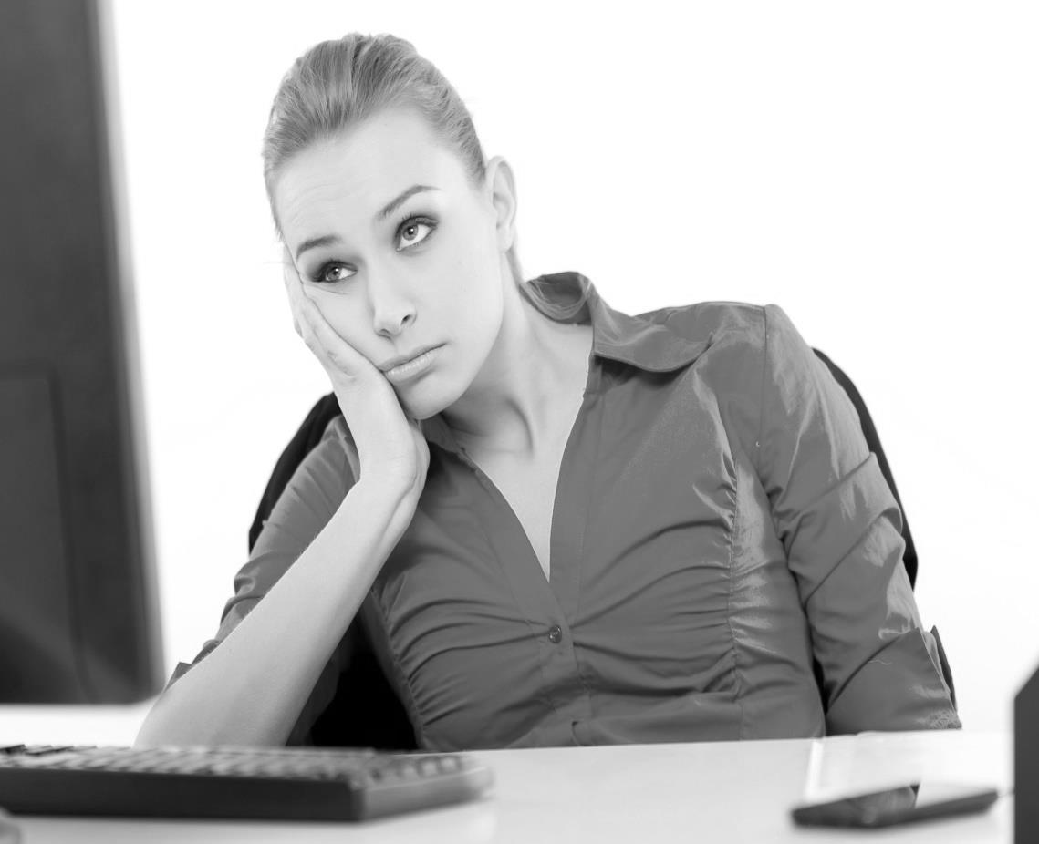
Lukewarm Believers
Do not have passion,
only apathy

Slide 14
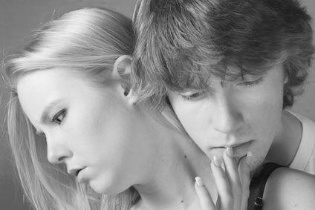
Lukewarm Believers
Have few moral principles,
instead they are careless

Slide 15
HOT
COLD
What Is Your Spiritual Temperature

