Slide 2
Mark 12:28-34
²⁸ Then one of the scribes came, and having heard them reasoning together, perceiving that He had answered them well, asked Him, which is the first commandment of all? ²⁹ Jesus answered him, the first of all the commandments is: Hear, O Israel, the Lord our God, the Lord is one. ³⁰ And you shall love the Lord your God with all your heart, with all your soul, with all your mind, and with all your strength. This is the first commandment. ³¹ And the second, like it, is this: You shall love your neighbor as yourself. There is no other commandment greater than these.³² So the scribe said to Him, well said, Teacher. You have spoken the truth, for there is one God, and there is no other but He. ³³ And to love Him with all the heart, with all the understanding, with all the soul, and with all the strength, and to love one’s neighbor as oneself, is more than all the whole burnt offerings and sacrifices. ³⁴ Now when Jesus saw that he answered wisely, He said to him, you are not far from the kingdom of God. But after that no one dared question Him.

Slide 4
“Which is the first commandment of all?” (Mk 12:28, NKJ)
“Which commandment is the most important of all?” (Mk 12:28, NEB)

Slide 5
Emotion
Life
Intellect
Energy

Slide 6
God so loved the world that He gave His only begotten Son, that whoever believes in Him should not perish but have everlasting life. (John 3:16)
But God demonstrates His own love toward us, in that while we were still sinners, Christ died for us. (Romans 5:8)
In this the love of God was manifested toward us, that God has sent His only begotten Son into the world, that we might live through Him. In this is love, not that we loved God, but that He loved us and sent His Son to be the propitiation for our sins.
(1 John 4:9-10)

Slide 11
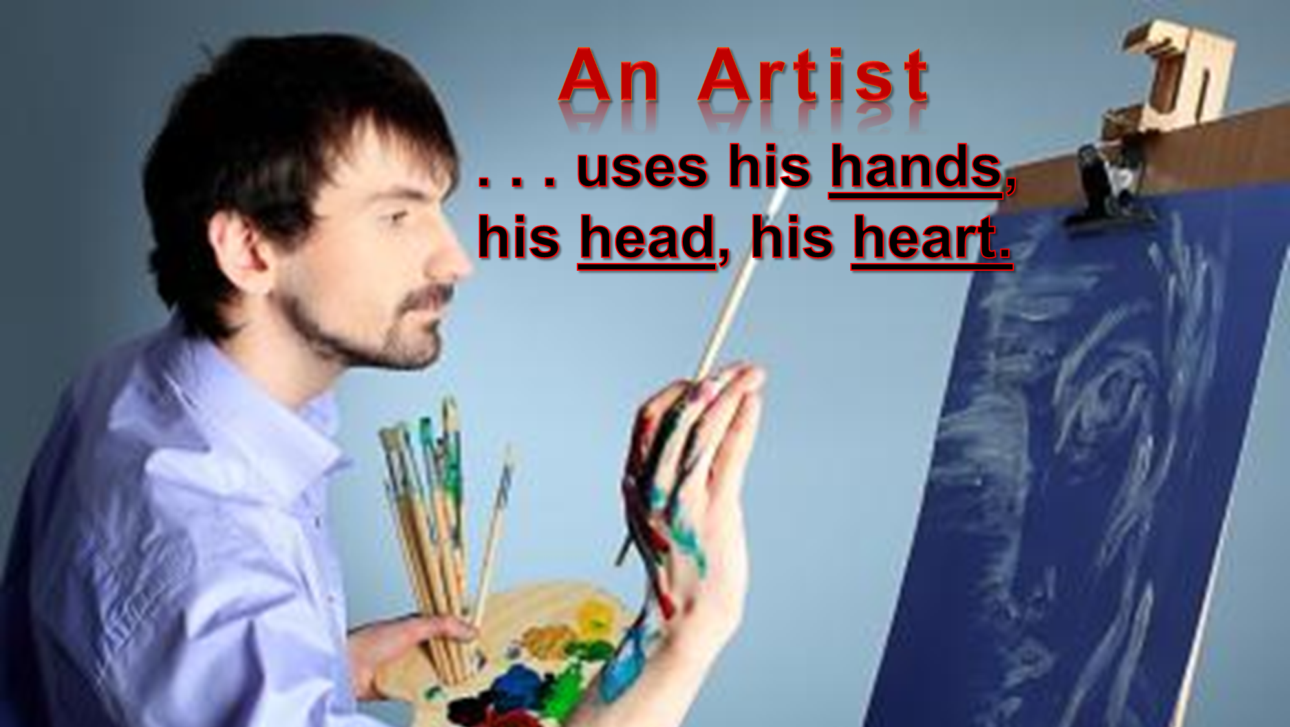
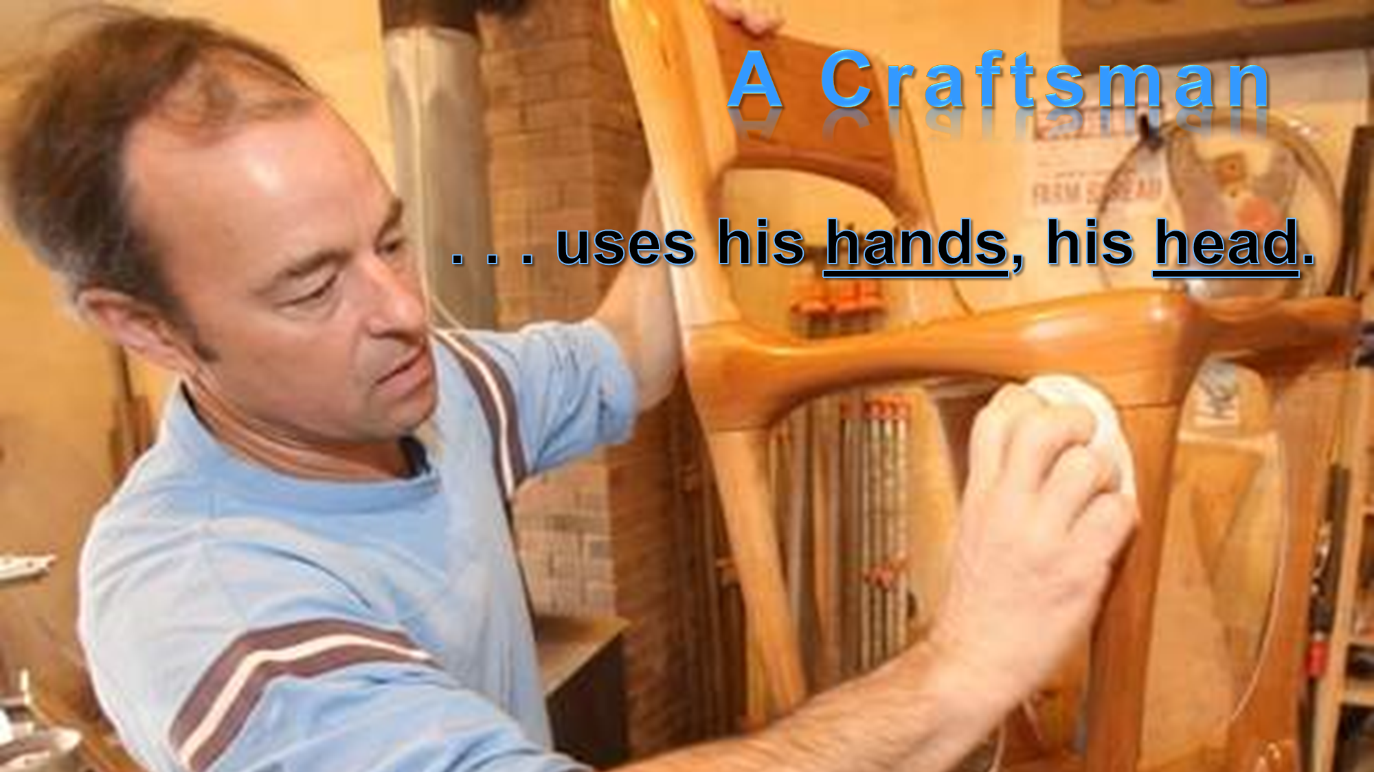
A Christian
. . . uses his hands, his head,
his heart, his life for God!

