Slide 2
¹² Therefore, as the elect of God, holy and beloved, put on tender mercies, kindness, humility, meekness, longsuffering; ¹³ bearing with one another, and forgiving one another, if anyone has a complaint against another; even as Christ forgave you, so you also must do. ¹⁴ But above all these things put on love, which is the bond of perfection. ¹⁵ And let the peace of God rule in your hearts, to which also you were called in one body; and be thankful. ¹⁶ Let the word of Christ dwell in you richly in all wisdom, teaching and admonishing one another in psalms and hymns and spiritual songs, singing with grace in your hearts to the Lord. ¹⁷ And whatever you do in word or deed, do all in the name of the Lord Jesus, giving thanks to God the Father through Him.

Slide 4
The Bible
And
Singing

Slide 5
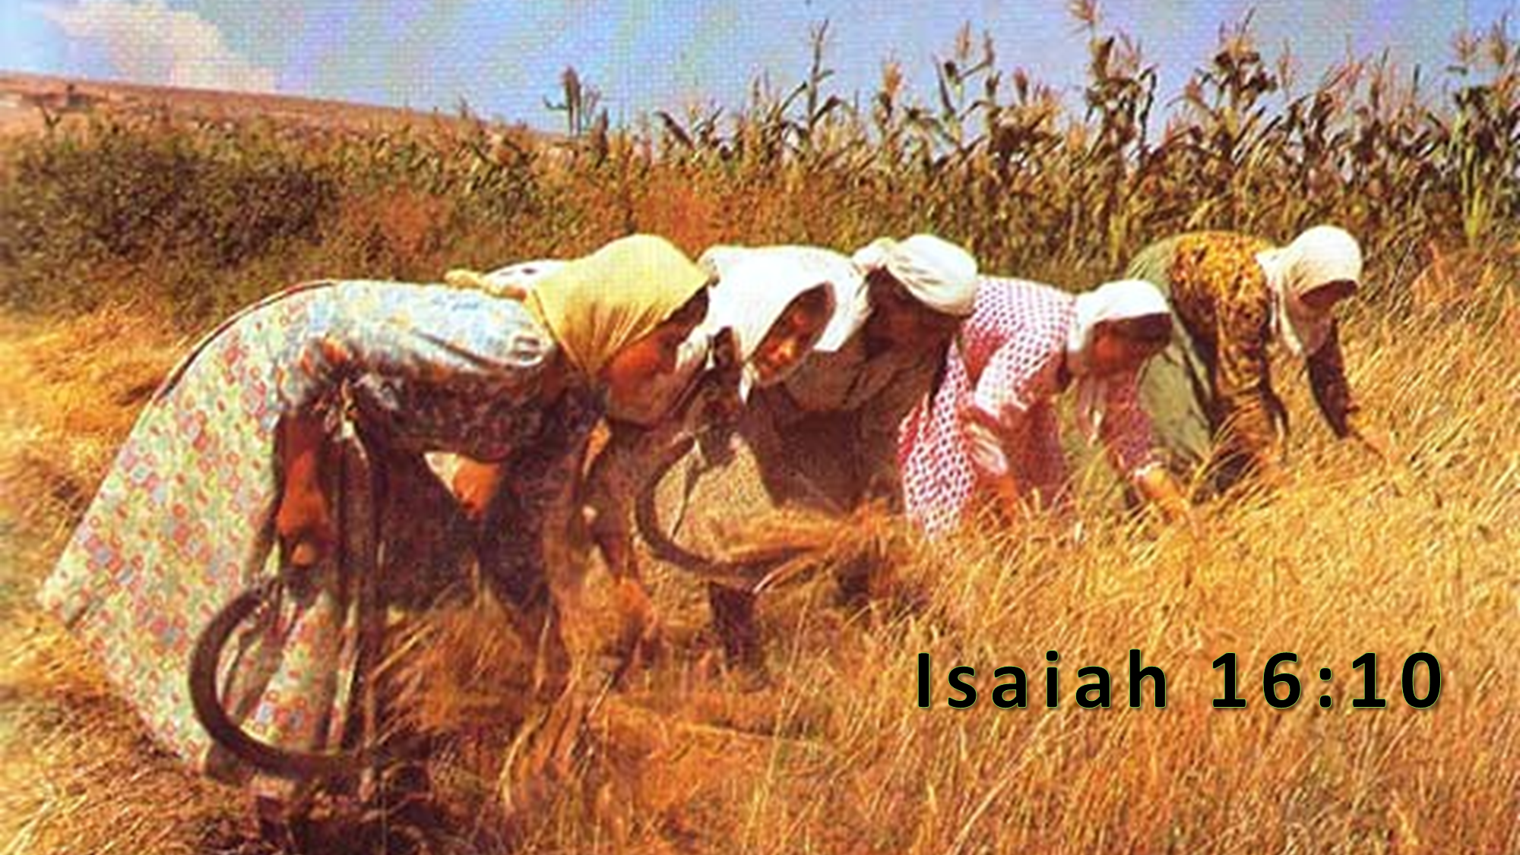
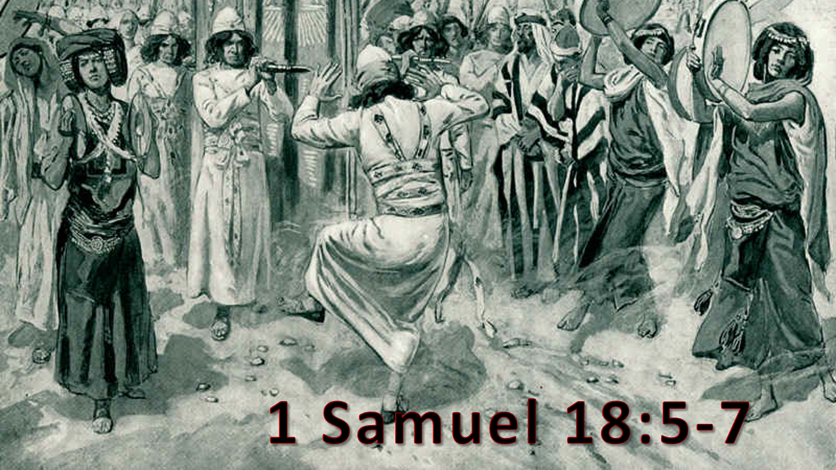

Slide 6
Some Christians refuse to sing
Some Christians sing with no emotion
Some wish to drastically curtail congregational singing
Some refuse to attend a service devoted to singing

Slide 10
(237) Let the Lower Lights be Burning

Slide 11
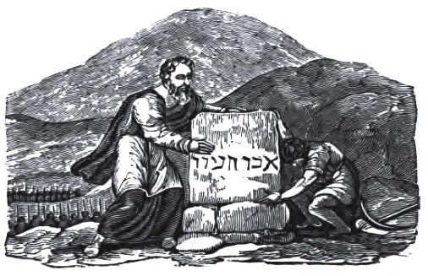
(420) O Thou Fount of Every Blessing

Slide 15
I will sing to the Lord as long as I live; I will sing praise to my God while I have my being.
(Psalms 104:33)

