Slide 2
Romans 10:8-15
⁸ But what does it say? the word is near you, in your mouth and in your heart (that is, the word of faith which we preach): ⁹ that if you confess with your mouth the Lord Jesus and believe in your heart that God has raised Him from the dead, you will be saved. ¹⁰ For with the heart one believes unto righteousness, and with the mouth confession is made unto salvation. ¹¹ For the Scripture says, whoever believes on Him will not be put to shame. ¹² For there is no distinction between Jew and Greek, for the same Lord over all is rich to all who call upon Him. ¹³ For whoever calls on the name of the Lord shall be saved.¹⁴ How then shall they call on Him in whom they have not believed? And how shall they believe in Him of whom they have not heard? And how shall they hear without a preacher? ¹⁵ And how shall they preach unless they are sent? As it is written: how beautiful are the feet of those who preach the gospel of peace, who bring glad tidings of good things!

Slide 4
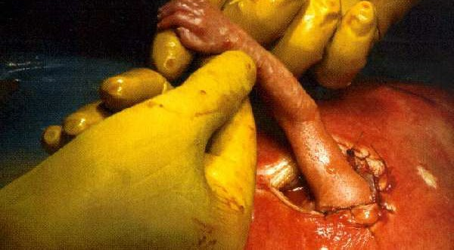
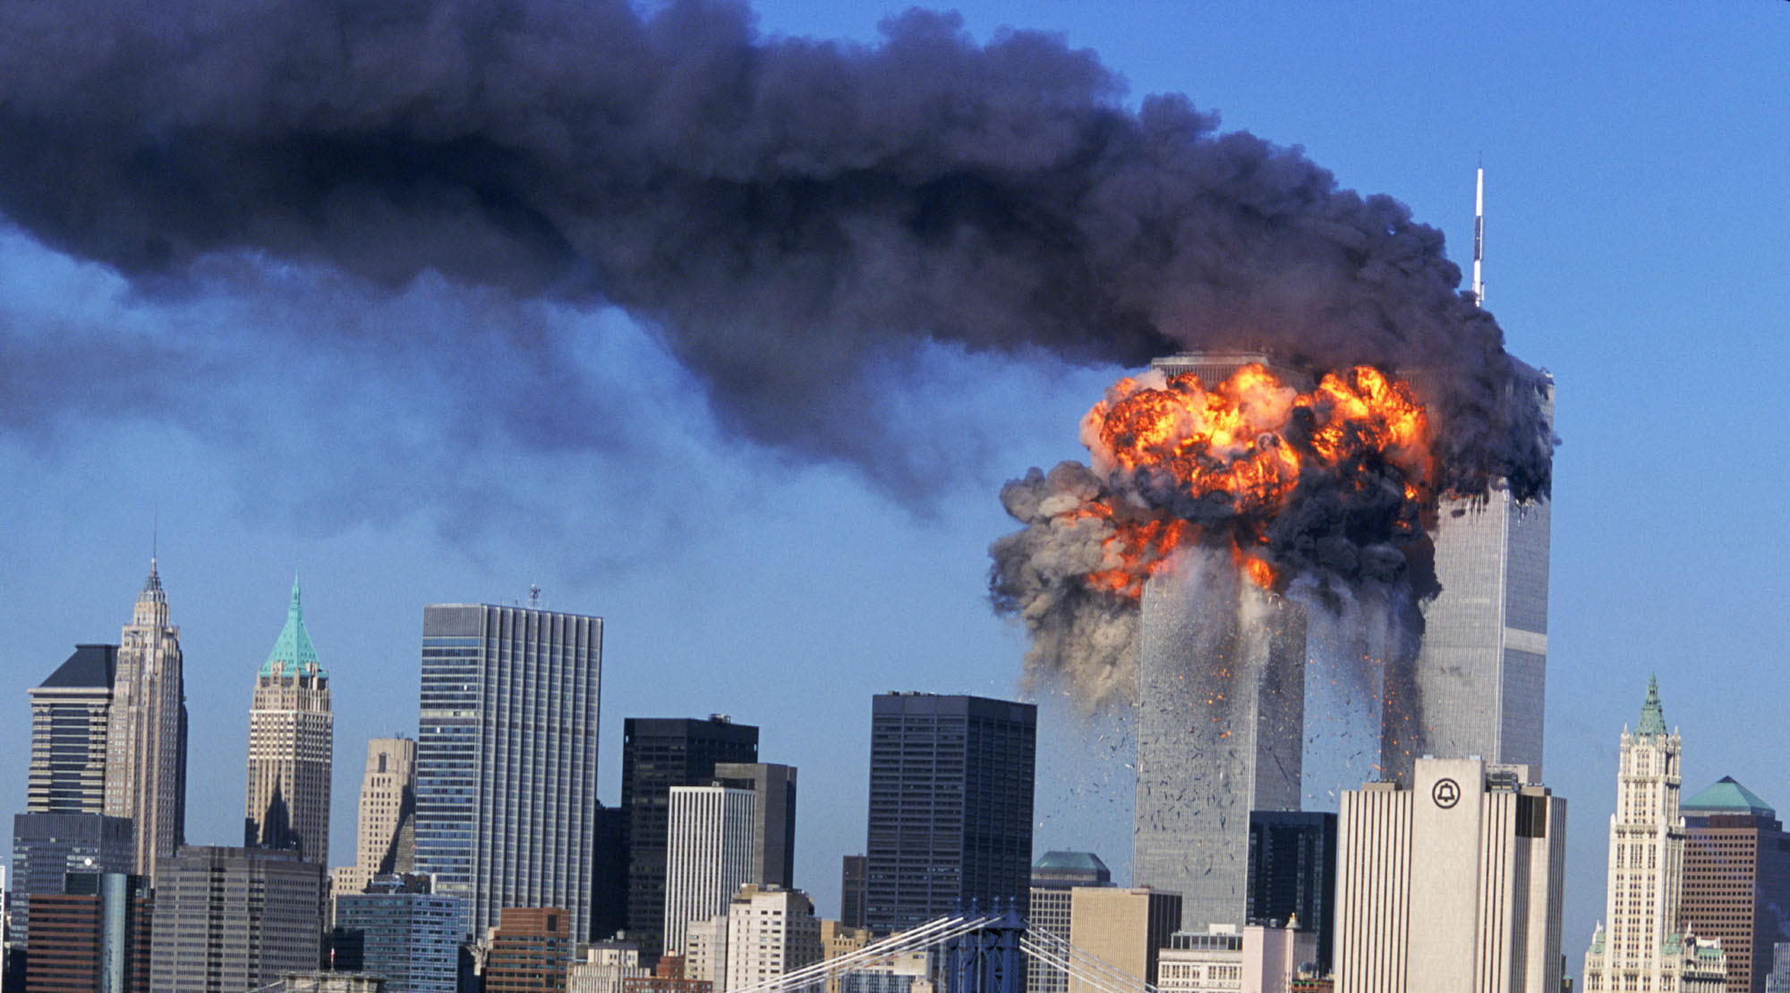
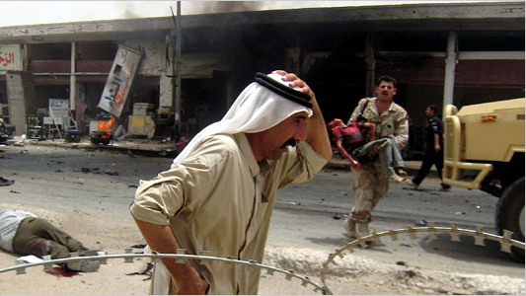
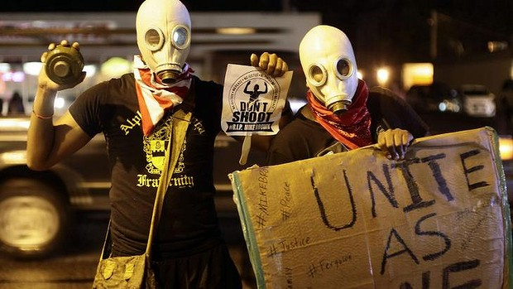

Slide 7
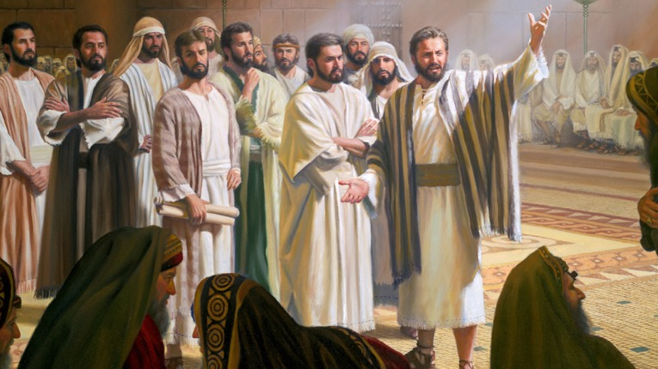
Preaching For The 21st Century

Slide 8
Preaching For The 21st Century

Slide 9
Preaching For The 21st Century
Authoritative Preaching

Slide 10
Preaching For The 21st Century
Absolute
Preaching

Slide 11
Preaching For The 21st Century

Slide 12
Preaching For The 21st Century

