Slide 2
Romans 8:31-39
³¹ What then shall we say to these things? If God is for us, who can be against us? ³² He who did not spare His own Son, but delivered Him up for us all, how shall He not with Him also freely give us all things? ³³ Who shall bring a charge against God’s elect? It is God who justifies. ³⁴ Who is he who condemns? It is Christ who died, and furthermore is also risen, who is even at the right hand of God, who also makes intercession for us. ³⁵ Who shall separate us from the love of Christ? Shall tribulation, or

Slide 3
Romans 8:31-39
distress, or persecution, or famine, or nakedness, or peril, or sword? ³⁶ As it is written: For Your sake we are killed all day long; we are accounted as sheep for the slaughter. ³⁷ Yet in all these things we are more than conquerors through Him who loved us. ³⁸ For I am persuaded that neither death nor life, nor angels nor principalities nor powers, nor things present nor things to come, ³⁹ nor height nor depth, nor any other created thing, shall be able to separate us from the love of God which is in Christ Jesus our Lord.

Slide 5
Help! Is anybody up there?

Slide 6
Suffering is a
Fact of Life

Slide 7
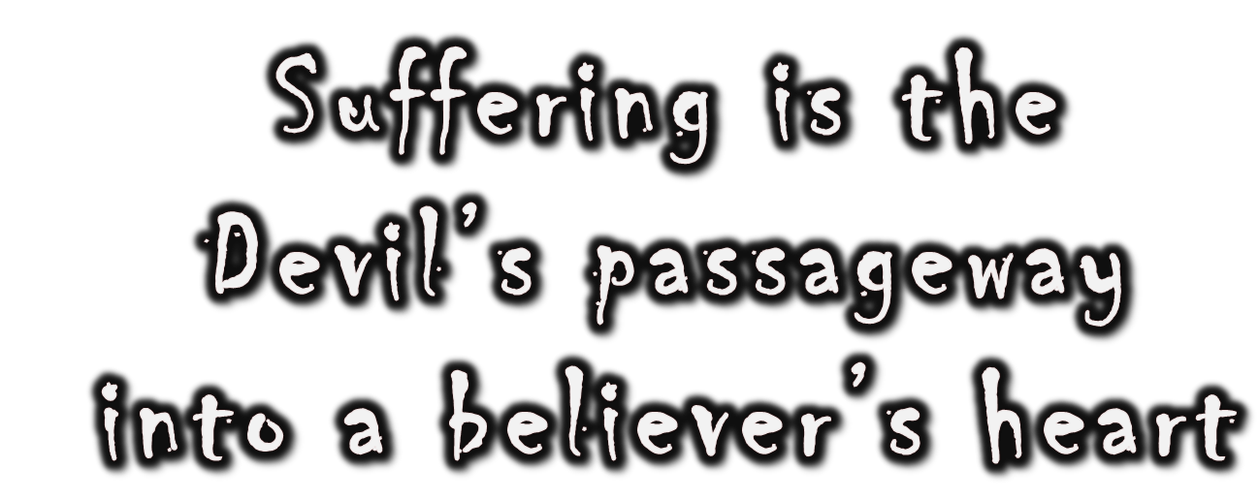

Slide 8
Suffering makes us
Vulnerable

Slide 9
DOUBT
FEARS
INDIFFERENCE
LACK OF PRAYER
LOVE FOR THE WORLD
SELF-SUFFECENCY
SINFUL IMPURITIES

