Slide 2
Revelation 19:1-5
¹ After these things I heard a loud voice of a great multitude in heaven, saying, alleluia! Salvation and glory and honor and power belong to the Lord our God! ² For true and righteous are His judgments, because He has judged the great harlot who corrupted the earth with her fornication; and He has avenged on her the blood of His servants shed by her. ³ Again they said, alleluia! Her smoke rises up forever and ever! ⁴ And the twenty-four elders and the four living creatures fell down and worshiped God who sat on the throne, saying, amen! Alleluia! ⁵ Then a voice came from the throne, saying, praise our God, all you His servants and those who fear Him, both small and great!

Slide 4
Heaven’s Alleluia Chorus
“After these things I heard something like a loud voice of a great multitude in heaven, saying, Hallelujah! Salvation and glory and power belong to our God . . .”
(Rev 19:1, NASB)

Slide 7
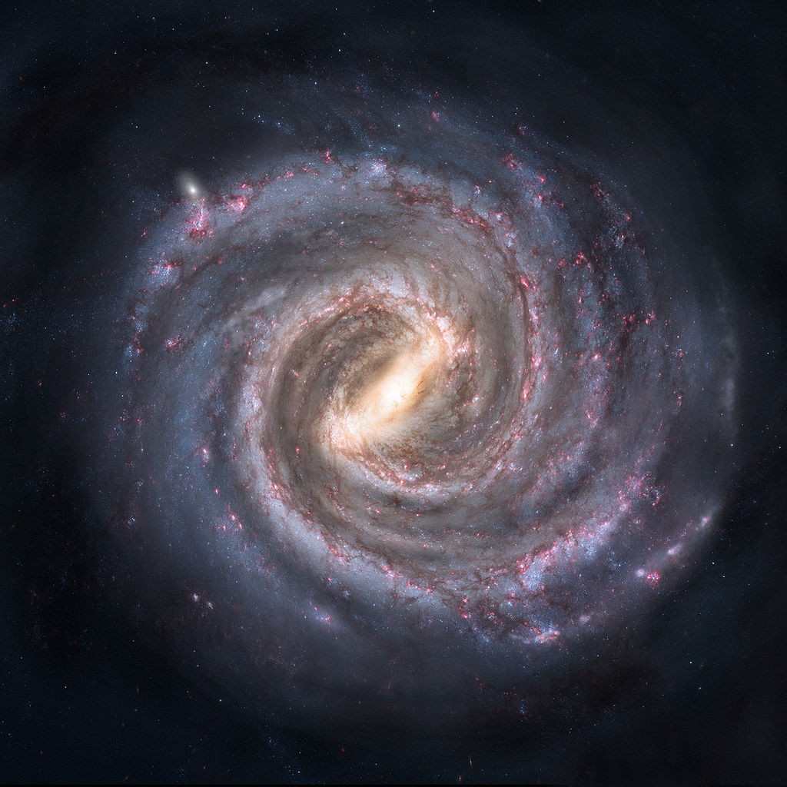
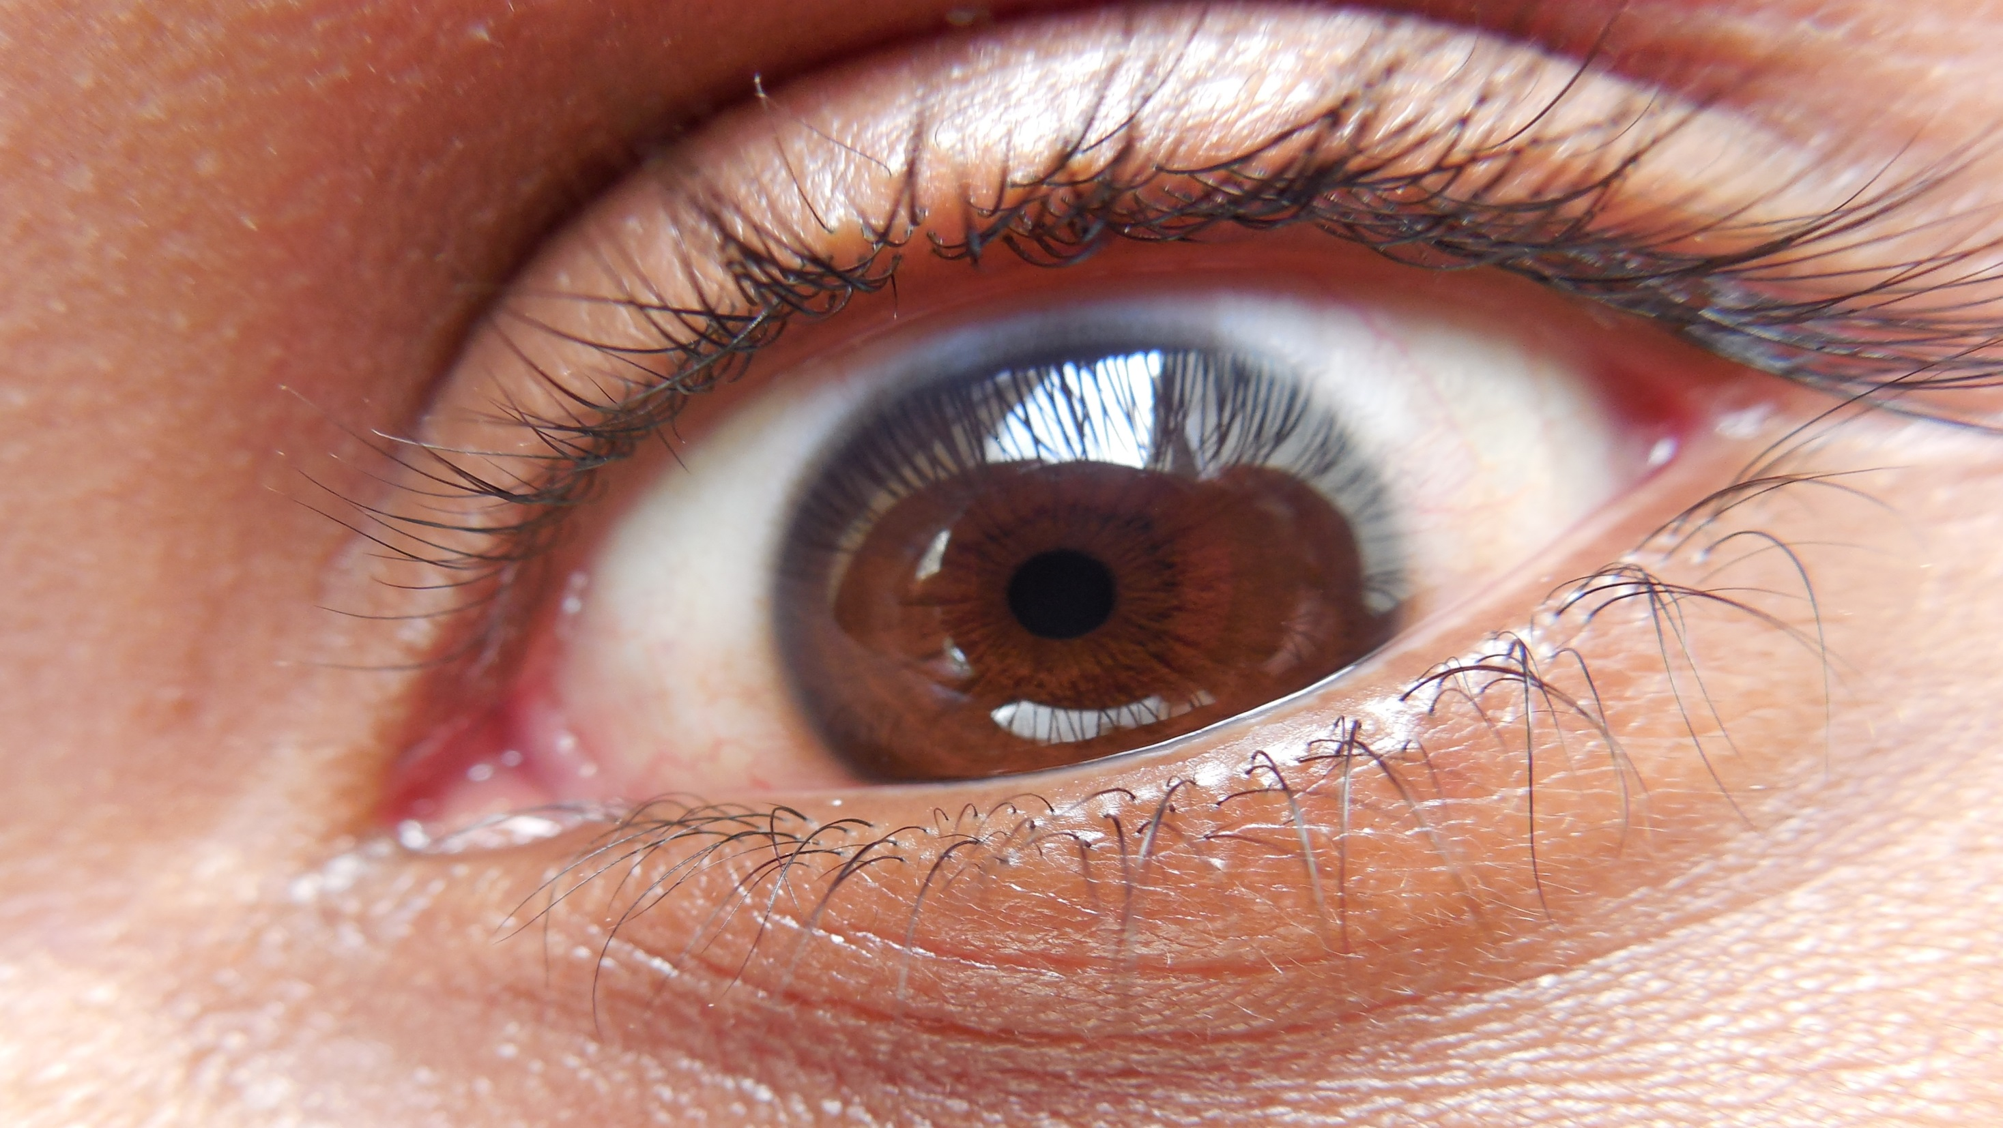
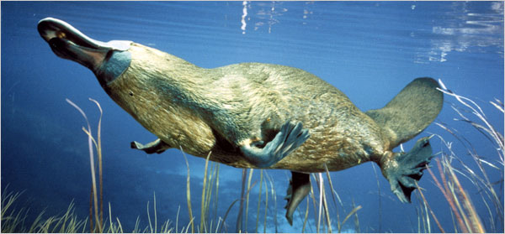

Slide 10
TRUST
Though He slay me, yet will I trust Him. (Job 13:15)

