Slide 2
Hosea 8:11-14
¹¹ Because Ephraim has made many altars for sin, they have become for him altars for sinning. ¹² I have written for him the great things of My law, but they were considered a strange thing. ¹³ For the sacrifices of My offerings they sacrifice flesh and eat it, but the Lord does not accept them. Now He will remember their iniquity and punish their sins. They shall return to Egypt. ¹⁴ For Israel has forgotten his Maker, and has built temples; Judah also has multiplied fortified cities; but I will send fire upon his cities, and it shall devour his palaces.

Slide 5
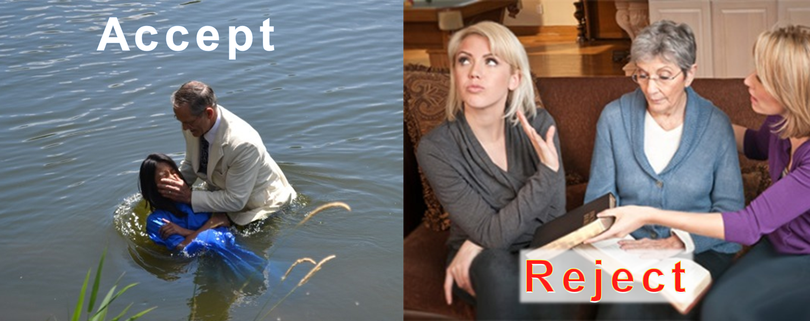
W H Y ?

Slide 6
We Don’t Understand
Beware Of The Leaven Of The Pharisees
Matthew 16:5-11

Slide 7
We Don’t Understand
The Parable Of The Sower
Matthew 13:3-9; 18-23

Slide 8
We Don’t Understand
Jesus Is The True Shepherd
John 10:1-6; 7-16

Slide 9
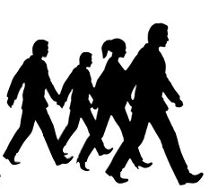
Bible is just ancient
stories, myths, folklore
The Bible trumps pseudoscience (1 Tim 6:20); Proven Science actually confirms the Bible!
God is “supernatural;” He is above nature and the miracles of the Bible are real.
The stories in ancient cultures of the creation and the flood really confirm the Bible—proving the biblical stories to be true!
The purported contradictions are easily understood when one takes into account that the gospels were NOT written as replicas.
Bible is the inspired,
infallible Word of God
Science, Physics, Technology—make the Bible unbelievable!
Many stories are scientifically impossible (Josh 10:13).
The “miracles” have a natural explanation. That is, the healings that occurred were actually the placebo effect!
The Bible stories are not original (Creation, flood, etc.).
Bible full of inconsistencies / contradictions (gospel accounts of the death of Jesus).

Slide 10
Search The Scriptures
Romans 10:17 (Hearing)
“To be saved and go to Heaven a sinner must hear the Words of the Gospel, believe Jesus is the Christ, repent of all sins, confess that Jesus is the Son of God, then be immersed in water—at which time the blood of Christ removes ALL sins. Further, this now saved person must live faithful or fall from grace and be eternally lost.”
Hebrews 11:6 (Believe)
Acts 17:30 (Repent)
Romans 10:9 (Confess)
Acts 22:16 (Baptism)
Revelation 2:10 (Faithful)

Slide 11
Why didn’t God just tell us Plainly?
Why did Jesus use Parables?
Why did Jesus tell stories?
Why didn’t God just spell it out clearly?
Why do we have to “search” it out?

Slide 12
Wayside/Hard
Thorny/Cares
“Why do You speak to them in parables?”
Matthew 13:10
Stoney/Stumbles
Good/Honest

Slide 13
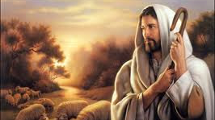
Then Paul and Barnabas grew bold and said, it was necessary that the word of God should be spoken to you first; but since you reject it, and judge yourselves unworthy of everlasting life . . . (Acts 13:46)
“How long do You keep us in doubt? If You are the Christ tell us plainly?”
John 10:24
Do not want to Understand and Obey!
Separates
Now when the Gentiles heard this, they were glad and glorified the word of the Lord. And as many as had been appointed to eternal life believed. And the word of the Lord was being spread throughout all the region. (Acts 13:48-49)
Want to Understand and Obey!

Slide 14
Bible is written to call only those . . .
. . . who hunger & thirst for righteousness (Matt. 5:6).
. . . who are burdened & broken by sin (Matt. 11:28).
. . . who are poor in spirit (Matt. 5:3).
. . . who are not wise in their understanding (Matt. 11:25).

