Slide 2
Romans 1:18-23
¹⁸ For the wrath of God is revealed from heaven against all ungodliness and unrighteousness of men, who suppress the truth in unrighteousness, ¹⁹ because what may be known of God is manifest in them, for God has shown it to them. ²⁰ For since the creation of the world His invisible attributes are clearly seen, being understood by the things that are made, even His eternal power and Godhead, so that they are without excuse, ²¹ because, although they knew God, they did not glorify Him as God, nor were thankful, but became futile in their thoughts, and their foolish hearts were darkened. ²² Professing to be wise, they became fools, ²³ and changed the glory of the incorruptible God into an image made like corruptible man—and birds and four-footed animals and creeping things.
¹⁸ For the wrath of God is revealed from heaven against all ungodliness and unrighteousness of men, who suppress the truth in unrighteousness, ¹⁹ because what may be known of God is manifest in them, for God has shown it to them. ²⁰ For since the creation of the world His invisible attributes are clearly seen, being understood by the things that are made, even His eternal power and Godhead, so that they are without excuse, ²¹ because, although they knew God, they did not glorify Him as God, nor were thankful, but became futile in their thoughts, and their foolish hearts were darkened. ²² Professing to be wise, they became fools, ²³ and changed the glory of the incorruptible God into an image made like corruptible man—and birds and four-footed animals and creeping things.

Slide 4
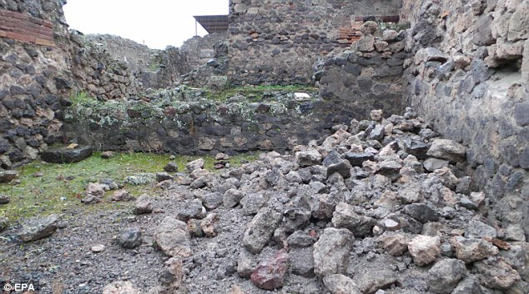
Sexual sins and perversions become the norm
Depraved passions define one’s behavior
Living by debased minds
Unrighteousness
Sexual immorality
Wickedness
Covetousness
Maliciousness
Filled of envy
Murder
Strife
Deceit
Evil-mindedness
Whisperers
Backbiters
Haters of God
Violent
Proud
Boasters
Inventors of evil things
Disobedient to parents
Undiscerning
Untrustworthy
Unloving
Unforgiving
Unmerciful
Tolerates sin in others

Slide 5
Remove God from the Nation’s Conscience

Slide 6
Remove God from the Covenant of Marriage

Slide 7
Remove God from the Worship of Christians

