Slide 2
Ecclesiastes 2:18-23
¹⁸ Then I hated all my labor in which I had toiled under the sun, because I must leave it to the man who will come after me. ¹⁹ And who knows whether he will be wise or a fool? Yet he will rule over all my labor in which I toiled and in which I have shown myself wise under the sun. This also is vanity. ²⁰ Therefore I turned my heart and despaired of all the labor in which I had toiled under the sun. ²¹ For there is a man whose labor is with wisdom, knowledge, and skill; yet he must leave his heritage to a man who has not labored for it. This also is vanity and a great evil. ²² For what has man for all his labor, and for the striving of his heart with which he has toiled under the sun? ²³ For all his days are sorrowful, and his work burdensome; even in the night his heart takes no rest. This also is vanity.

Slide 4
“For we brought nothing into this world, and it is certain we can carry nothing out” (1 Timothy 6:7).

Slide 6
MEAGER

Slide 8
Memory that they were
loved sincerely and
unconditionally

Slide 9
Memory that their father
and mother loved
each other deeply

Slide 10
An example of developing
a Spirit of
Reverence

Slide 11
The value of living by
The Golden Rule

Slide 12
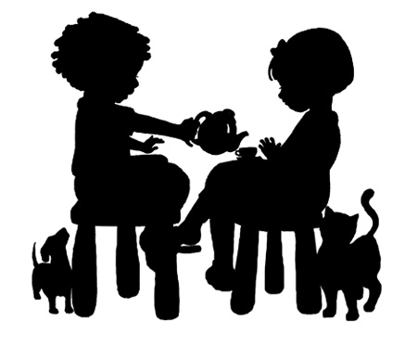
An example of practicing
Christian Hospitality

Slide 13
The memory that home was
always a refuge
of safety

Slide 14
The knowledge that dad and
mom did the very
best they could

Slide 15
. . . the memory you are loved sincerely and unconditional
. . . the memory that your dad and mom loved each other deeply
. . . an example of developing a spirit of Reverence for God
. . . the value of living by the Golden Rule of Jesus
. . . an example of practicing Christian hospitality
. . . the memory that home was always a place of refuge
. . . the knowledge that we always did the best we could

