Slide 2
Luke 10:30-37
³⁰ Then Jesus answered and said: A certain man went down from Jerusalem to Jericho, and fell among thieves, who stripped him of his clothing, wounded him, and departed, leaving him half dead. ³¹ Now by chance a certain priest came down that road. And when he saw him, he passed by on the other side. ³² Likewise a Levite, when he arrived at the place, came and looked, and passed by on the other side. ³³ But a certain Samaritan, as he journeyed, came where he was. And when he saw him, he had compassion. ³⁴ So he went to him and bandaged his wounds, pouring on oil and wine; and he set him on his own animal, brought him to an inn, and took care of him. ³⁵ On the next day, when he departed, he took out two denarii, gave them to the innkeeper, and said to him, take care of him; and whatever more you spend, when I come again, I will repay you. ³⁶ So which of these three do you think was neighbor to him who fell among the thieves? ³⁷ And he said, he who showed mercy on him. Then Jesus said to him, go and do likewise.

Slide 5
But a certain Samaritan, as he journeyed, came where he was. And when he saw him, he had compassion (Lk 10:33).
So which of these three do you think was neighbor to him who fell among the thieves? And he said, he who showed mercy on him. Then Jesus said to him, go and do likewise. (Lk 10:36-37).

Slide 6
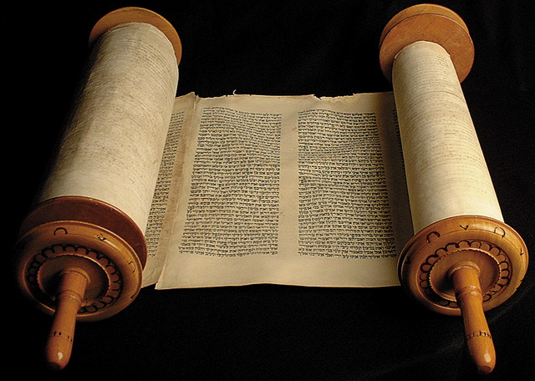
They Just Walked On By
Lawyer: (25, 29) Expert in the law of Moses—this is why Jesus asks him “What is written in the law?” [He quoted Deut 6:5 & Lev 19:18 but looked for a loophole].
Priest: (31) There were 24 orders of priests (1 Chron 24:1-19) and each order served in the temple twice a year.
Levite: (32) A member of the tribe of Levi who were not priests but assisted the priests in their temple duties (1 Chron 23:24-32).
Each knew the demands of God but failed to recognize the needs of humanity!

Slide 7
They Just Walked On By
Because they didn’t try to understand / comfort
Because they wouldn’t take the time to help
Because they didn’t want to get involved

