Slide 2
1 Corinthians 6:17-20
¹⁷ But he who is joined to the Lord is one spirit with Him. ¹⁸ Flee sexual immorality. Every sin that a man does is outside the body, but he who commits sexual immorality sins against his own body. ¹⁹ Or do you not know that your body is the temple of the Holy Spirit who is in you, whom you have from God, and you are not your own? ²⁰ For you were bought at a price; therefore glorify God in your body and in your spirit, which are God’s.

Slide 4
“. . . conduct yourselves throughout the time of your stay here in fear; knowing that you were not redeemed with corruptible things, like silver or gold, from your aimless conduct received by tradition from your fathers, but with the precious blood of Christ, as of a lamb without blemish and without spot.”
(1 Peter 1:17-19)

Slide 6
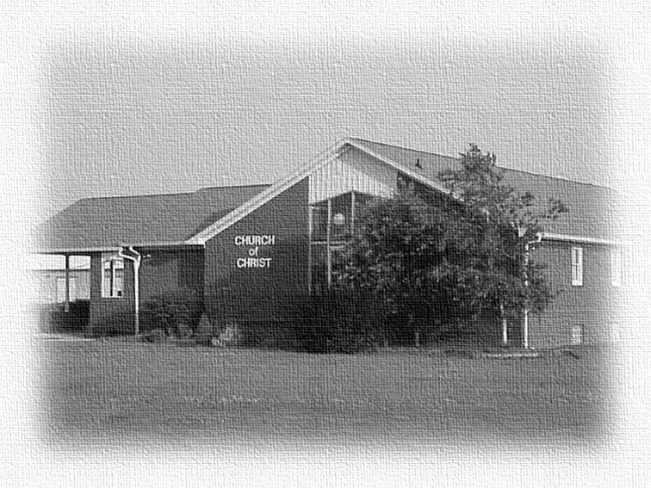
“I Belong to the Church”
Become Members ~ Ac 9:26
For as we have many members in one body, but all the members do not have the same function, so we, being many, are one body in Christ, and individually members of one another, (Romans 12:4-5).
The body is one and has many members . . . For by one Spirit we were all baptized into one body—whether Jews or Greeks, whether slaves or free . . . in fact the body is not one member but many, (1 Cor 12:12-14).
Work & Worship Together~ Ac 2:42-45
We are Members of One Another ~ Eph 4:25

Slide 7
“I Belong to the Church”
“I Belong to Jesus Christ”
I joined the church last March!
I remember when they came into the church!
Oh, he left the church a long time ago!
She was restored to the church last week!

Slide 8
“I Belong to Jesus Christ”
(Serve) in sincerity of heart, as to Christ; not with eye-service, as men-pleasers, but as bondservants of Christ, doing the will of God from the heart, with goodwill doing service, as to the Lord, and not to men, (Eph 6:5-7).
And whatever you do, do it heartily, as to the Lord and not to men, knowing that from the Lord you will receive the reward of the inheritance; for you serve the Lord Christ, (Col 3:23-24).

Slide 9
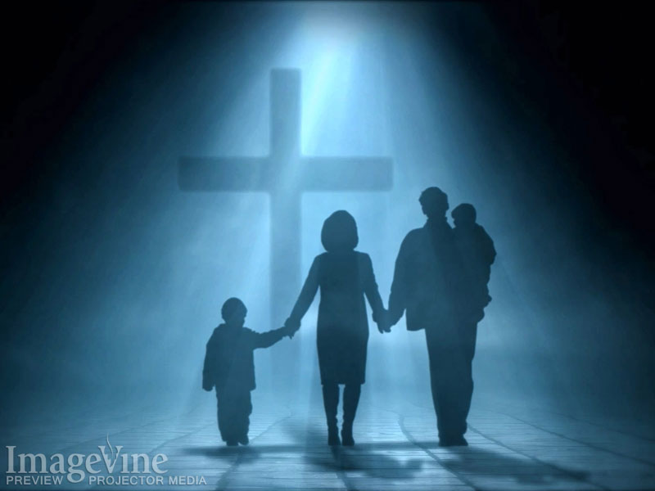
“I Belong to Jesus Christ”
Worship

Slide 10
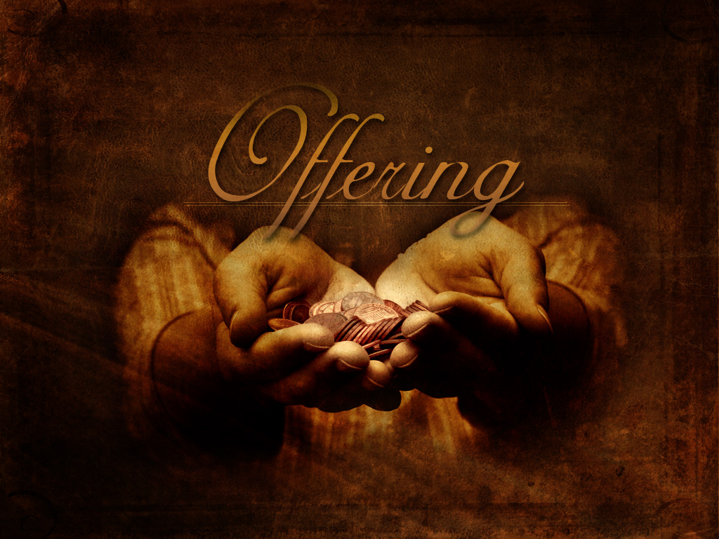
“I Belong to Jesus Christ”

Slide 11
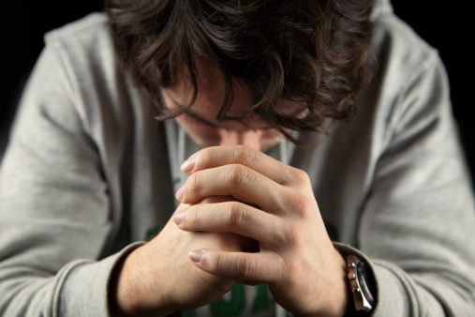
“I Belong to Jesus Christ”
Prayer Life

Slide 12
“I Belong to Jesus Christ”

Slide 13
“I Belong to Jesus Christ”

