Slide 2
1 Timothy 3:8-13
⁸ Likewise deacons must be reverent, not double-tongued, not given to much wine, not greedy for money, ⁹ holding the mystery of the faith with a pure conscience. ¹⁰ But let these also first be tested; then let them serve as deacons, being found blameless. ¹¹ Likewise, their wives must be reverent, not slanderers, temperate, faithful in all things. ¹² Let deacons be the husbands of one wife, ruling their children and their own houses well. ¹³ For those who have served well as deacons obtain for themselves a good standing and great boldness in the faith which is in Christ Jesus.

Slide 4
2 of 4

Slide 5
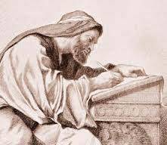
Paul and Timothy, bondservants of Jesus Christ, to all the saints in Christ Jesus who are in Philippi, with the bishops and deacons, (Philippians 1:1).
Saints: Christians
(Acts 8:3; 9:13)
Bishops: Elders / Pastors (Acts 20:17,28)
Deacons: Special servants of the church (Acts 6:1-6)

Slide 6
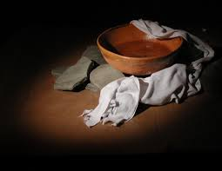
Deacons are not Overseers
Deacons are not Evangelists
Deacons are Servants
Then the twelve summoned the multitude of the disciples and said, it is not desirable that we should leave the word of God and serve tables. Therefore, brethren, seek out from among you seven men . . . whom we may appoint over this business (Acts 6:2-3).
But let these also first be tested; then let them serve as deacons, being found blameless . . . For those who have served well as deacons . . . (Acts 6:2-3).

Slide 7
1 Timothy 3:8-12
Likewise deacons must be reverent, not double-tongued, not given to much wine, not greedy for money, holding the mystery of the faith with a pure conscience. But let these also first be tested; then let them serve as deacons, being found blameless. Likewise their wives must be reverent, not slanderers, temperate, faithful in all things. Let deacons be the husbands of one wife, ruling their children and their own houses well.
Each qualification MUST be met by each man BEFORE he is appointed

Slide 8
1 Timothy 3:8-12
Likewise deacons must be reverent, not double-tongued, not given to much wine, not greedy for money, holding the mystery of the faith with a pure conscience. But let these also first be tested; then let them serve as deacons, being found blameless. Likewise their wives must be reverent, not slanderers, temperate, faithful in all things. Let deacons be the husbands of one wife, ruling their children and their own houses well.
hoôsautoôs
“In the same way:—even so, likewise, after the same (in like) manner.”

Slide 9
1 Timothy 3:8-12
Likewise deacons must be reverent, not double-tongued, not given to much wine, not greedy for money, holding the mystery of the faith with a pure conscience. But let these also first be tested; then let them serve as deacons, being found blameless. Likewise their wives must be reverent, not slanderers, temperate, faithful in all things. Let deacons be the husbands of one wife, ruling their children and their own houses well.
semnos
“August, venerable, honest (Phil 4:8); to be respected for honorable character”
(A Deacon must be an honorable and serious man – one who is known and respected for his integrity.)

Slide 10
1 Timothy 3:8-12
Likewise deacons must be reverent, not double-tongued, not given to much wine, not greedy for money, holding the mystery of the faith with a pure conscience. But let these also first be tested; then let them serve as deacons, being found blameless. Likewise their wives must be reverent, not slanderers, temperate, faithful in all things. Let deacons be the husbands of one wife, ruling their children and their own houses well.
dilogos
“Double in speech, saying one thing with one person another with another (with the intent to deceive)”
A Deacon must NOT be 2-faced; having 2-standards one for self/friends, one for all others. Also: James 3:9-10)

Slide 11
1 Timothy 3:8-12
Likewise deacons must be reverent, not double-tongued, not given to much wine, not greedy for money, holding the mystery of the faith with a pure conscience. But let these also first be tested; then let them serve as deacons, being found blameless. Likewise their wives must be reverent, not slanderers, temperate, faithful in all things. Let deacons be the husbands of one wife, ruling their children and their own houses well.
NIV: “not indulging in much wine”
NASB: “or addicted to much wine”
NLT: “They must not be heavy drinkers”
prosechoô
“To hold the mind, to give attention to, to attach one’s self to, to be given or addicted to . . .”

Slide 12
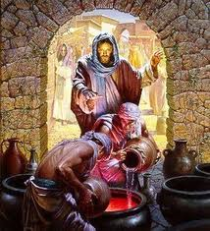
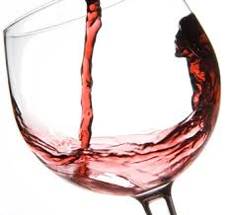
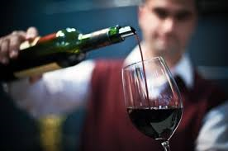
1 Tim 5:23
John 2:1-11
Reasoning Goes Like This:
Drunkenness is sinful (Gal 5:19)
Drinking wine (beer, liquor) moderately is OK
Only elders are to be total abstainers (1 Tim 3:3)

Slide 13
“Do not look on the wine when it is red, when it sparkles in the cup, when it swirls around smoothly” (Prov 23:31).
“Wine is a mocker, strong drink is a brawler, and whoever is led astray by it is not wise” (Prov 20:1).
“Woe to him who gives drink to his neighbor, pressing him to your bottle, even to make him drunk . . .” (Hab 2:15).

Slide 14
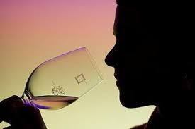
CONSEQUENCES
IF Jesus made intoxicating wine then the following is also true:
Disciples CAN drink intoxicants
Disciples can make/manufacture intoxicants (Distilleries)
Disciples can sell intoxicants (Bars)
Wine (oinos): Jn 2:1-11
a general term that could mean an intoxicant (Acts 2:13-15),
Or simply grape juice (Isa 65:8 Wine is in the cluster).
Jesus would never have violated Hab 2:15 (sinned)!

Slide 15
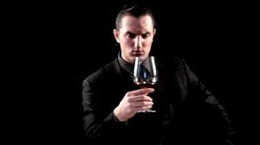
Wine (oinos): 1 Tim 5:23
Wine (oinos): is a general term that could mean an intoxicant or simply grape juice. One must ASSUME the wine in this verse is an intoxicant.
CONSIDER
Timothy had to be told to drink wine/oinos (He was an abstainer).
He was told to use a “little.”
It was to be taken for a medical not social reason.
Wine would not include (beer, coolers, malt liquor, gin, etc.).
Alcohol is an addictive drug (Matt 6:13, God doesn’t lead us into temptation).
“No longer drink only water, but use a little wine for your stomach’s sake and your frequent infirmities” (1 Tim 5:23).

Slide 16
1 Timothy 3:8-12
Likewise deacons must be reverent, not double-tongued, not given to much wine, not greedy for money, holding the mystery of the faith with a pure conscience. But let these also first be tested; then let them serve as deacons, being found blameless. Likewise their wives must be reverent, not slanderers, temperate, faithful in all things. Let deacons be the husbands of one wife, ruling their children and their own houses well.
prosechoô
“To hold the mind, to give attention to, to attach one’s self to, to be given or addicted to . . .”
“Much wine” does not mean “as opposed to a little wine.” If so, then Paul is saying a deacon may be ADDITCED to a little wine.
However, 1 Cor 6:12

Slide 17
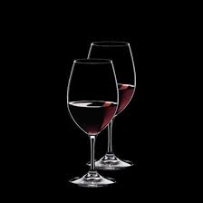
Not Given To Much Wine,
Substitute cocaine / heroin for wine: “Not addicted to much _____”
“Do not be overly wicked,” (Eccl 7:17). Can we be moderately wicked?
“The same flood of dissipation,” (1 Pet 4:4). Can we be engaged in some slight dissipation?

Slide 18
Not Given To Much Wine,
Condemning the excess by implication condemns the lesser.
Rom 6:12 – “do not let sin reign in your mortal body,” does not permit sin so long as it doesn’t reign!
Mom says: “You must stop this nonstop lying.” She does not mean that sporadic lying is permissible?
Dad tells the boys, “You must stop this constant fighting.” He does not mean that fighting is OK so long as it is occasional?

Slide 19
Not use alcoholic beverages
“Much wine” does not mean “as opposed to a little wine.” Paul is saying that a deacon may NOT be addicted to wine, whether a little or a lot!
NOT be 2-faced; having two standards one for himself/friends, one for all others. Also he must not talk about or malign others (James 3:9-10)
An honorable and serious man – a godly man who is known and respected for his integrity and his genuineness and devotion to the spiritual!
Not doubled-tongued
Be Reverent
A Deacon Must . . .

