Slide 2
1 Timothy 3:8-13
⁸ Likewise deacons must be reverent, not double-tongued, not given to much wine, not greedy for money, ⁹ holding the mystery of the faith with a pure conscience. ¹⁰ But let these also first be tested; then let them serve as deacons, being found blameless. ¹¹ Likewise, their wives must be reverent, not slanderers, temperate, faithful in all things. ¹² Let deacons be the husbands of one wife, ruling their children and their own houses well. ¹³ For those who have served well as deacons obtain for themselves a good standing and great boldness in the faith which is in Christ Jesus.

Slide 4
1 of 3

Slide 5
Saints: Christians
(Acts 8:3; 9:13)
Bishops: Elders / Pastors (Acts 20:17,28)
Deacons:
Paul and Timothy, bondservants of
Jesus Christ, to all the saints in
Christ Jesus who are in Philippi,
with the bishops and deacons:

Slide 6
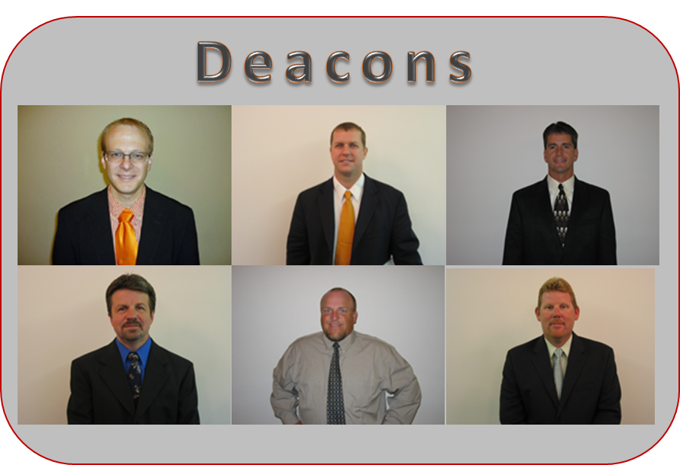

Slide 7
Therefore, brethren, seek out from among you seven men of good reputation, full of the Holy Spirit and wisdom, whom we may appoint over this business; but we will give ourselves continually to prayer and to the ministry of the word. And the saying pleased the whole multitude. And they chose Stephen, a man full of faith and the Holy Spirit, and Philip, Prochorus, Nicanor, Timon, Parmenas, and Nicolas, a proselyte from Antioch, whom they set before the apostles; and when they had prayed, they laid hands on them. (Acts 6:3-6)

Slide 8
1 Timothy 3:8-12
Likewise deacons must be reverent, not double-tongued, not given to much wine, not greedy for money, holding the mystery of the faith with a pure conscience. But let these also first be tested; then let them serve as deacons, being found blameless. Likewise their wives must be reverent, not slanderers, temperate, faithful in all things. Let deacons be the husbands of one wife, ruling their children and their own houses well.
Each qualification MUST be met by each man BEFORE he is appointed
Acts 6:3
Therefore, brethren, seek out from among you seven men of good reputation, full of the Holy Spirit and wisdom, whom we may appoint over this business;

Slide 9
Selection and Appointment is not Based on
His Popularity (How well liked / admired / sociable he is)
Feel Sorry For (If he isn’t selected it will hurt his feelings)
Help him Grow (He will become more involved if appointed)
Long Time Member (If he isn’t appointed it will look bad)
Nice Family (Lot’s of relatives, he’s from a wonderful family)
Nevertheless I have a few things against you, because you allow . . . (Rev 2:20).
And you are puffed up, and have not rather mourned . . . (1 Cor 5:2)

Slide 10
1 Timothy 3:10, 13
Let these also first be tested; then let them serve as deacons . . .
For those who have served well as deacons obtain for themselves a good standing and great boldness in the faith which is in Christ Jesus.

Slide 11
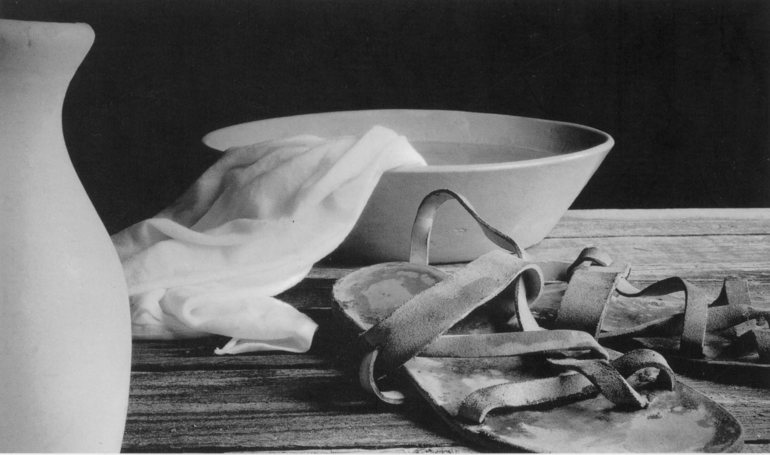
The Work (Service) of Deacons
Serving the Physical Needs of the Local Congregation
Caring for the widows, poor, helpless.
Serving at periods of worship.
Preparing the building for worship.
Preparation/help with baptisms.
Making visitors’ welcome (card, etc.).
Any elders’ delegated responsibilities.

