Slide 2
Isaiah 55:6-9
⁶ Seek the Lord while He may be found, call upon Him while He is near. ⁷ Let the wicked forsake his way, and the unrighteous man his thoughts; let him return to the Lord, and He will have mercy on him; and to our God, for He will abundantly pardon. ⁸ For My thoughts are not your thoughts, nor are your ways My ways, says the Lord. ⁹ For as the heavens are higher than the earth, so are My ways higher than your ways, and My thoughts than your thoughts.

Slide 5
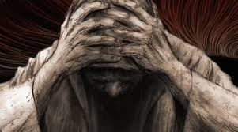
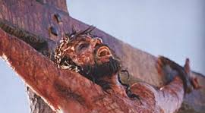
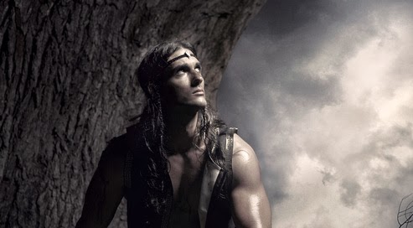
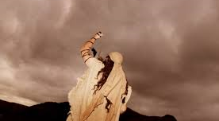
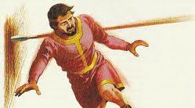
. . . have You set me as Your target, so that I am a burden to myself? (Job 7:20).
. . . have you brought us up out of Egypt to die in the wilderness? (Num 21:5).
. . . then has all this happened to us? (Judg 6:13).
. . . have You forgotten me? Why do I go mourning because of the oppression of the enemy?
(Psa 42:9).
. . . have You forsaken Me?
(Matt 27:46).

Slide 6
What’s Going On
Behind The Scenes?

Slide 7
Seeing From
God’s
Perspective

Slide 8
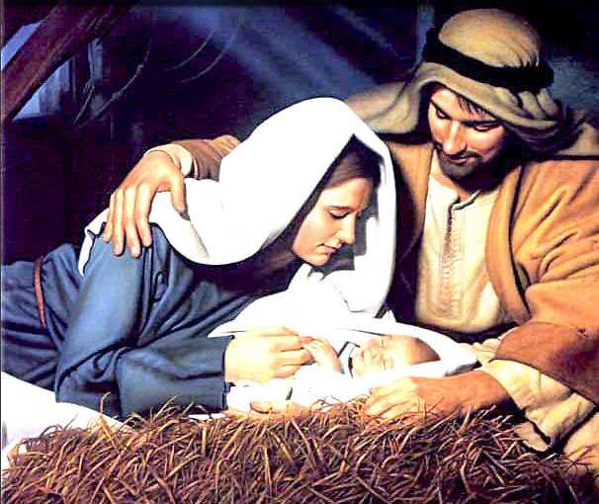
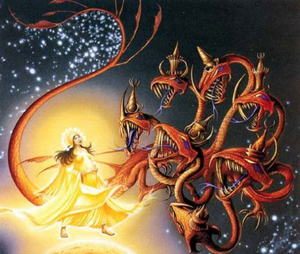
And she brought forth her firstborn Son, and wrapped Him in swaddling cloths, and laid Him in a manger . . . (Luke 2:7).
. . . a great, fiery red dragon having seven heads and ten horns . . . stood before the woman who was ready to give birth, to devour her Child as soon as it was born. (Rev 12:3-4).

Slide 9
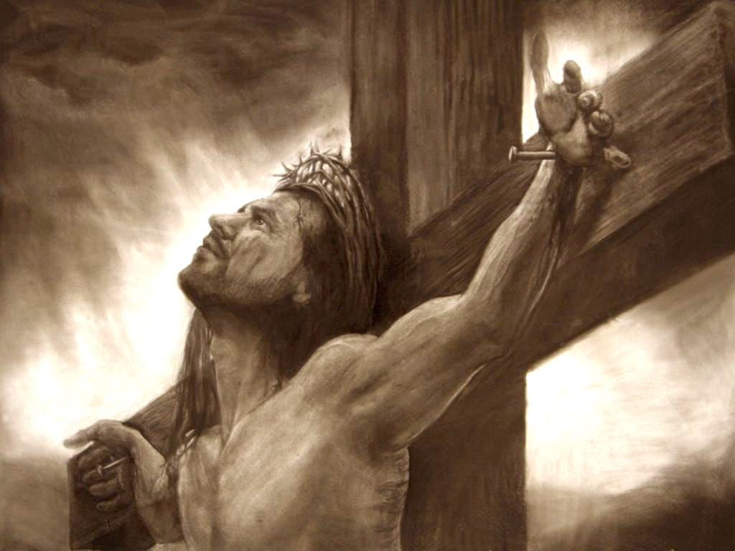
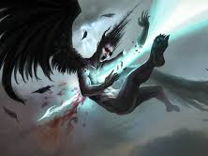
It shall be imputed to us who believe in Him who raised up Jesus our Lord from the dead, who was delivered up because of our offenses, and was raised because of our justification. (Rom 4:24-25).
So the great dragon was cast out, that serpent of old, called the Devil and Satan, who deceives the whole world; he was cast to the earth, and his angels were cast out with him.
(Rev 12:9).

Slide 10
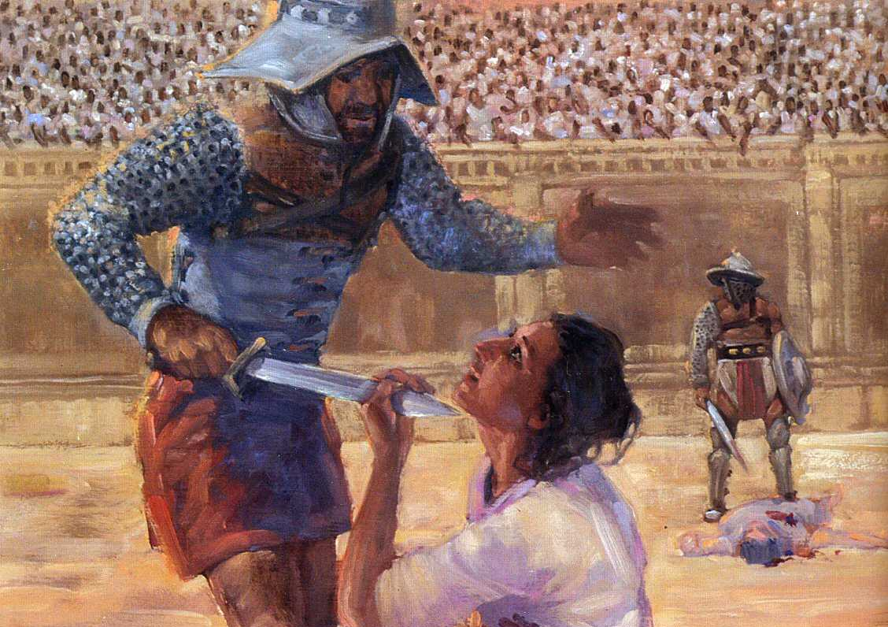
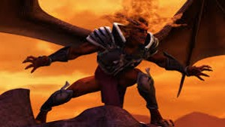
Another horse, fiery red, went out. And it was granted to the one who sat on it to take peace from the earth, and that people should kill one another; and there was given to him a great sword. (Rev 6:4).
And the dragon was enraged with the woman, and he went to make war with the rest of her offspring, who keep the commandments of God and have the testimony of Jesus Christ.
(Rev 12:17).

Slide 11
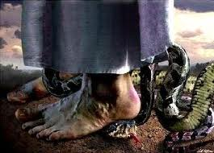
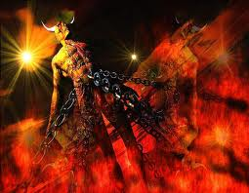
And I will put enmity between you and the woman, and between your seed and her Seed; He shall bruise your head, and you shall bruise His heel.
(Gen 3:15).
The devil, who deceived them, was cast into the lake of fire and brimstone where the beast and the false prophet are. And they will be tormented day and night forever and ever. (Rev 20:10).

Slide 12
Trust in the Living God
“In God I have put my trust; I will not fear. What can flesh do to me?” (Psa 56:4)
“To You, O Lord, I lift up my soul. O my God, I trust in You . . .” (Psa 25:1)
“Trust in the LORD with all your heart, and lean not on your own understanding” (Pro 3:5)
Job 13:15
2 Cor 12:8-10
You
Lk 7:18-23
Dan 3:17-18

