Slide 2
⁴⁴ Again, the kingdom of heaven is like treasure hidden in a field, which a man found and hid; and for joy over it he goes and sells all that he has and buys that field. ⁴⁵ Again, the kingdom of heaven is like a merchant seeking beautiful pearls, ⁴⁶ who, when he had found one pearl of great price, went and sold all that he had and bought it.

Slide 4
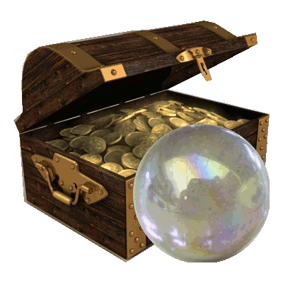
Hidden Treasure
Pearl of Great Price
Looking for Value not Bargain
Recognized the true Value
Did not seek to Haggle
Made the necessary Purchase

Slide 5
Inflation

Slide 6
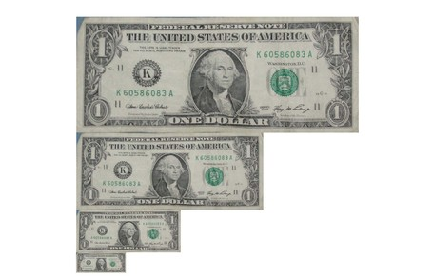
1913 ($1.00)
Cheapened Dollar
1950 ($2.43)
1990 ($13.20)
2012 ($23.27)

Slide 7
1967 ($0.45)
2014 ($3.99)

Slide 8
African-American
Arab-American
Asian-American
European-American
German-American
Greek-American
Irish-American
Italian-American
Japanese-American
Latino-American
Native-American
Polish-American
Russian-American

Slide 9
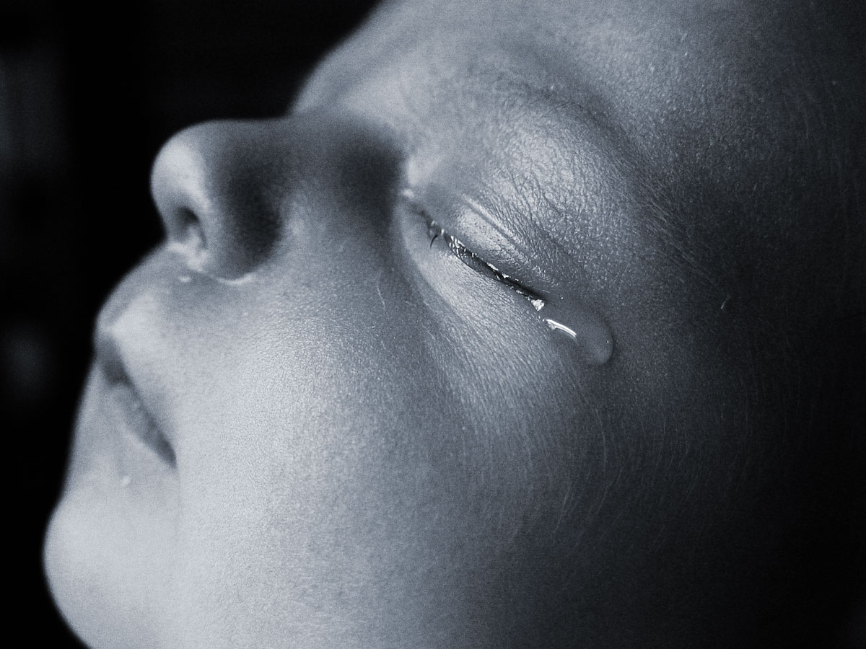
Abortion
Since 1973
57,161,238 & Counting
2014
755,472
& Counting
Cheapened Life

Slide 10
Euthanasia
417
& Counting
Cheapened Life

Slide 11
Number of Murders in U.S. (2013)
16,238
Deaths per 100,000 population:
5.2
Cheapened Life

Slide 12
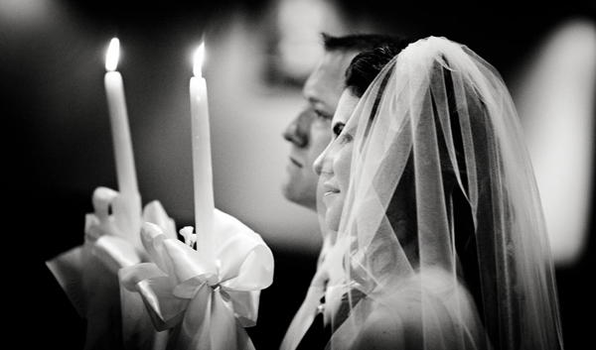
Matthew 19:3-9
Ephesians 5:22-32
Cheapened Home / Family

Slide 13
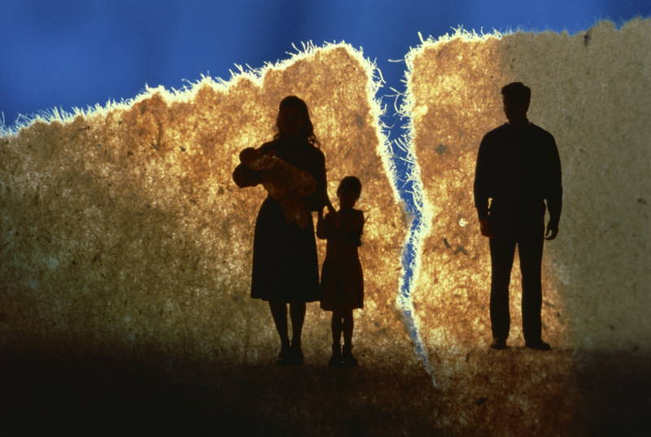
Divorce
Cheapened Home / Family

Slide 14
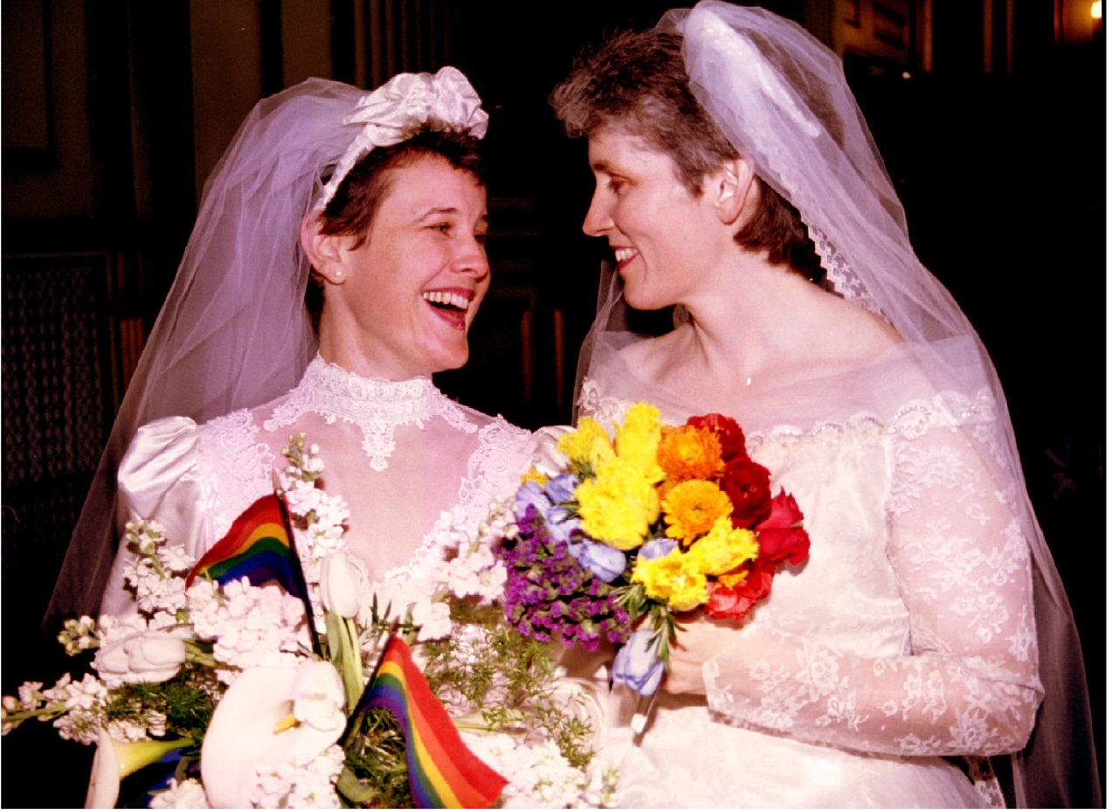
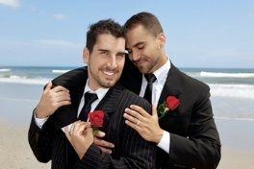
“Same-Sex Marriages”
Cheapened Home / Family

Slide 15
Cheapened Morality

Slide 16
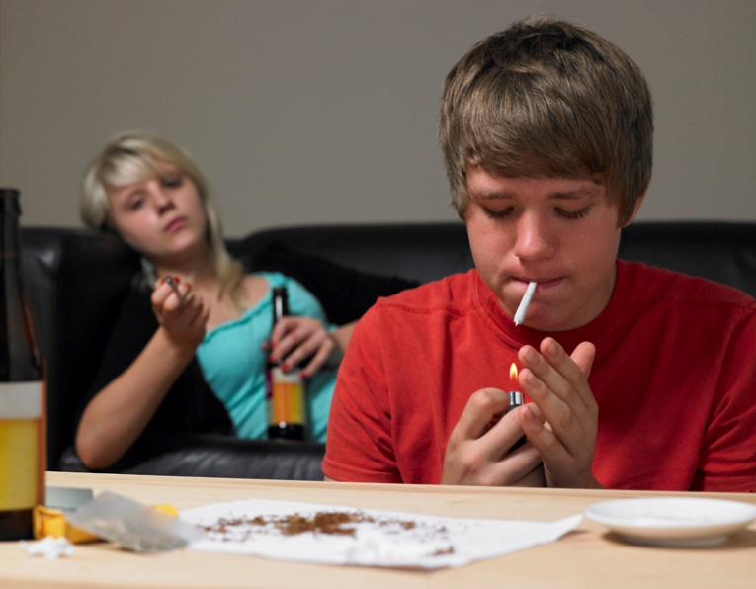
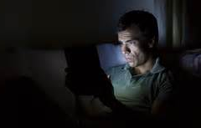
Drug Use
Sexual
Promiscuity
Alcohol
Consumption
Pornography
Workplace
Theft
Cheating
Cheapened Morality

Slide 17
Cheapened Authority

Slide 18
Cheapened Authority

Slide 19
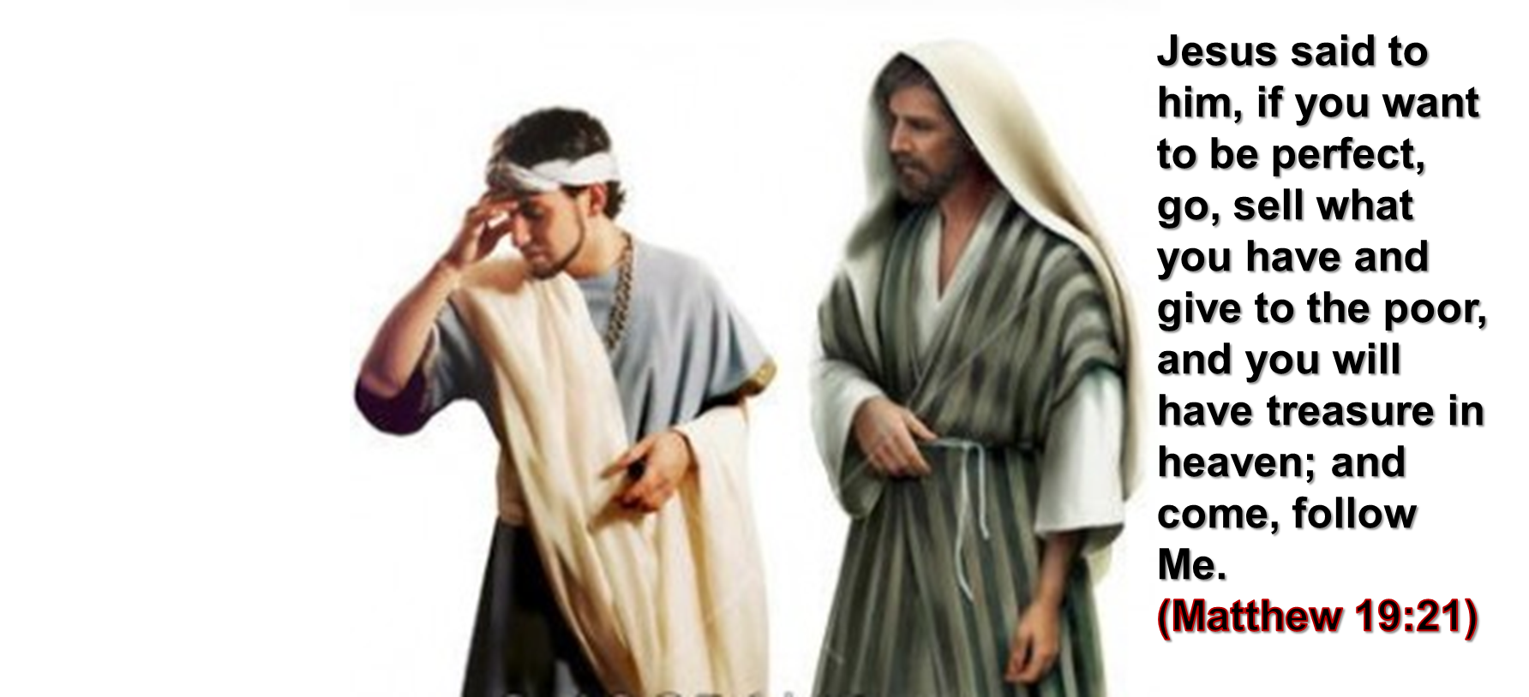
This isn’t as much about giving away all our money as it is about fully GIVING our lives to Jesus and TOTALLY following Him! Lk 14:33
And now why are you waiting? Arise and be baptized, and wash away your sins, calling on the name of the Lord.
(Acts 22:16)
Cheapened Salvation

Slide 20
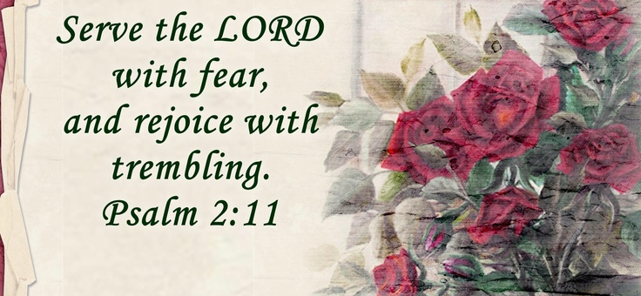
Cheapened GOD

