Slide 2
²⁵ Now his older son was in the field. And as he came and drew near to the house, he heard music and dancing. ²⁶ So he called one of the servants and asked what these things meant. ²⁷ And he said to him, your brother has come, and because he has received him safe and sound, your father has killed the fatted calf. ²⁸ But he was angry and would not go in. Therefore his father came out and pleaded with him. ²⁹ So he answered and said to his father, lo, these many years I have been serving you; I never transgressed your commandment at any time; and yet you never gave me a young goat, that I might make merry with my friends. ³⁰ But as soon as this son of yours came, who has devoured your livelihood with harlots, you killed the fatted calf for him. ³¹ And he said to him, son, you are always with me, and all that I have is yours. ³² It was right that we should make merry and be glad, for your brother was dead and is alive again, and was lost and is found.

Slide 4
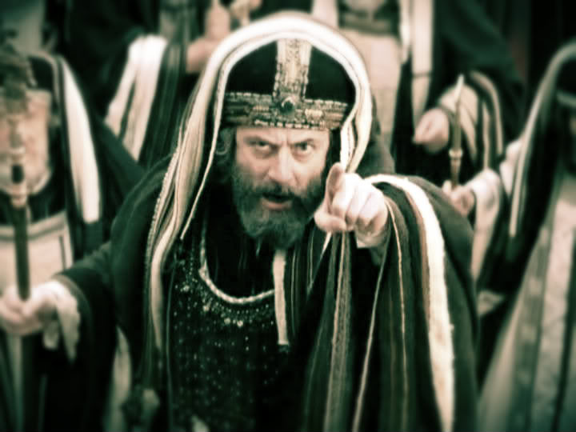
Then all the tax collectors and the sinners drew near to Him to hear Him. And the Pharisees and scribes complained, saying, this Man receives sinners and eats with them. (Luke 15:1-2)

Slide 5
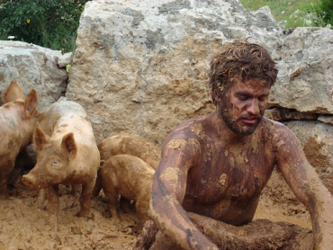
Then he went and joined himself to a citizen of that country, and he sent him into his fields to feed swine. And he would gladly have filled his stomach with the pods that the swine ate, and no one gave him anything. But when he came to himself, he said, how many of my father’s hired servants have bread enough and to spare, and I perish with hunger! I will arise and go to my father, and will say to him, Father, I have sinned against heaven and before you, and I am no longer worthy to be called your son. Make me like one of your hired servants. (Luke 15:15-19)

Slide 6
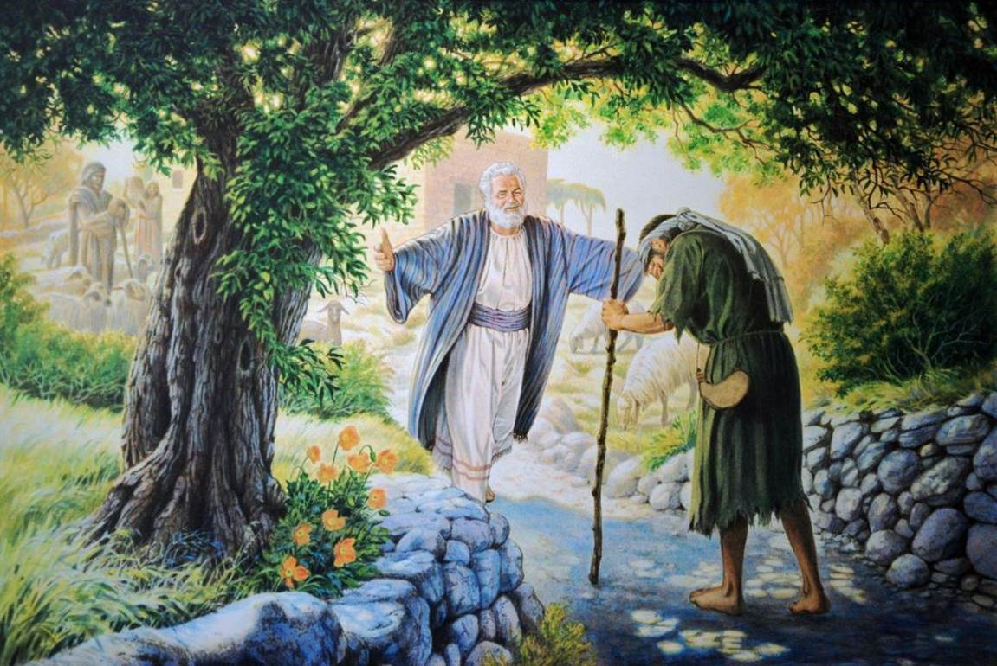
But when he was still a great way off, his father saw him and had compassion, and ran and fell on his neck and kissed him. And the son said to him, father, I have sinned against heaven and in your sight, and am no longer worthy to be called your son. But the father said to his servants, bring out the best robe and put it on him, and put a ring on his hand and sandals on his feet. And bring the fatted calf here and kill it, and let us eat and be merry; for this my son was dead and is alive again; he was lost and is found. And they began to be merry. (Luke 15:20-24)

Slide 7
Had a Suspicious Heart (25-26)
Had an Angry Heart (27-28)
Had an Unforgiving Heart (29-30)
Had a Graceless Heart (29)

