Slide 2
Hebrews 11:23-28
²³ By faith Moses, when he was born, was hidden three months by his parents, because they saw he was a beautiful child; and they were not afraid of the king’s command. ²⁴ By faith Moses, when he became of age, refused to be called the son of Pharaoh’s daughter, ²⁵ choosing rather to suffer affliction with the people of God than to enjoy the passing pleasures of sin, ²⁶ esteeming the reproach of Christ greater riches than the treasures in Egypt; for he looked to the reward. ²⁷ By faith he forsook Egypt, not fearing the wrath of the king; for he endured as seeing Him who is invisible. ²⁸ By faith he kept the Passover and the sprinkling of blood, lest he who destroyed the firstborn should touch them.

Slide 4
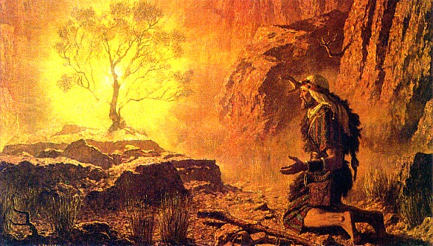
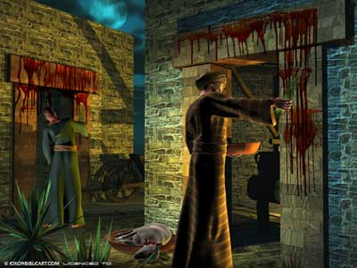
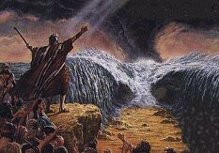
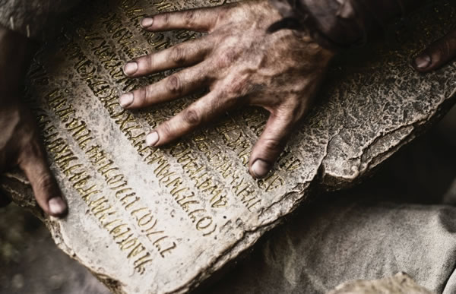
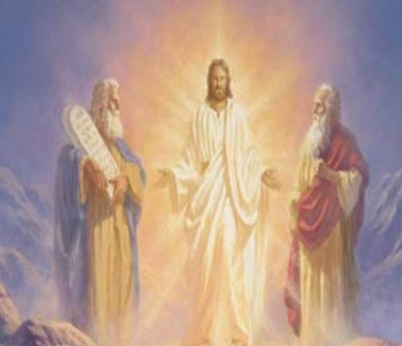
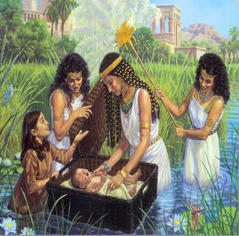
By faith Moses, when he was born, was hidden three months by his parents,
(NKJ)
By faith Moses’ parents hid him for three months after he was born,
(NIV)
So the Lord spoke to Moses face to face, as a man speaks to his friend. Exodus 33:11

Slide 5
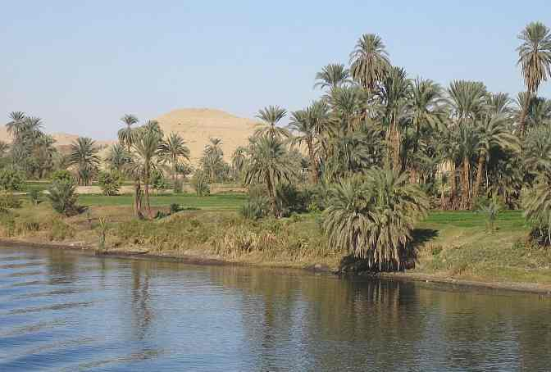
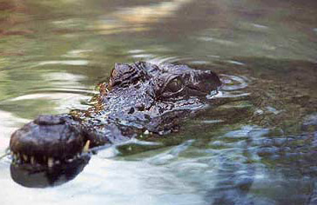
But the children of Israel were fruitful and increased abundantly, multiplied and grew exceedingly mighty; and the land was filled with them. Now there arose a new king over Egypt, who did not know Joseph. (Exod 1:7-8).
. . . let us deal shrewdly with them, lest they multiply, and it happen, in the event of war, that they also join our enemies and fight against us, and so go up out of the land. Therefore they set taskmasters over them to afflict them with their burdens. (Exod 1:10-11).
So Pharaoh commanded all his people, saying, every son who is born you shall cast into the river . . . (Exod 1:22).

Slide 6
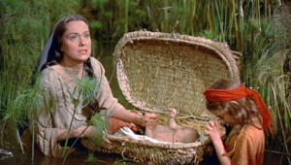
And a man of the house of Levi went and took as wife a daughter of Levi. So the woman conceived and bore a son. And when she saw that he was a beautiful child, she hid him three months. But when she could no longer hide him, she took an ark of bulrushes for him, daubed it with asphalt and pitch, put the child in it, and laid it in the reeds by the river’s bank. And his sister stood afar off, to know what would be done to him. (Exod 2:1-4)

Slide 7
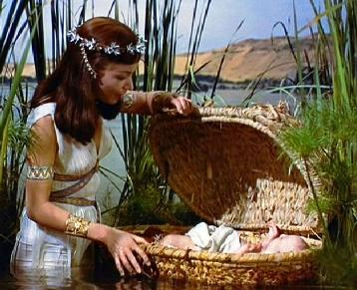
“Then the daughter of Pharaoh came down to bathe at the river. And her maidens walked along the riverside; and when she saw the ark among the reeds, she sent her maid to get it. And when she opened it, she saw the child, and behold, the baby wept. So she had compassion on him, and said, this is one of the Hebrews’ children.” (Exodus 2:5-6)

Slide 8
A Faith that Produced Hope
A Faith that Produced Courage
A Faith that Produced Trust
A Faith that Influenced a Son

