Slide 2
John 1:1-5
¹ In the beginning was the Word, and the Word was with God, and the Word was God. ² He was in the beginning with God. ³ All things were made through Him, and without Him nothing was made that was made. ⁴ In Him was life, and the life was the light of men. ⁵ And the light shines in the darkness, and the darkness did not comprehend it.

Slide 4
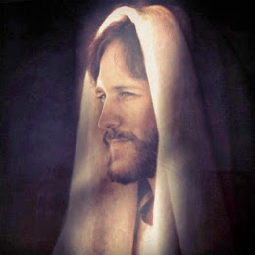
Jesus:
A Jew (Jn 4:9)
A teacher who came from God (Jn 3:2)
A Sinner (Jn 9:16)
A glutton & a drunk (Lk 7:34)
Reincarnation of John the baptist (Matt 14:2)
Jeremiah, Elijah, one of the prophets (Matt 16:14)
Always been controversy & continues (Jn 7:46)
“Who can this be . . .?”
(Mark 4:41)

Slide 5
Jesus:
Jewish Rabbi: “I see Jesus as a gifted leader and teacher with an exceptional flair for the use of parables.”
Liberal Protestant Theologians: “A great teacher but certainly not a supernatural miracle worker.”
Mormon: “Jesus Christ was not begotten by the Holy Ghost.”
Jehovah’s Witness: “He . . . was flesh, a human son of God, a perfect man . . .”
“Who can this be . . .?”
(Mark 4:41)

Slide 6
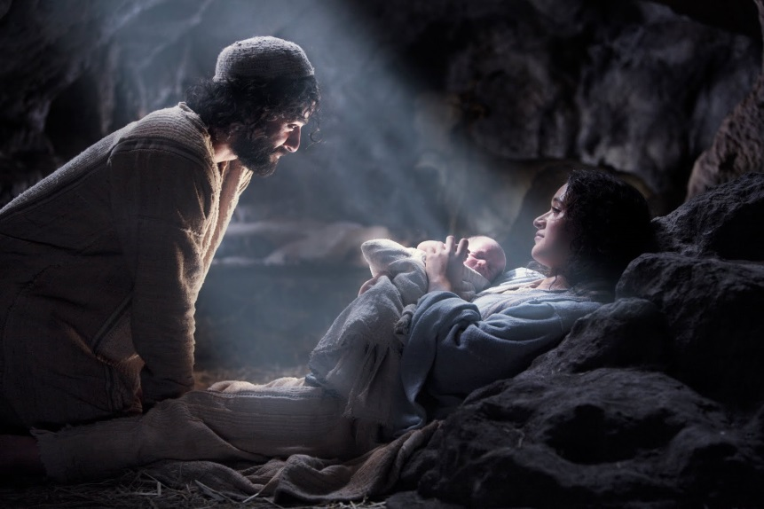
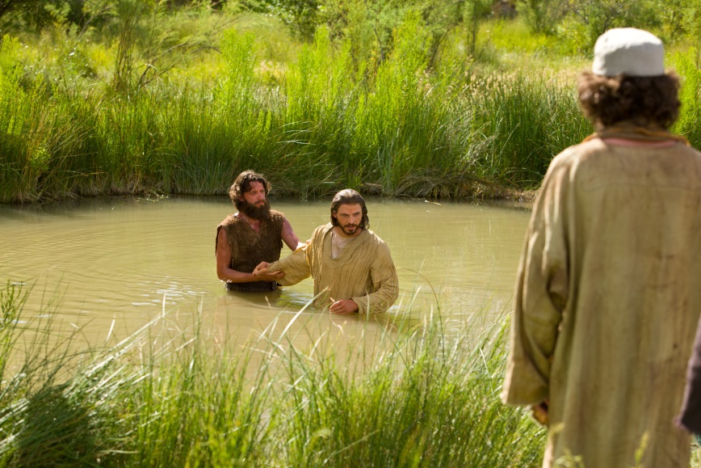
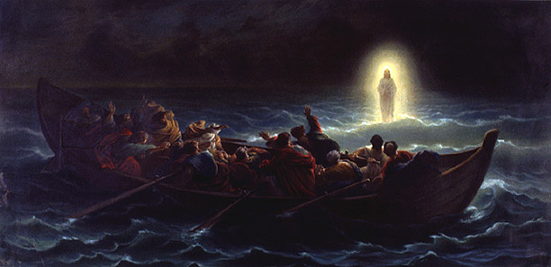
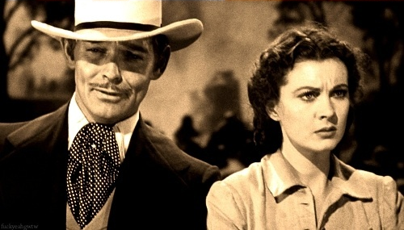
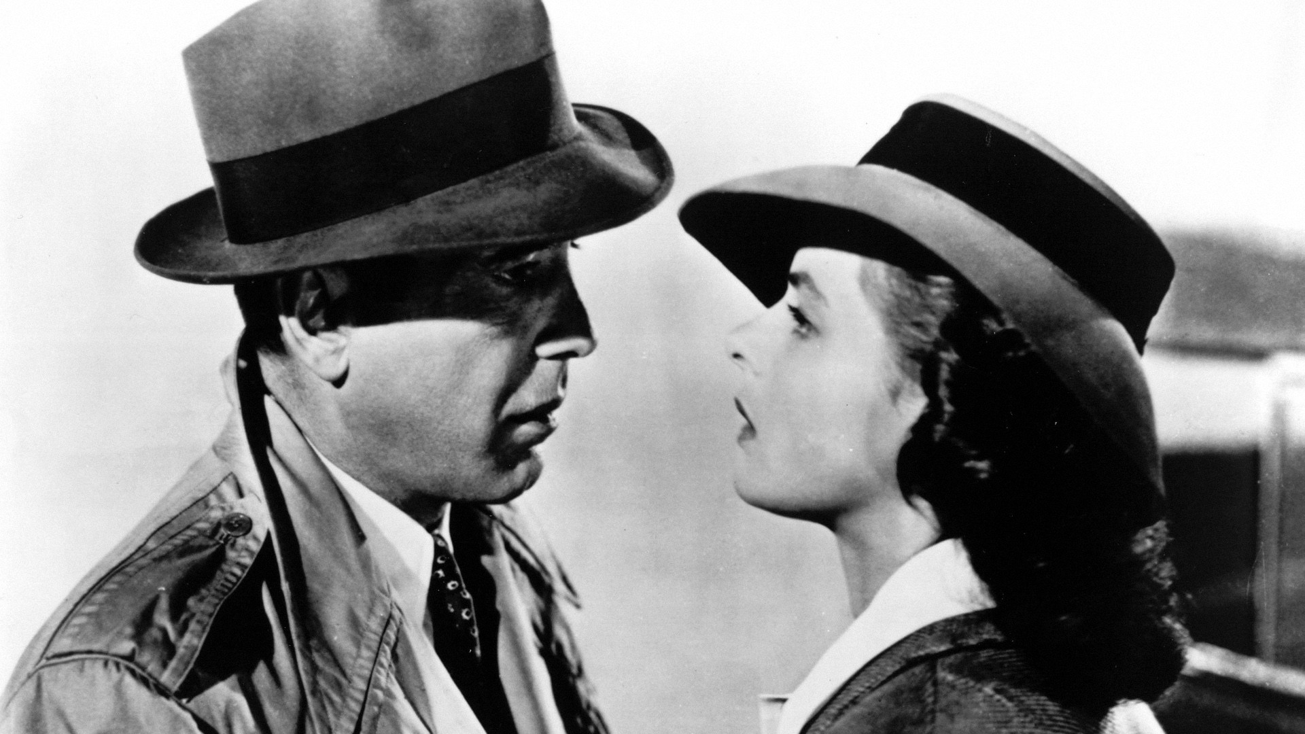
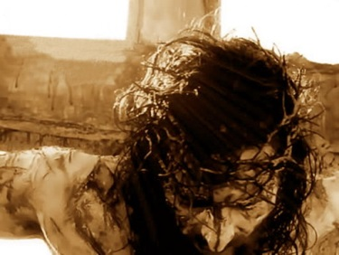
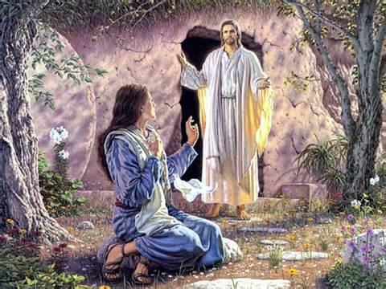
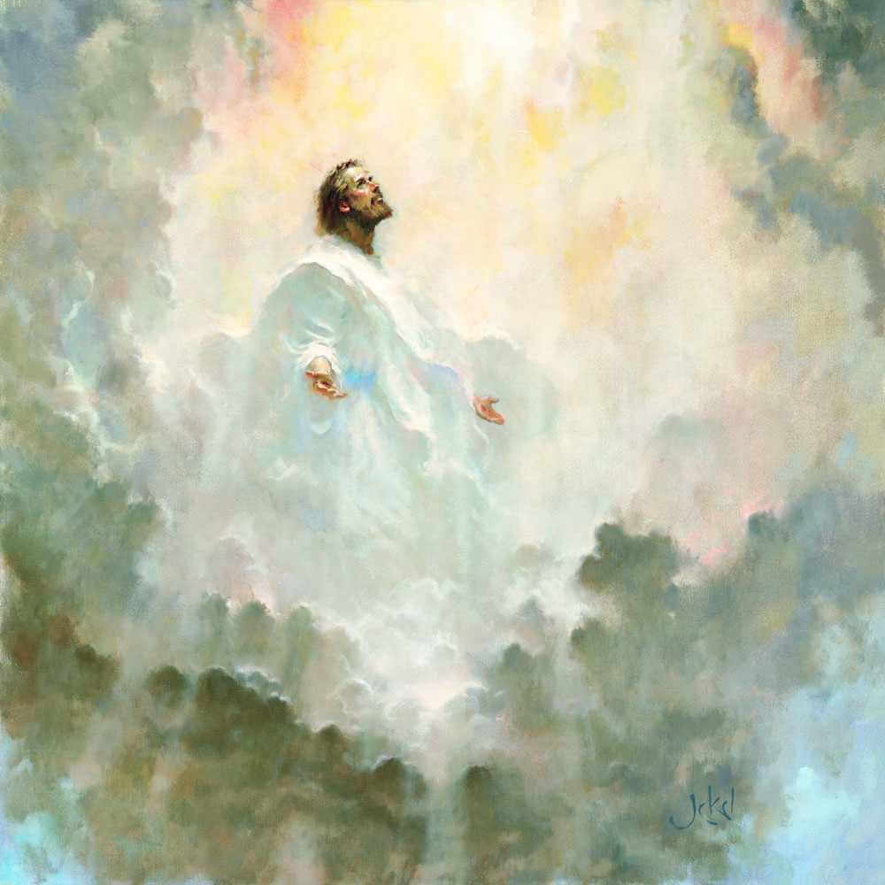

Slide 7
In the beginning was the Word, and the Word was with God, and the Word was God. He was in the beginning with God. All things were made through Him, and without Him nothing was made that was made.
(John 1:1-3)
In the beginning was the Word, and the Word was with God, and the Word was God. He was in the beginning with God. All things were made through Him, and without Him nothing was made that was made.
(John 1:1-3)
In the beginning was the Word, and the Word was with God, and the Word was God. He was in the beginning with God. All things were made through Him, and without Him nothing was made that was made.
(John 1:1-3)
arche
“The beginning of all things”
logos
Intelligence, speech (Jn 1:14, Rev 19:13)

Slide 8
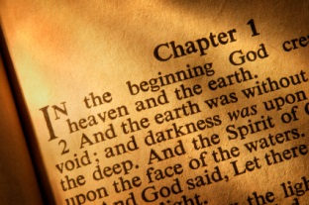
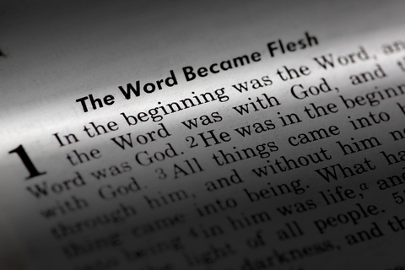
Beginning, then comes forward
Beginning, then goes backward

Slide 9
In the beginning was the Word, and the Word was with God, and the Word was God. He was in the beginning with God. All things were made through Him, and without Him nothing was made that was made.
(John 1:1-3)
In the beginning was the Word, and the Word was with God, and the Word was God. He was in the beginning with God. All things were made through Him, and without Him nothing was made that was made.
(John 1:1-3)
In the beginning was the Word, and the Word was with God, and the Word was God. He was in the beginning with God. All things were made through Him, and without Him nothing was made that was made.
(John 1:1-3)
arche
“The beginning of all things”
The eternal existence of Jesus (Jn 8:57-58)

Slide 10
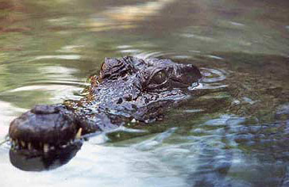
Before the manger Jesus existed as The Word (Philippians 2:6-7)
Before Bethlehem He had “timeless existence” (Jn 8:58; Exod 3:14)
Before John there was Jesus (John 1:30)
Before Galilee there was Heaven (John 6:62)
Before sorrow there was glory (John 17:5)

Slide 11
Jesus: Creation
(John 1:3) “All things were made through Him, and without Him nothing was made that was made.”
(Colossians 1:16-17) “For by Him all things were created that are in heaven and that are on earth, visible and invisible, whether thrones or dominions or principalities or powers. All things were created through Him and for Him. And He is before all things, and in Him all things consist.”
(Hebrews 1:1-2) “God, who at various times and in various ways spoke in time past to the fathers by the prophets, has in these last days spoken to us by His Son, whom He has appointed heir of all things, through whom also He made the worlds”

Slide 12
In the beginning was the Word, and the Word was with God, and the Word was God. He was in the beginning with God. All things were made through Him, and without Him nothing was made that was made.
(John 1:1-3)
In the beginning was the Word, and the Word was with God, and the Word was God. He was in the beginning with God. All things were made through Him, and without Him nothing was made that was made.
(John 1:1-3)
In the beginning was the Word, and the Word was with God, and the Word was God. He was in the beginning with God. All things were made through Him, and without Him nothing was made that was made.
(John 1:1-3)
The eternal existence of Jesus (Jn 8:57-58)
pros
“Face-to-Face”
Distinct from Father

Slide 13
Then God said, let Us make man in Our image, according to Our likeness (Genesis 1:26).;
Then the Lord God said, behold, the man has become like one of Us, to know good and evil (Genesis 3:22).
Come, let Us go down and there confuse their language, that they may not understand one another’s speech. So the Lord scattered them abroad from there over the face of all the earth . . . (Genesis 11:7).

Slide 14
Father
Psa 90:2
Son
Mic 5:2
Is Not
GOD
Deut 6:4
Is
Is
Is Not
Is Not
Is
Spirit
Heb 9:14

Slide 15
In the beginning was the Word, and the Word was with God, and the Word was God. He was in the beginning with God. All things were made through Him, and without Him nothing was made that was made.
(John 1:1-3)
In the beginning was the Word, and the Word was with God, and the Word was God. He was in the beginning with God. All things were made through Him, and without Him nothing was made that was made.
(John 1:1-3)
In the beginning was the Word, and the Word was with God, and the Word was God. He was in the beginning with God. All things were made through Him, and without Him nothing was made that was made.
(John 1:1-3)
In the beginning was the Word, and the Word was with God, and the Word was God. He was in the beginning with God. All things were made through Him, and without Him nothing was made that was made.
(John 1:1-3)
pros
“Face-to-Face”
Distinct from Father
Jn 1:14
God became Human
1 Tim 3:16; Matt 1:23

Slide 16
Jesus came, the doors being shut, and stood in the midst, and said, peace to you! Then He said to Thomas, reach your finger here, and look at My hands; and reach your hand here, and put it into My side. Do not be unbelieving, but believing. And Thomas answered and said to Him, my Lord and my God! (John 20:26-28)
And we know that the Son of God has come and has given us an understanding, that we may know Him who is true; and we are in Him who is true, in His Son Jesus Christ. This is the true God and eternal life. (1 John 5:20)
His Miracles (John 14:11; Matthew 12:22-28; Acts 2:22)
Forgiving Sins (Mark 2:1-11; Luke 23:43; John 8:1-11)
Accepted Worship (Matthew 4:10; Matthew 8:2; John 9:38; John 5:23)
Proving His Deity

Slide 17
What this means to me
Before sin there was a Savior (1 Peter 1:18-20)
His love is a matchless love (John 3:16; Galatians 2:20)
He has the power to save me (Romans 8:31-39)
He has a plan to save me (1 John 4:9-10; Romans 6:3-4)
I will live with Him in Glory (John 14:1-2; Romans 8:24)

