Slide 2
Matthew 16:13-19
¹³ When Jesus came into the region of Caesarea Philippi, He asked His disciples, saying, who do men say that I, the Son of Man, am? ¹⁴ So they said, some say John the Baptist, some Elijah, and others Jeremiah or one of the prophets. ¹⁵ He said to them, but who do you say that I am? ¹⁶ Simon Peter answered and said, You are the Christ, the Son of the living God. ¹⁷ Jesus answered and said to him, blessed are you, Simon Bar-Jonah, for flesh and blood has not revealed this to you, but My Father who is in heaven. ¹⁸ And I also say to you that you are Peter, and on this rock I will build My church, and the gates of Hades shall not prevail against it. ¹⁹ And I will give you the keys of the kingdom of heaven, and whatever you bind on earth will be bound in heaven, and whatever you loose on earth will be loosed in heaven.

Slide 5
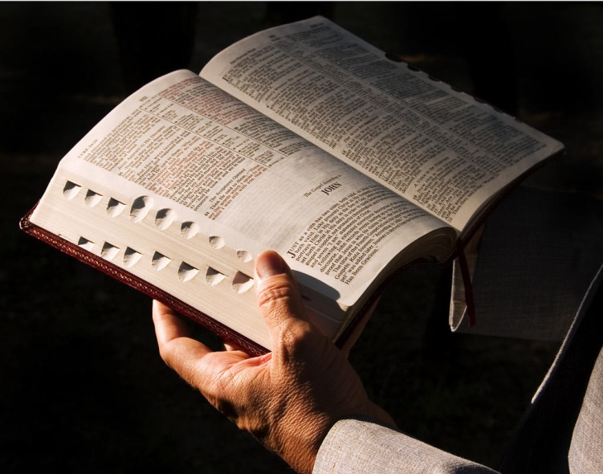
Is the church of Christ
a denomination?
NO
“ . . . on this rock I will build My church” (Matthew 16:18).
“Christ is head of the church” (Ephesians 5:23).
“The churches of Christ greet you” (Romans 16:16).

Slide 6
What is “church”?
Not: A building for public worship, “The little brick church”
Not: A religious worship service, “I’ve been to church this morning”
Not: A particular sect / denomination, “The Church of the Nazarene Church”

Slide 7
What is “church”?
Consider Acts 8:1-4
Ekklesia (an assembly of people—Acts 19:32, 39, 41) “The church (assembly) of Christ (the Lord).” An O.T. equivalent—Numbers 20:4, “the assembly of the Lord.”
The “church of Christ” refers to people who are “called” out of sin and into Christ—collectively they are the church of Christ (He owns them 1 Pet 1:18-19; Acts 20:28)
(Men & Women)

Slide 8
2 Thess 2:14

Slide 9
…Matthew 16:18
Acts 8:1, 39-40

Slide 10
The Church
Antioch
Corinth
1 Cor 12:13
Ephesus
Danville
Brownsburg
Plainfield

Slide 11
What is “denomination”?
DENOMINATION: “A religious organization whose congregations are united in their adherence to its beliefs and practices.”
DENOMINATIONALISM “The emphasizing of denominational differences to the point of being narrowly exclusive.”
A denomination seeks to be a part of the whole—but distinctive from the other parts—exclusive in its name, organization, doctrine.

Slide 12
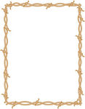
The Church
Catholic
Baptist
SAVED
Lutheran
Methodist
Nazarene
Episcopal

Slide 14
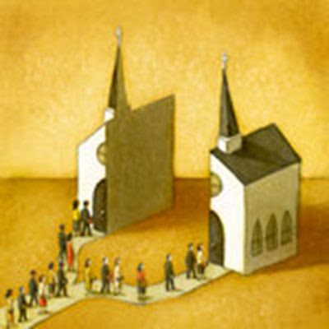
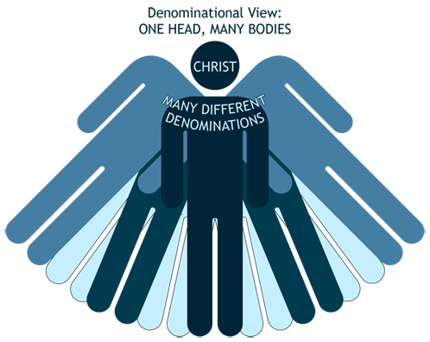
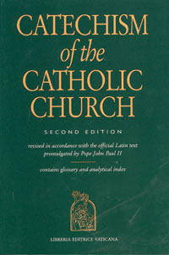
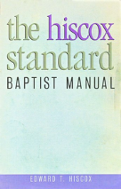
The Bible and denominationalism
Bible calls for unity (Jn 17:20-21; 1 Cor 1:10-12)
Promotes division
Bible says Jesus is the head (Col 1:18)
Promotes freak
Bible says every church teach same (1Cor 4:17)
Different (Gal 1:8)

Slide 15
Bible + Catholic Catechism = Catholic Church
Bible + Nazarene Manuel = Nazarene Church
Bible + Methodist Discipline = Methodist Church
Bible + Book of Mormon = Mormon Church
Bible + Baptist Guide = Baptist Church
Bible + NOTHING = church of Christ (Acts 11:26; Lk 8:11)

