Slide 2
Matthew 4:18-22
¹⁸ And Jesus, walking by the Sea of Galilee, saw two brothers, Simon called Peter, and Andrew his brother, casting a net into the sea; for they were fishermen. ¹⁹ Then He said to them, follow Me, and I will make you fishers of men. ²⁰ They immediately left their nets and followed Him. ²¹ Going on from there, He saw two other brothers, James the son of Zebedee, and John his brother, in the boat with Zebedee their father, mending their nets. He called them, ²² and immediately they left the boat and their father, and followed Him.

Slide 6
Making Disciples of ALL Men
I say to you, lift up your eyes and look at the fields, for they are already white for harvest! (John 4:35)

Slide 7
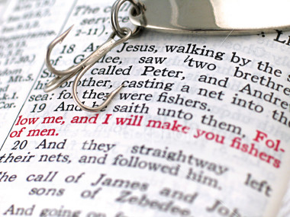
2014

Slide 8
Committed (2 Timothy 1:12)
Patient (Galatians 6:9)
Courageous (Acts 4:19-20)
GO (Matthew 28:19)

