Slide 2
Romans 7:13-20
¹³ Has then what is good become death to me? Certainly not! But sin, that it might appear sin, was producing death in me through what is good, so that sin through the commandment might become exceedingly sinful. ¹⁴ For we know that the law is spiritual, but I am carnal, sold under sin. ¹⁵ For what I am doing, I do not understand. For what I will to do, that I do not practice; but what I hate, that I do. ¹⁶ If, then, I do what I will not to do, I agree with the law that it is good. ¹⁷ But now, it is no longer I who do it, but sin that dwells in me. ¹⁸ For I know that in me (that is, in my flesh) nothing good dwells; for to will is present with me, but how to perform what is good I do not find. ¹⁹ For the good that I will to do, I do not do; but the evil I will not to do, that I practice. ²⁰ Now if I do what I will not to do, it is no longer I who do it, but sin that dwells in me.

Slide 4
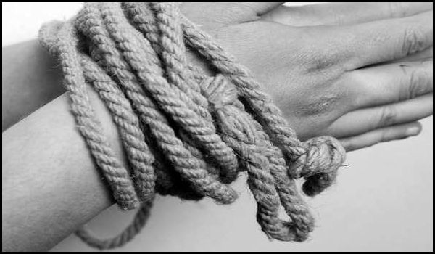
“His own iniquities entrap the wicked man, and he is caught in the cords of his sin.”
(Proverbs 5:22)

Slide 5

“having eyes full of adultery and that cannot cease from sin, enticing unstable souls.”
(2 Peter 2:14)

Slide 6
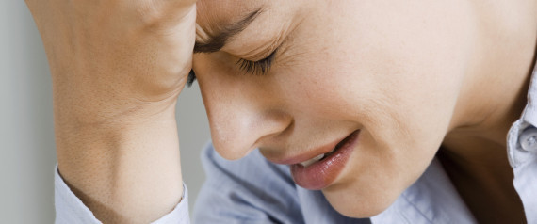
Why Do I Do What I Don’t Want To Do?
A Teenager discovers dad’s files of child porn on the computer!
A wife stumbles upon an email from her husband’s mistress!
A mother comes out of a drunken haze to see the red imprint of her hand on her daughter’s face!
A squad car pulls into the driveway to examine the car after a hit-and-run!

Slide 7
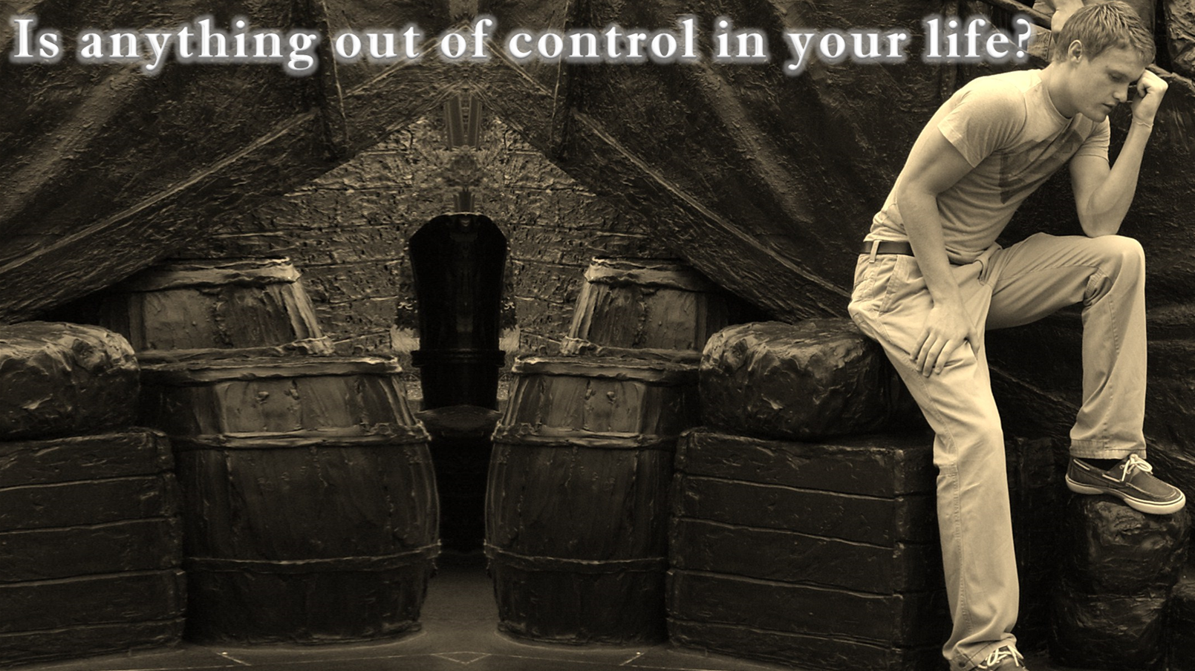
Jealously (Titus 3:3)
Temper (Ephesians 4:31)
Hate (Matthew 5:44)
W/out self-control (2 Timothy 3:3)
We Know These Are Wrong!

Slide 8

For the flesh lusts against the Spirit, and the Spirit against the flesh; and these are contrary to one another, so that you do not do the things that you wish
(Galatians 5:17)
For what I am doing, I do not understand. For what I will to do, that I do not practice; but what I hate, that I do.
(Romans 7:15)
O wretched man that I am! Who will deliver me from this body of death?
(Romans 7:24)

Slide 9
Why Do I Do What I Don’t Want To Do?
Failure to Take Responsibility for Choices / Behavior
Accepting the “Forbidden Fruit Disorder”

Slide 10
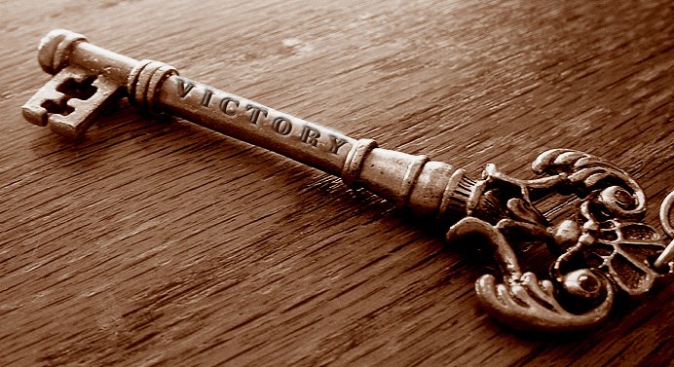
(John 8:32) You shall know the truth . . .
But the truth will hurt first!
Admit / Confess—Rom 7:13
Surrender Mind—2 Cor 10:5
Think Spiritual—Phil 4:8
Watch & Pray—Matt 26:41

Slide 11

Surely His salvation is near to those who fear Him, that glory may dwell in our land. Mercy and truth have met together; righteousness and peace have kissed.
(Psalm 85:9-10)

