Slide 2
1 Samuel 8:1-9
¹ Now it came to pass when Samuel was old that he made his sons judges over Israel. ² The name of his firstborn was Joel, and the name of his second, Abijah; they were judges in Beersheba. ³ But his sons did not walk in his ways; they turned aside after dishonest gain, took bribes, and perverted justice. ⁴ Then all the elders of Israel gathered together and came to Samuel at Ramah, ⁵ and said to him, look, you are old, and your sons do not walk in your ways. Now make us a king to judge us like all the nations. ⁶ But the thing displeased Samuel when they said, give us a king to judge us. So Samuel prayed to the Lord. ⁷ And the Lord said to Samuel, heed the voice of the people in all that they say to you; for they have not rejected you, but they have rejected Me, that I should not reign over them. ⁸ According to all the works which they have done since the day that I brought them up out of Egypt, even to this day—with which they have forsaken Me and served other gods—so they are doing to you also. ⁹ Now therefore, heed their voice. However, you shall solemnly forewarn them, and show them the behavior of the king who will reign over them.

Slide 4
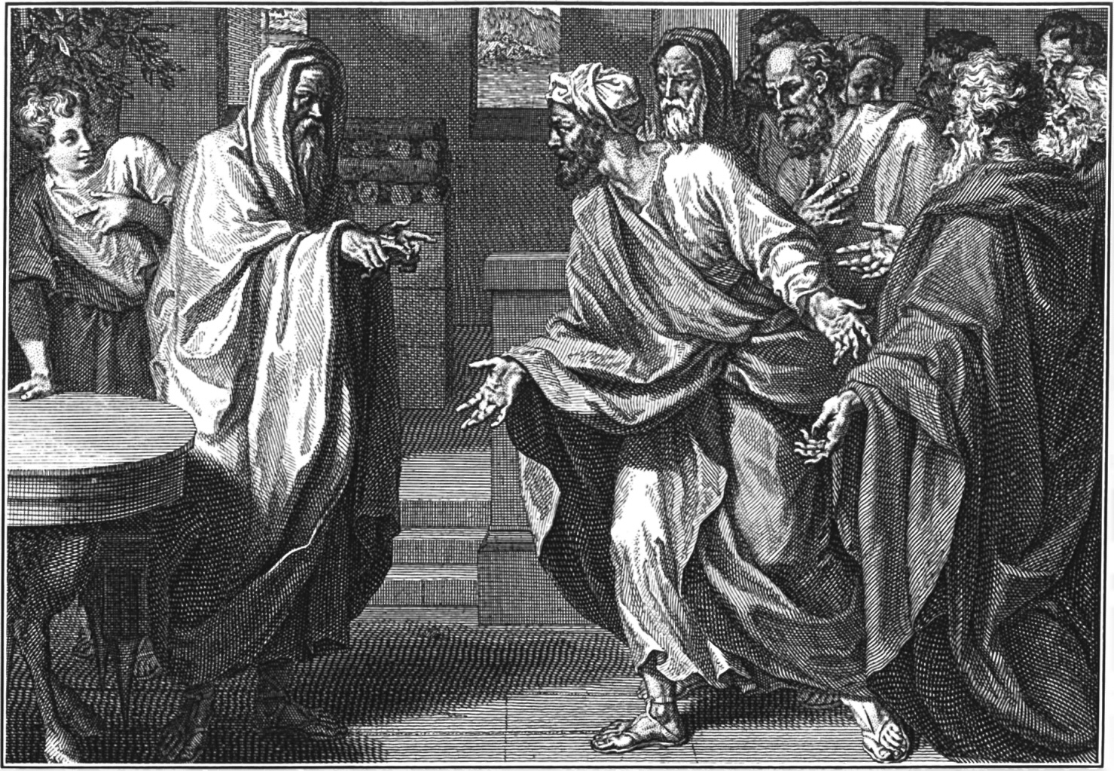
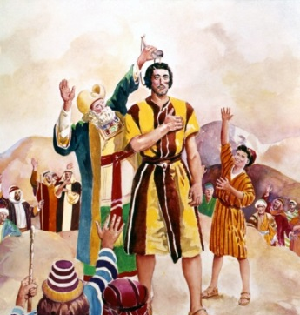
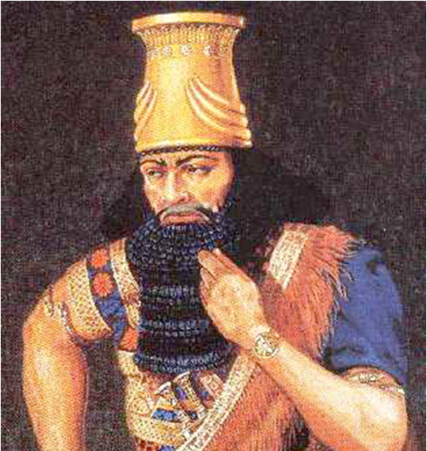
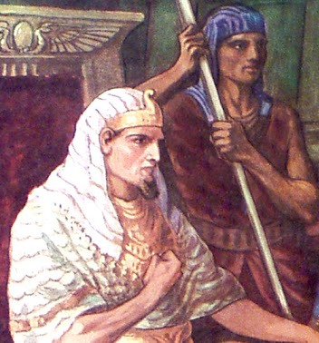
And the Lord said to Samuel, heed the voice of the people in all that they say to you; for they have not rejected you, but they have rejected Me, that I should not reign over them, (1 Samuel 8:7).
“Look, you are old, and your sons do not walk in your ways. Now make us a king to judge us like all the nations”
(1 Samuel 8:5).
Israel
Ammon
Syria
Egypt

Slide 5
Be Careful For What You Ask!
Draft your Sons (1 Sam 8:11)
Force Daughters to Work (vs. 13)
Confiscate Best Lands (vs. 14)
Take the Best Men/Women (vs. 16)
Heavy Tax on Everything (vs. 17)
They wanted a “Man of War” (1 Sam 8:20)
Biggest & Baddest In Israel (1 Sam 9:2)
Immediately Went to War (1 Sam 11)
Saul was a disappointment from the beginning

Slide 6
Be Careful For What You Ask!
Matt 19:16 -- Now behold, one came and said to Him, good Teacher, what good thing shall I do that I may have eternal life?
Matt 19:17 -- But if you want to enter into life, keep the commandments.
Matt 19:20 -- The young man said to Him, all these things I have kept from my youth. What do I still lack?
Matt 19:21 -- Jesus said to him, if you want to be perfect, go, sell what you have and give to the poor, and you will have treasure in heaven; and come, follow Me.
Matt 19:22 -- But when the young man heard that saying, he went away sorrowful, for he had great possessions.
More than he bargained for!

Slide 7
Be Careful For What You Ask!
“O Lord give
me patience.”
We might just get the trials to produce the patience for which we pray (James 1:2-3).

Slide 8
Be Careful For What You Ask!
Some are seeking husbands or wives using the standards of the world!

Slide 9
Be Careful For What You Ask!
Some are seeking to raise their children to be “like” the other children in the world!

Slide 10
Be Careful For What You Ask!
Some seek to acquire all the things that others have!
You just might get it!

