Slide 2
Matthew 18:1-5
¹ At that time the disciples came to Jesus, saying, who then is greatest in the kingdom of heaven? ² Then Jesus called a little child to Him, set him in the midst of them, ³ and said, assuredly, I say to you, unless you are converted and become as little children, you will by no means enter the kingdom of heaven. ⁴ Therefore whoever humbles himself as this little child is the greatest in the kingdom of heaven. ⁵ Whoever receives one little child like this in My name receives Me.

Slide 4
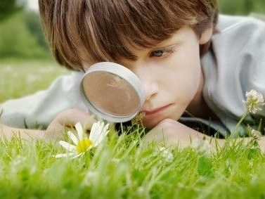
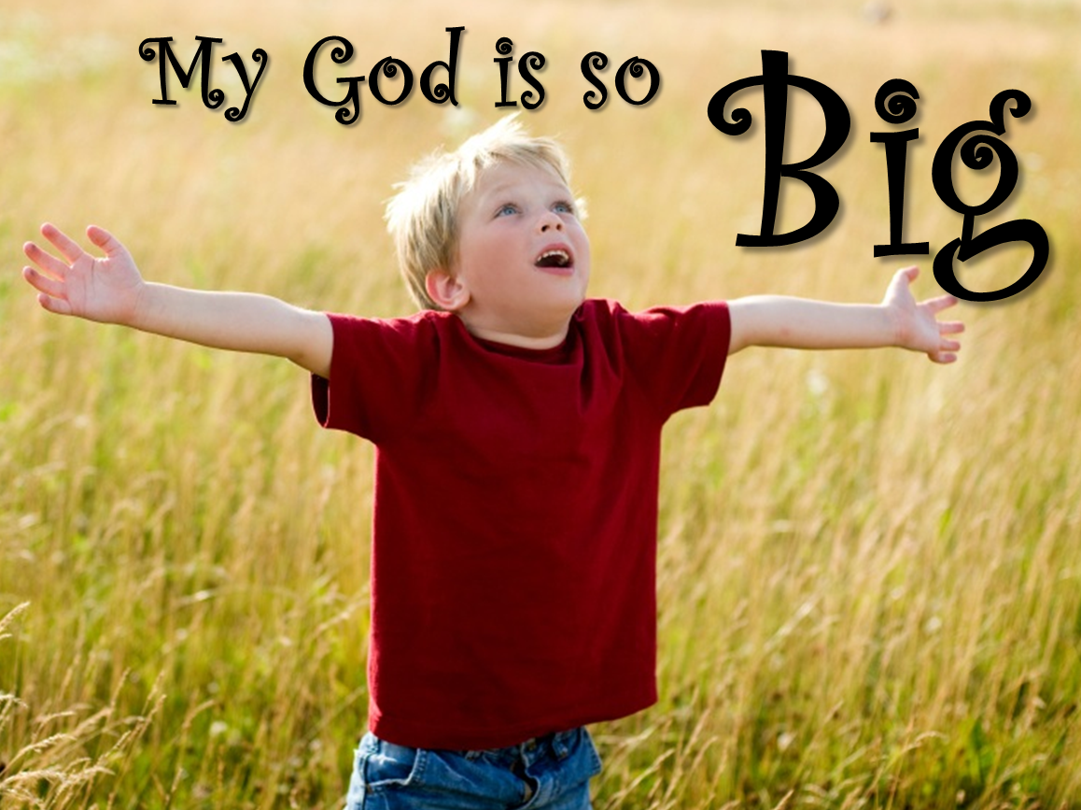
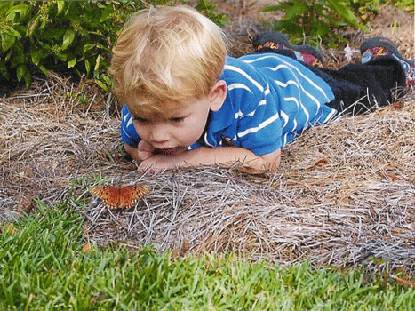
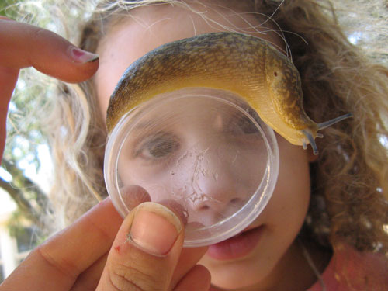
“Assuredly, I say to you, unless you are converted and become as little children, you will by no means enter the kingdom of heaven”
(Matthew 18:3).

Slide 5
1 John 4:4
Isaiah 29:14
Acts 2:22
Acts 3:10

Slide 6
“. . . I am not ashamed, for I know whom I have believed and am persuaded that He is able to keep what I have committed to Him until that day,”
(2 Timothy 1:12).
“. . . I am not ashamed, for I know whom I have believed and am persuaded that He is able to keep what I have committed to Him until that day,”
(2 Timothy 1:12).
“. . . I am not ashamed, for I know whom I have believed and am persuaded that He is able to keep what I have committed to Him until that day,”
(2 Timothy 1:12).
“. . . I am not ashamed, for I know whom I have believed and am persuaded that He is able to keep what I have committed to Him until that day,”
(2 Timothy 1:12).

Slide 7
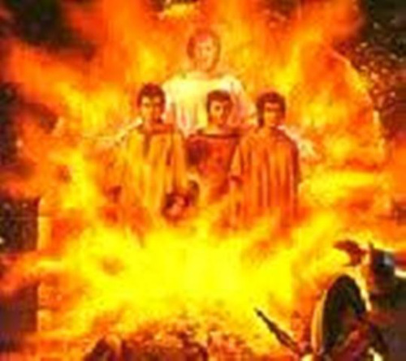
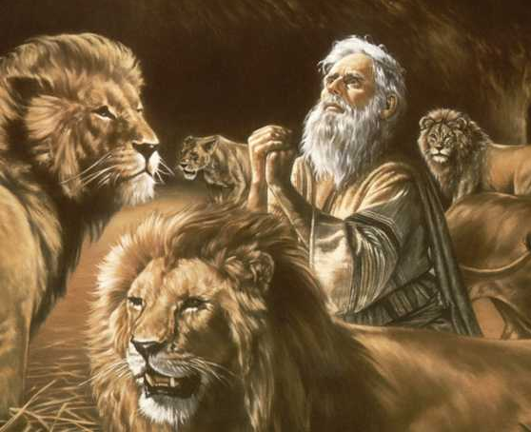
“. . . I know whom I have believed and am persuaded that He is able to keep what I have committed to Him until that day,”
(2 Timothy 1:12).

Slide 8
Therefore do not worry, saying, what shall we eat? or what shall we drink? or what shall we wear? For after all these things the Gentiles seek. For your heavenly Father knows that you need all these things. But seek first the kingdom of God and His righteousness, and all these things shall be added to you. Therefore do not worry about tomorrow, for tomorrow will worry about its own things. Sufficient for the day is its own trouble.
Matthew 6:31-34

Slide 9
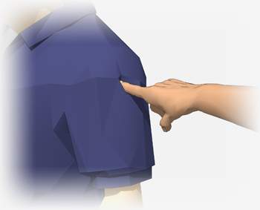
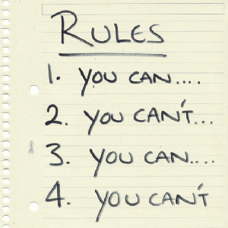

Slide 10
The Faith
of a Child

