Slide 2
John 12:20-26
²⁰ Now there were certain Greeks among those who came up to worship at the feast. ²¹ Then they came to Philip, who was from Bethsaida of Galilee, and asked him, saying, sir, we wish to see Jesus. ²² Philip came and told Andrew, and in turn Andrew and Philip told Jesus. ²³ But Jesus answered them, saying, the hour has come that the Son of Man should be glorified. ²⁴ Most assuredly, I say to you, unless a grain of wheat falls into the ground and dies, it remains alone; but if it dies, it produces much grain. ²⁵ He who loves his life will lose it, and he who hates his life in this world will keep it for eternal life. ²⁶ If anyone serves Me, let him follow Me; and where I am, there My servant will be also. If anyone serves Me, him My Father will honor.
sir, we wish to see Jesus

Slide 4
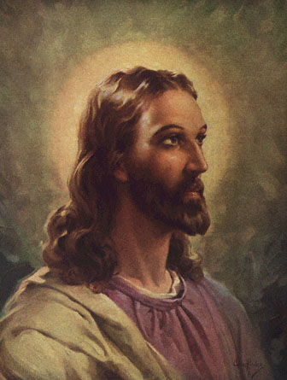
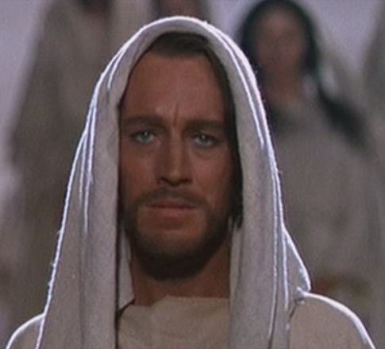
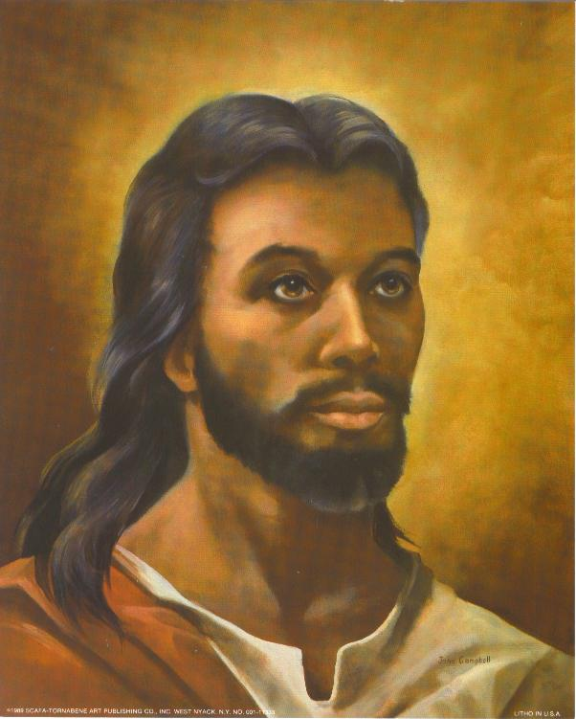
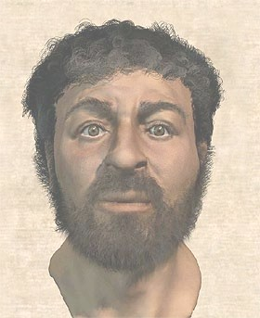
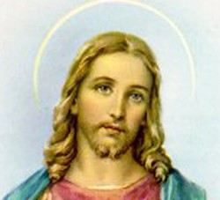
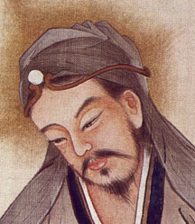
Scandinavian | Hispanic | African | Asian
“He is a tall man, well shaped and of an amiable and reverend aspect; his hair is of a color that can hardly be matched, falling into graceful curls . . . parted on the crown of his head, running as a stream to the front after the fashion of the Nazarites; his forehead high, large and imposing; his cheeks without spot or wrinkle, beautiful with a lovely red; his nose and mouth formed with exquisite symmetry; his beard, and of a color suitable to his hair, reaching below his chin and parted in the middle like a fork; his eyes bright blue, clear and serene . . .”

Slide 5
God With Us
Friend of Sinners
Expression of Love

