Slide 2
Psalms 39:1-7
¹ I said, I will guard my ways, lest I sin with my tongue; I will restrain my mouth with a muzzle, while the wicked are before me. ² I was mute with silence, I held my peace even from good; and my sorrow was stirred up. ³ My heart was hot within me; while I was musing, the fire burned. Then I spoke with my tongue: ⁴ Lord, make me to know my end, and what is the measure of my days, that I may know how frail I am. ⁵ Indeed, You have made my days as handbreadths, and my age is as nothing before You; certainly every man at his best state is but vapor. Selah ⁶ Surely every man walks about like a shadow; surely they busy themselves in vain; he heaps up riches, and does not know who will gather them. ⁷ And now, Lord, what do I wait for? My hope is in You.

Slide 4
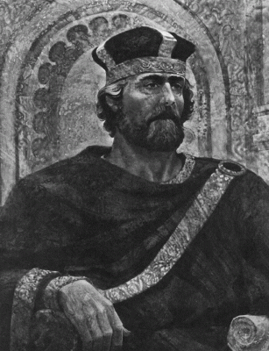
King David’s Dark Reflections
Sin (2 Sam 11:1-27)
Censure (2 Sam 12:1-12)
Remorse (2 Sam 12:13)
Consequences (2 Sam 12:10)
Pierced (Psa 38:2)
Sick (Psa 38:3)
Troubles (Psa 38:6)
Distressed (Psa 38:8)
Abandoned (Psa 38:11)
Enemies seek him (Psa 38:12)
Grieves over his sin (Psa 38:18)
Refuses to cry out (Psa 39:1-2)
His reflections lit a fire (Psa 39:3)

Slide 5
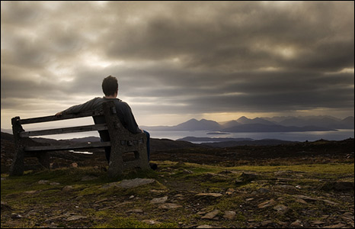
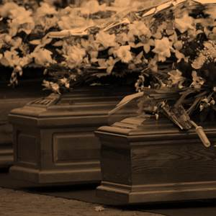
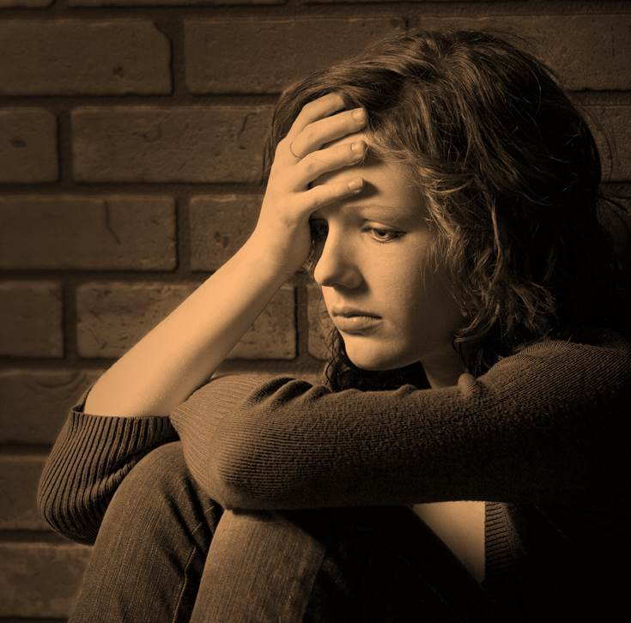
Funerals
Troubles

Slide 6
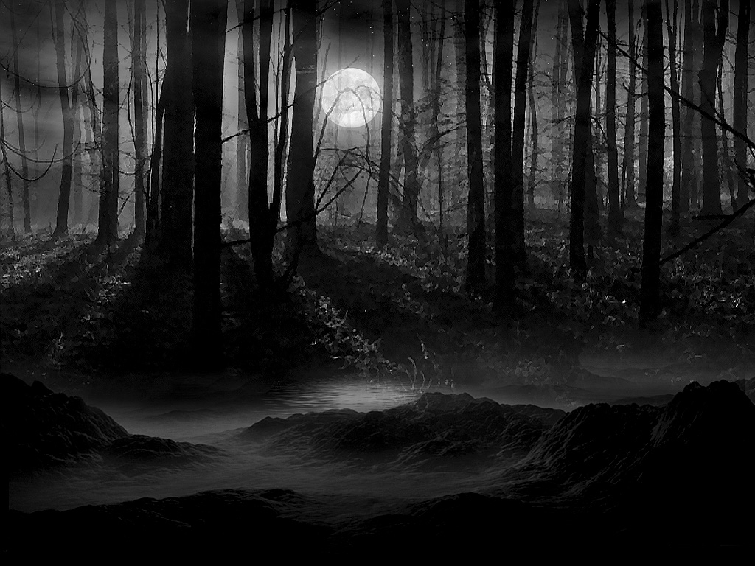
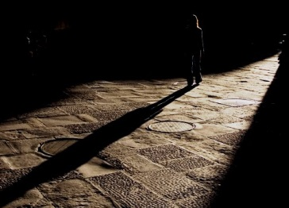
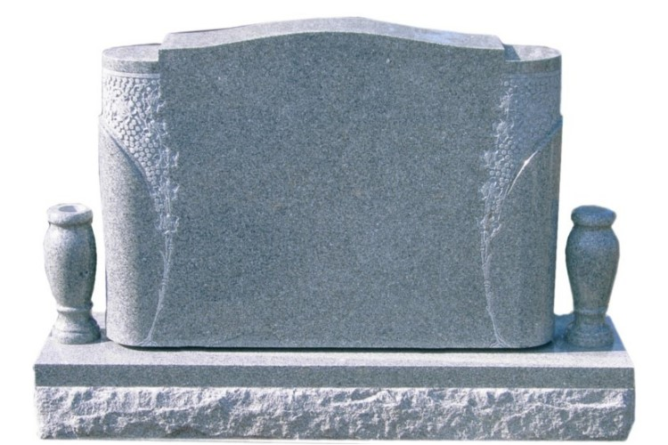
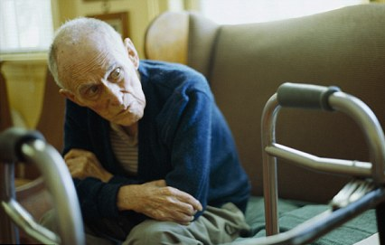
4 Lord, make me to know my end, and what is the measure of my days, that I may know how frail I am.
5 Indeed, You have made my days as handbreadths, and my age is as nothing before You; certainly every man at his best state is but vapor.
6 Surely every man walks about like a shadow; surely they busy themselves in vain; He heaps up riches, and does not know who will gather them.
7 And now, Lord, what do I wait for? My hope is in You.
Psalm 39:
Disappointments
Sorrows
Frailty
of Life
Certainty
of
Death
Come unto Me
Matt 11:28

Slide 7
What are YOU waiting for?
But God be thanked that though you were slaves of sin, yet you obeyed from the heart that form of doctrine to which you were delivered. And having been set free from sin, you became slaves of righteousness.
Romans 6:17-18

