Slide 2
Galatians 1:6-10
⁶ I marvel that you are turning away so soon from Him who called you in the grace of Christ, to a different gospel, ⁷ which is not another; but there are some who trouble you and want to pervert the gospel of Christ. ⁸ But even if we, or an angel from heaven, preach any other gospel to you than what we have preached to you, let him be accursed. ⁹ As we have said before, so now I say again, if anyone preaches any other gospel to you than what you have received, let him be accursed. ¹⁰ For do I now persuade men, or God? Or do I seek to please men? For if I still pleased men, I would not be a bondservant of Christ.

Slide 4
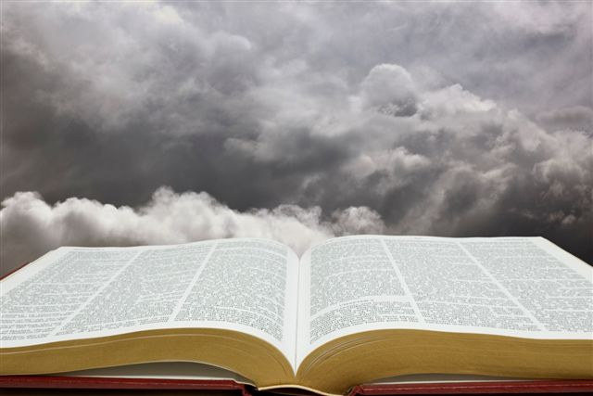
Authority for All Things
Direct
Statements
Examples to
Follow
Forced
Conclusions
Commands to Follow (“This do” 1 Cor 11:25)
Prohibitions (“Abstain from fleshly lusts” 1 Pet 2:11)
Affirmatives to Respect (“He who believes and is baptized will be saved” Mk 16:16)
Divinely Approved Examples
(“Brethren, join in following my example, and note those who so walk, as you have us for a pattern” Phil 3:17)
Necessary Inferences
(“For the priesthood being changed, of necessity there is also a change of the law . . . For it is evident that our Lord arose from Judah . . .” Heb 7:12-14)
Heb 8:5
For He said, see that you make all things according to the pattern shown you on the mountain.

Slide 5
Luke 22:7 ~ Unleavened Bread
Luke 22:18 ~ Fruit of the Vine Luke 22:19 Do this . . .
Acts 20:7 ~ First Day of Week
1 Cor 11:26 ~ For as Often . . .
What about Cups, Plates, Servers,
Where is the authority for these?
Churches of Christ practice the weekly observance of the Lord’s Supper consisting of unleavened bread and fruit of the vine.
Why? By what authority is it done?

Slide 6
Eph 5:19 ~ Singing
Col 3:16 ~ Psalms, Hymns & Spiritual Songs
Acts 16:25 ~ Singing Hymns
1 Cor 14:15 ~ Sing w/ the spirit
What about Books, pitch pipes, Song Leaders,
Where is the authority for these?
Churches of Christ participate in a cappella singing.
Why? By what authority is it done?

Slide 7
Authority for all Things
All Bible authority will be either specific or generic or it could be both. It is absolutely crucial that we understand the difference between specific and generic authority.
SPECIFIC
Constituting or falling into a specifiable category.
Restricted to a particular individual, situation, relation, or effect.
When God has been SPECIFIC or when He has SPECIFIED – no one can change any peculiar detail!

Slide 8
Authority for all Things
All Bible authority will be either specific or generic or it could be both. It is absolutely crucial that we understand the difference between specific and generic authority.
Genesis 6
Build an ark of gopher wood
Length-300 cubits
Width-50 cubits
Height-30 cubits
Three stories/decks
301 Cubits
Oak
Specific
49 Cubits
Hickory
4 Decks
Balsa

Slide 9
Authority for all Things
All Bible authority will be either specific or generic or it could be both. It is absolutely crucial that we understand the difference between specific and generic authority.
Generic
Characteristic of a whole group or class.
General.
Having no particularly distinctiveness.
When God has NOT specified or when He has NOT been restrictive– then we can employ an aid (help) to facilitate our obedience.

Slide 10
Authority for all Things
All Bible authority will be either specific or generic or it could be both. It is absolutely crucial that we understand the difference between specific and generic authority.
Gopher Wood
300 cubits
50 cubits
30 cubits
3 stories/decks
Hammers
Different Wood
Buckets
Life Boat
Ladders
Scaffolding
Change Size

Slide 11
Authority for all Things
All Bible authority will be either specific or generic or it could be both. It is absolutely crucial that we understand the difference between specific and generic authority.
Ibuprofen is in a group of drugs called nonsteroidal anti-inflammatory drugs.
Advil
Tylenol
Motrin
Midol
Aspirin
Nuprin
Xanax

Slide 12
Authority for all Things
All Bible authority will be either specific or generic or it could be both. It is absolutely crucial that we understand the difference between specific and generic authority.
Lord’s Supper
Unleavened Bread & Fruit of the Vine
Each Sunday
Peanut Butter
Plates
Containers
Nehi Orange
Servers
Saturday
Time

Slide 13
Authority for all Things
All Bible authority will be either specific or generic or it could be both. It is absolutely crucial that we understand the difference between specific and generic authority.
Music
Singing Psalms, Hymns & Spiritual Songs
Making melody w/in Heart
Getting Pitch
Pianos
Books
Leaders
Organs
Instruments
Parts

Slide 14
Authority for all Things
All Bible authority will be either specific or generic or it could be both. It is absolutely crucial that we understand the difference between specific and generic authority.
Matt 28:19
Make Disciples of all nations
Baptizing in the name of Father, Son and Holy Spirit
Automobile
Not Going
Plane
Not Baptizing
Walking
Social Gospel
Internet

Slide 15
Authority for all Things
All Bible authority will be either specific or generic or it could be both. It is absolutely crucial that we understand the difference between specific and generic authority.
Hebrews 10:25
Assembling Together
Worship
Edify
Work
Outside
Not Assembling
Private Home
Politics
Rented Building
Basketball
Purchased Building

Slide 16
Authority for all Things
Generic Authority:
always allows for expediencies
EXPEDIENCY
“Suitable for achieving a particular end in a given circumstance.”
Remember: An expediency advances the obedience of that which is authorized.
ADDITION
“to join or unite so as to bring about an increase.”
Remember: An addition is always MORE than what is authorized.

Slide 17
Authority for all Things
Difference between an expediency & an addition
Gal 1:6-7
I marvel that you are turning away so soon from Him who called you in the grace of Christ, to a different gospel, which is not another; but there are some who trouble you and want to pervert the gospel of Christ.
Different = Another = Perversion
Commandment | Expediencies | Another/Addition
Eph 5:19 Books, Parts Piano, Guitar
Acts 20:7 Cups, Plates Saturday
Eph 4:12 Classes, Pulpit SS Organization
Heb 13:15 Kneel, Sit Beads, Candles
1 Cor 16:1-2 Checks, Cash Wednesday

Slide 18
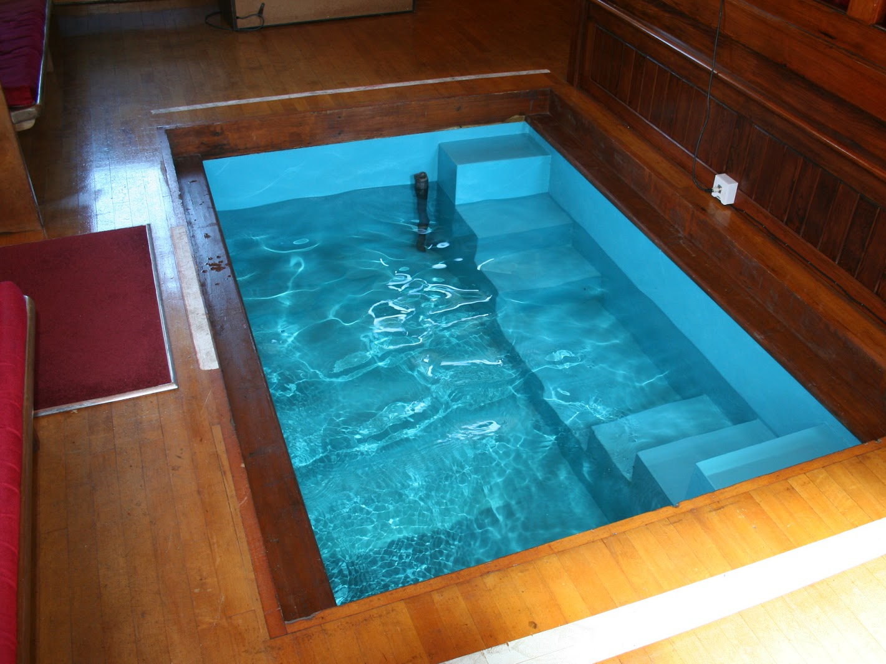
Authority for all Things
Authority for all Things
Expediencies Always Involve Human Judgment
What is being aided must first be authorized (Mk 16:16)
The expedient must not be specified (Not Mentioned)
An expedient must actually facilitate (Assist & Simplify)
Expedients must not violate one’s conscience (1 Cor 8:13)
An addition cannot be an expedient (Sprinkling)

Slide 19
An Investigation of Authority!
Our Next Study,
What about
when God says
NOTHING?

