Slide 2
2 Timothy 2:14-19
¹⁴ Remind them of these things, charging them before the Lord not to strive about words to no profit, to the ruin of the hearers. ¹⁵ Be diligent to present yourself approved to God, a worker who does not need to be ashamed, rightly dividing the word of truth. ¹⁶ But shun profane and idle babblings, for they will increase to more ungodliness. ¹⁷ And their message will spread like cancer. Hymenaeus and Philetus are of this sort, ¹⁸ who have strayed concerning the truth, saying that the resurrection is already past; and they overthrow the faith of some. ¹⁹ Nevertheless the solid foundation of God stands, having this seal: The Lord knows those who are His, and, let everyone who names the name of Christ depart from iniquity.

Slide 4
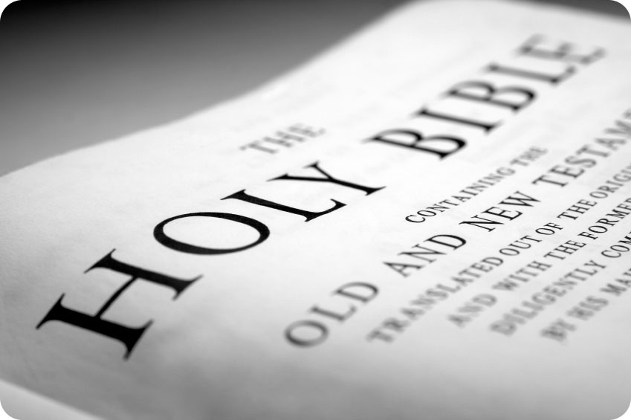
Esteeming the Word of God
Handle the Bible so that it fits together the way God intends!
orthotomeoô
Thayer Definition:
1) to cut straight,
1a) to proceed on straight paths, hold a straight course,
2) to make straight and smooth, to handle aright, to teach the truth directly and correctly
2 Tim 2:15
Be diligent to present yourself approved to God, a worker who does not need to be ashamed, rightly dividing the word of truth.

Slide 5
Build According to the Pattern
Heb 8:5
For He said, see that you make all things according to the pattern shown you on the mountain.
2 Tim 1:13
Hold fast the pattern of sound words which you have heard from me, in faith and love which are in Christ Jesus.
1Thess 2:13
For this reason we also thank God without ceasing, because when you received the word of God which you heard from us, you welcomed it not as the word of men, but as it is in truth, the word of God, which also effectively works in you who believe.
1 Pet 4:11
If anyone speaks, let him speak as the oracles of God.

Slide 6
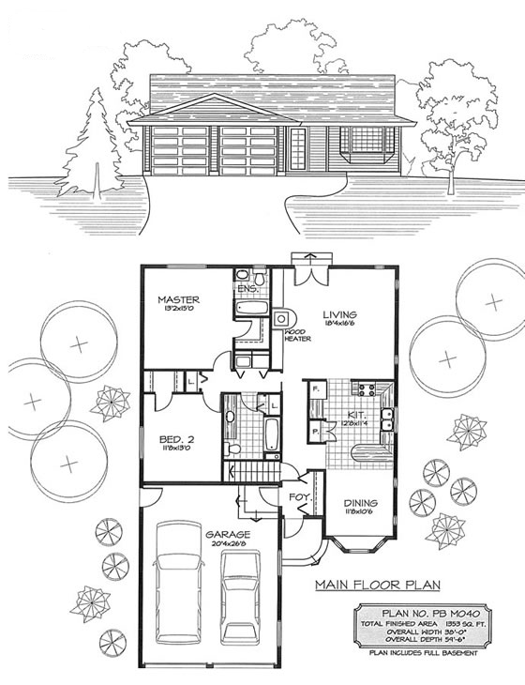
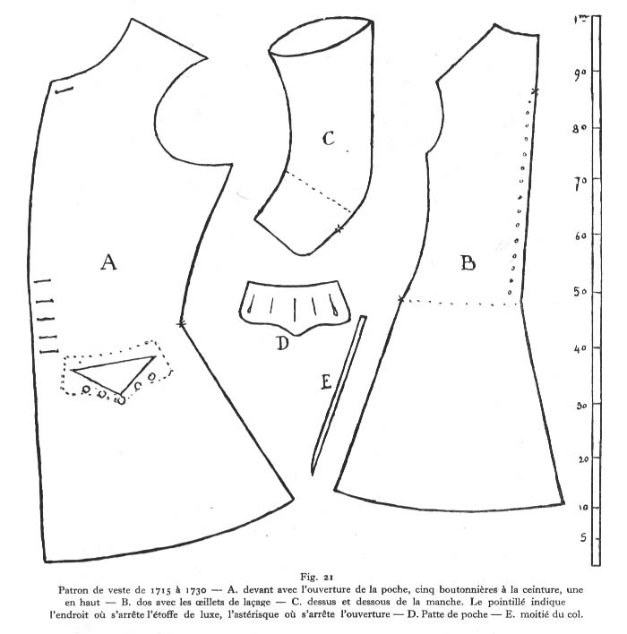
Build According to the Pattern
Heb 8:5
For He said, see that you make all things according to the pattern shown you on the mountain.
tupos
The mark of a stroke or blow, print; a figure formed by a blow or impression. An example; in the technical sense, the pattern in conformity to which a thing must be made.

Slide 7
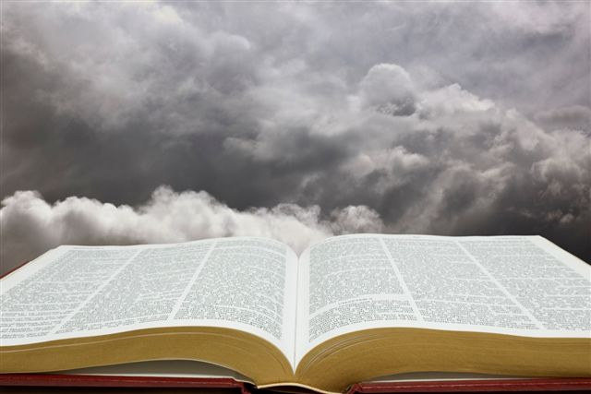
Build According to the Pattern
Direct
Statements
Examples to
Follow
Forced
Conclusions
Commands to Follow (“This do” 1 Cor 11:25)
Prohibitions (“Abstain from fleshly lusts” 1 Pet 2:11)
Affirmatives to Respect (“He who believes and is baptized will be saved” Mk 16:16)
Divinely Approved Examples
(“Brethren, join in following my example, and note those who so walk, as you have us for a pattern” Phil 3:17)
Necessary Inferences
(“For the priesthood being changed, of necessity there is also a change of the law . . . For it is evident that our Lord arose from Judah . . .” Heb 7:12-14)

Slide 8
Build According to the Pattern
Jesus & Apostles/Prophets have given direct statements,
Jesus & Apostles/Prophets have given divinely approved examples we must follow:
Phil 3:17; Phil 4:9; 1 Cor 11:1
Unless there is compelling evidence in the text to disregard approved examples, we must regard them to be authoritative.
Affirmatives to Respect:
Mk 16:16; Matt 10:37-38; Lk 10:16
Prohibitions to Avoid:
1 Pet 2:11; 1 Thess 4:3; 1 Thess 5:22
Commands to Follow:
Jn 14:15; 1 Cor 11:25; Eph 5:19; 2 Pet 3:1-2

Slide 9
What is a Binding Example?
No Example is Binding:
“We say again without reservation: Divine law is not (never) established by human example.”
All Examples are Binding:
“If so much as one example is bound, then every approved example must then be bound today!”
IF NO EXAMPLE IS BINDING, THEN . . .
Elders are not to be appointed in every church ~ Ac 14:23
Baptism is not immediate ~ Ac 16:33
Not obligated to become all things ~ 1 Cor 9:22
No weekly observance of Lord’s Supper ~ Ac 20:7
IF EVERY EXAMPLE IS BINDING, THEN . . .
Can teach only in schools owned by men named Tyrannus ~ Ac 19:9
Only meet for prayer & preaching in an upper room ~ Ac 1:13-15
We must only and always kneel for prayer ~ Ac 20:36

Slide 10
What Example is Binding?
The actions of any example must be consistent with other undisputed Scriptural teaching ~ (The “example” of Gal 2:11-14 is not consistent with Jas 2:1, 9)
Uniformity in essential details must be present in any example for the action involved to be considered binding ~ (Christians met in various facilities: Houses Rom 16:5; Schools, Ac 19:9: Unidentified buildings, 1 Cor 11:33-34; Outside, Ac 16:13; Upper room, Ac 20:8)
No example of action can be binding when it cannot be universally applied ~ (Traveled by ship, Ac 27:1, but there are places one cannot travel by ship)
It must be an “example” and not an “explanation.” Example: “One that serves as a pattern to be imitated or not to be imitated.” Explanation: “A statement clarifying one's conduct.”

Slide 11
What Example is Binding?
Acts 20:7-9
Now on the first day of the week, when the disciples came together to break bread, Paul, ready to depart the next day, spoke to them and continued his message until midnight.
There were many lamps in the upper room where they were gathered together.
And in a window sat a certain young man named Eutychus, who was sinking into a deep sleep. He was overcome by sleep; and as Paul continued speaking, he fell down from the third story and was taken up dead.
A PATTERN for obeying Matthew 26:26-29
An EXPLANATION of the events pertaining to Eutychus.

Slide 12
Build According to the Pattern
Jesus & Apostles/Prophets have given direct statements,
Jesus & Apostles/Prophets have given divinely approved examples we must emulate:
Jesus & Apostles/Prophets expect us to reach necessary (logically unavoidable) inferences (conclusions) from what is revealed:
Matt 11:3-5; Matt 22:23-33; Heb 7:12-14
Necessary Inferences must be conclusions that are logically unavoidable.

Slide 13
Respecting Necessary Inferences
“I firmly believe that the
binding of conclusions through
the use of Necessary Inference
is the cause of the misunderstanding
of Bible Authority and thus division.”
If Bible authority is not authorized by necessary inference then the Bible does not authorize any action from individuals today. Because there are no explicitly addressed statements to you or me.
Is this statement: “I firmly believe that the binding of conclusions through the use of Necessary Inference is the cause of the misunderstanding of Bible Authority and thus division” an explicit statement from the Bible or is it an inference he has drawn?
"J.R. must be baptized."

Slide 14
Respecting Necessary Inferences
The Existence of God is known by means of Necessary Inference ~ Ac 14:15-17; Rom 1:20
Cain’s rejected sacrifice is understood by means of Necessary Inference ~ Gen 4:1-7; Heb 11:4; Rom 10:17
Children’s innocence is known by means of Necessary Inference ~ Ezek 18:20; Matt 19:14
Knowing the possibility of “falling from grace” is understood by means of Necessary Inference ~ Gal 5:4
The innocent’s right to remarry is known by means of Necessary Inference ~ Matt 19:9

Slide 15
Luke 22:19 ~ And He took bread, gave thanks and broke it, and gave it to them, saying, this is My body which is given for you; do this in remembrance of Me.
Command!
Acts 20:7 ~ Now on the first day of the week, when the disciples came together to break bread . . .
Example!
1 Cor 11:26 ~ For as often as you eat this bread and drink this cup, you proclaim the Lord's death till He comes.
N. I.
Churches of Christ practice the weekly observance of the Lord’s Supper.
Why? By what authority is it done?

Slide 16
Eph 5:19 ~ Speaking to one another in psalms and hymns and spiritual songs, singing and making melody in your heart to the Lord.
Command!
Acts 16:25 ~ But at midnight Paul and Silas were praying and singing hymns to God . . .
Example!
1 Cor 14:15 ~ I will sing with the spirit, and I will also sing with the understanding.
N. I.
Churches of Christ participate in a cappella singing.
Why? By what authority is it done?

Slide 17
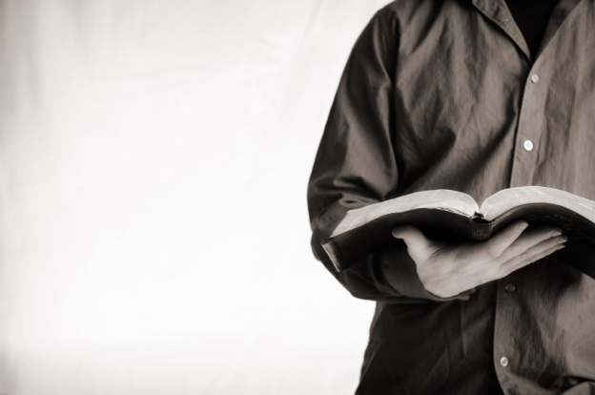
An Investigation of Authority!
Our Next Study,
Generic
&
Specific

