Slide 2
2 John 7-11
⁷ For many deceivers have gone out into the world who do not confess Jesus Christ as coming in the flesh. This is a deceiver and an antichrist. ⁸ Look to yourselves, that we do not lose those things we worked for, but that we may receive a full reward. ⁹ Whoever transgresses and does not abide in the doctrine of Christ does not have God. He who abides in the doctrine of Christ has both the Father and the Son. ¹⁰ If anyone comes to you and does not bring this doctrine, do not receive him into your house nor greet him; ¹¹ for he who greets him shares in his evil deeds.

Slide 4
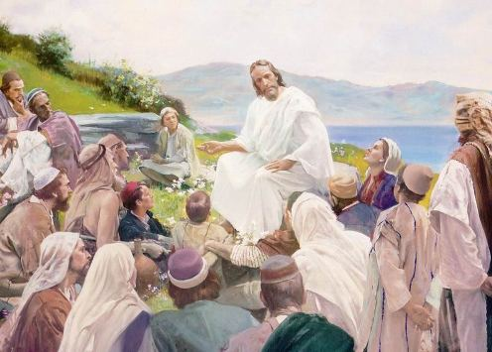
How God Speaks to Mankind Today
Heb 1:1-2
God, who at various times and in various ways spoke in time past to the fathers by the prophets, has in these last days spoken to us by His Son . . .
SPOKEN INSPIRATION | WRITTEN INSPIRATION
“Holy men of God spoke as they were moved by the Holy Spirit” (2 Peter 1:21) | “By revelation . . . I have . . . written . . . when you read you may understand . . .” (Ephesians 3:3-4)
John 14:26
But the Helper, the Holy Spirit, whom the Father will send in My name, He will teach you all things, and bring to your remembrance all things that I said to you.

Slide 5
Can the Bible be understood
“No, because you can prove anything by the Bible!”
“No, because the Bible contains contradictions!”
“Not alike, because the Bible says one thing to you and another to me.”
“No, because it all depends on how you look at it.”
“No, because it would be egotistical to say we can understand the Bible.”

Slide 6
Can the Bible be understood
Who was the mother of Jesus?
Mary ~ Matt 1:20-25
In what city was Jesus born?
Bethlehem ~ Matt 2:5
Who built an ark of gopher wood?
Noah ~ Gen 6:13-22
Who killed 1000 men w/jawbone of a donkey?
Samson ~ Judg 15:15

Slide 7
The Bible can be Understood
When He had called the multitude to Himself, He said to them, hear and understand (Matt 15:10)
So Philip ran to him, and heard him reading the prophet Isaiah, and said, do you understand what you are reading? (Acts 8:30)
For we are not writing any other things to you than what you read or understand. Now I trust you will understand, even to the end (2 Cor 1:13)
By which, when you read, you may understand my knowledge in the mystery of Christ (Eph 3:4)
Therefore do not be unwise, but understand what the will of the Lord is (Eph 5:17)

Slide 8
The Bible can be Understood
Jesus answered and said to them, are you not therefore mistaken, because you do not know the Scriptures nor the power of God? (Mk 12:24)
And you shall know the truth, and the truth shall make you free. (Jn 8:32)
Now we have received, not the spirit of the world, but the Spirit who is from God, that we might know the things that have been freely given to us by God (1 Cor 2:12)
And that from childhood you have known the Holy Scriptures, which are able to make you wise for salvation through faith which is in Christ Jesus (2 Tim 3:15)

Slide 9
Is it Possible to Understand the Bible alike?
For God is not the author of confusion but of peace, as in all the churches of the saints (1 Cor 14:33)
In the beginning God created the heavens and the earth.
In the beginning the earth spontaneously combusted.
There was no beginning, the earth has always been here.
1 + 1 = 2
1 + 1 = 3
1 + 1 = 5
2 Cups of Flour
2 Cups of Salt
2 Cups of Beans
“If anyone wants to do His will, he shall know concerning the doctrine, whether it is from God . . .” (Jn 7:17)

Slide 10
Forbidden to go Beyond the Scriptures
I could not go beyond the word of the LORD my God, to do less or more (Num 22:18)
You shall not add to the word which I command you, nor take anything from it (Deut 4:2)
Whatever I command you, be careful to observe it; you shall not add to it nor take away from it (Deut 12:32)
Every word of God is pure; he is a shield to those who put their trust in Him. Do not add to His words, lest He rebuke you, and you be found a liar (Prov 30:5-6)
You may learn in us not to think beyond what is written (1 Cor 4:6)

Slide 11
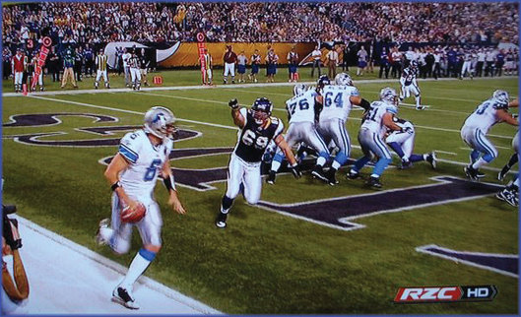
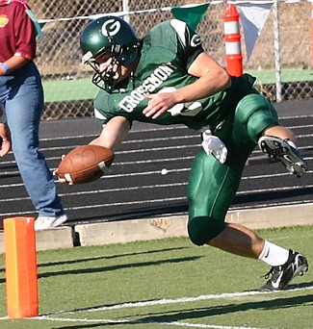
Forbidden to go Beyond the Scriptures
Whoever transgresses and does not abide in the doctrine of Christ does not have God. He who abides in the doctrine of Christ has both the Father and the Son (2 John 9)
parabainoô
to go past or to overstep, violate, break the rules
"Stepping out of Bounds"

Slide 12
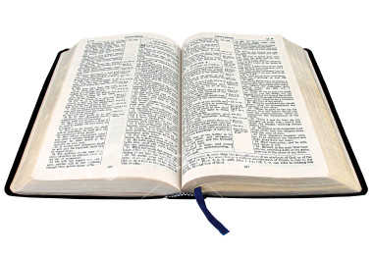
Forbidden to go Beyond the Scriptures
Whoever transgresses and does not abide in the doctrine of Christ does not have God. He who abides in the doctrine of Christ has both the Father and the Son (2 John 9)
"Stepping out of Bounds"
Book
Chapter
Verse

Slide 13
How Do We Determine Bible Authority?
History
Science
Math
How do we learn anything?
Tell them what you want or what is expected of them.
Show them what is expected.
Give them sufficient evidence so they may deduce what is expected.
Direct Statement
Give Examples
Forced Conclusion

Slide 14
During the N.T. era – how did men understand the O.T.; God’s written will?
This Meant:
The O.T. Stated what was expected!
The O.T. Showed what was expected!
The O.T. Gave enough information to Necessarily Infer what was expected!
Matthew 5:21
You have heard that it was said to those of old, you shall not murder . . .
Heb 11:3
By faith we understand that the worlds were framed by the word of God . . .
1 Cor 10:11
Now all these things happened to them as examples . . .
Rom 15:4
For whatever things were written before were written for our learning . . .
Matt 19:3-6
. . . A man shall . . . be joined to his wife, and the two shall become one flesh . . . let not man separate.
Matt 22:23-32
I am the God of Abraham, the God of Isaac, and the God of Jacob; God is not the God of the dead, but of the living.
Direct Statements
Given Examples
Forced Conclusions

Slide 15
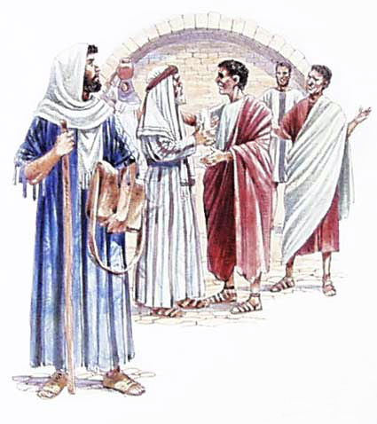
During the N.T. era – how did men understand God’s will about Circumcision?
This Meant:
The O.T. Told what was God’s Will!
Gentile conversion w/out circumcision Showed what was God’s Will!
God telling Peter to go to the Gentiles, he necessarily inferred what was God’s Will!
Acts 15:12
Conversion of many Gentiles w/out circumcision ~ Acts 14:27
Acts 15:13-21
The O.T. book of Amos said it was the will of God ~ Amos 9:11
Acts 15:7-11
Conversion of Cornelius w/out circumcision ~ Acts 10
Direct Statements
Given Examples
Forced Conclusions

Slide 16
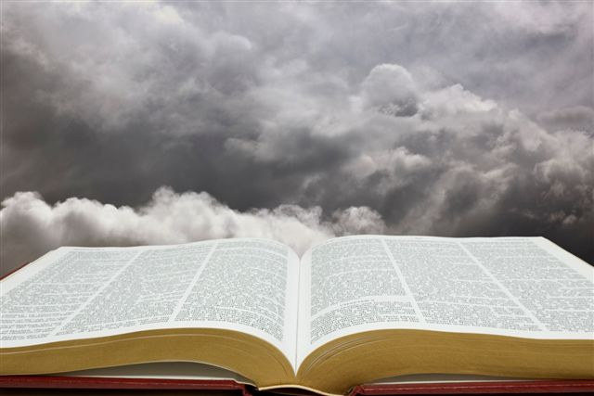
The Bible Teaches us today in one or more of these three ways!
Commands to Follow (“This do” 1 Cor 11:25)
Prohibitions (“Abstain from fleshly lusts” 1 Pet 2:11)
Affirmatives to Respect (“He who believes and is baptized will be saved” Mk 16:16)
Divinely Approved Examples
(“Brethren, join in following my example, and note those who so walk, as you have us for a pattern” Phil 3:17)
Necessary Inferences
(“For the priesthood being changed, of necessity there is also a change of the law . . . For it is evident that our Lord arose from Judah . . .” Heb 7:12-14)
Direct Statements
Given Examples
Forced Conclusions

Slide 17
An Investigation of Authority!
Our Next Study,
Principles in Practice
The Nature of All Authority

