Slide 2
Acts 4:7-12
⁵ And it came to pass, on the next day, that their rulers, elders, and scribes, ⁶ as well as Annas the high priest, Caiaphas, John, and Alexander, and as many as were of the family of the high priest, were gathered together at Jerusalem. ⁷ And when they had set them in the midst, they asked, by what power or by what name have you done this? ⁸ Then Peter, filled with the Holy Spirit, said to them, rulers of the people and elders of Israel: ⁹ If we this day are judged for a good deed done to a helpless man, by what means he has been made well, ¹⁰ let it be known to you all, and to all the people of Israel, that by the name of Jesus Christ of Nazareth, whom you crucified, whom God raised from the dead, by Him this man stands here before you whole. ¹¹ This is the ‘stone which was rejected by you builders, which has become the chief cornerstone. ¹² Nor is there salvation in any other, for there is no other name under heaven given among men by which we must be saved.

Slide 4

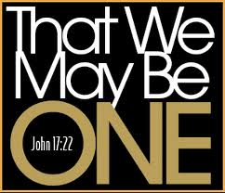

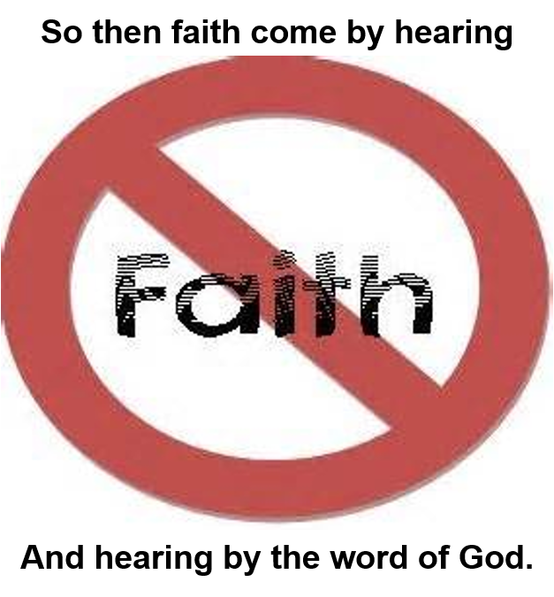
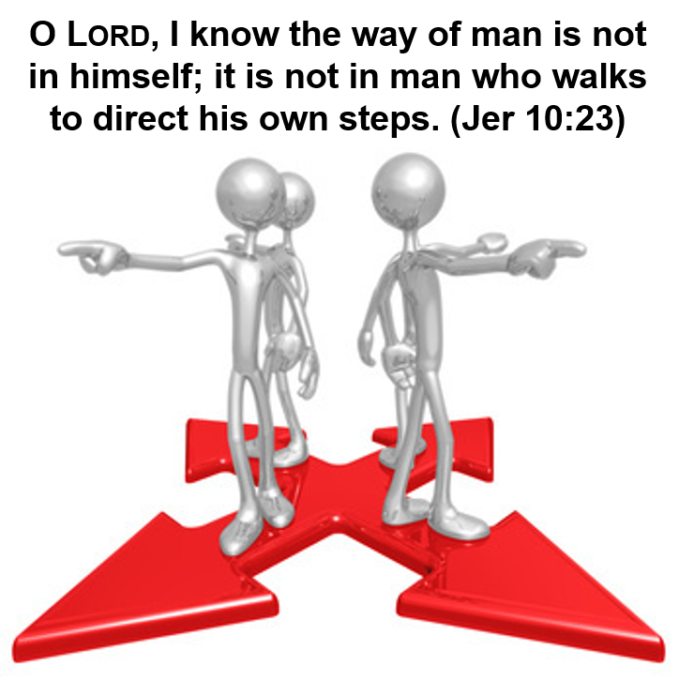
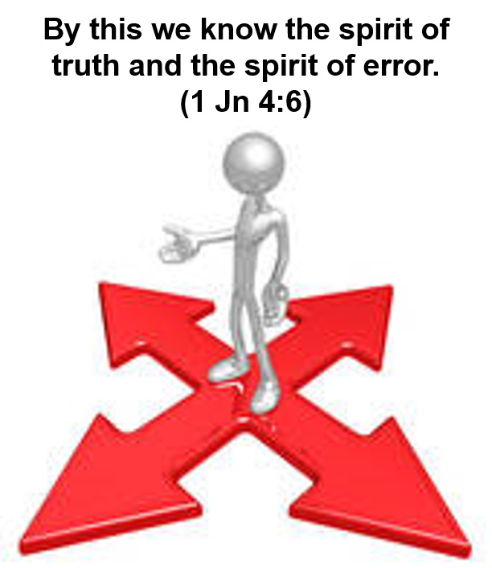
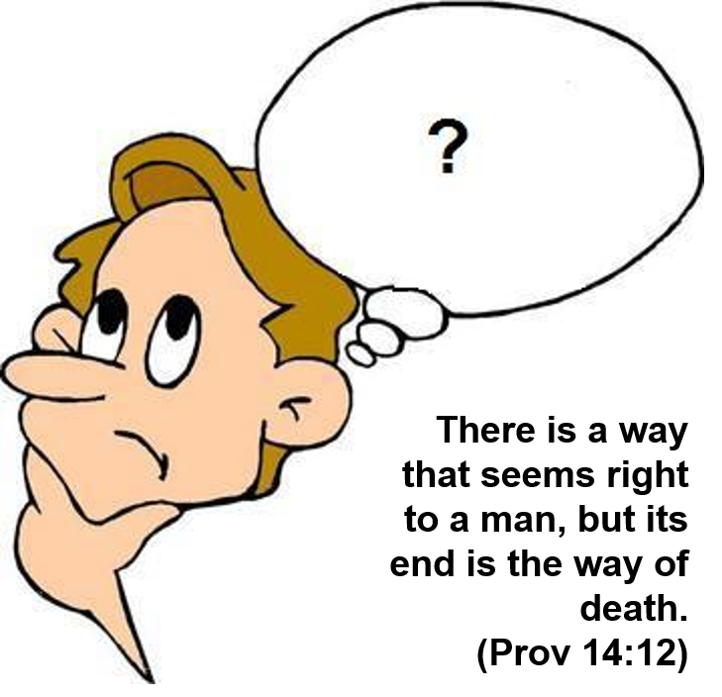
There must be Authority in Religion
There must be Authority in Religion
2012: 43,000 “Christian Denominations” worldwide

Slide 5

All Religious Authority
God
Men

Slide 6

By this we know the spirit of truth and the spirit of error.
(1 John 4:6)
Matthew 21:23-27
“The baptism of John—where was it from? From heaven or from men?”
“This wisdom does not descend from above, but is earthly, sensual, demonic. For where envy and self-seeking exist, confusion and every evil thing are there. But the wisdom that is from above is first pure, then peaceable, gentle, willing to yield, full of mercy and good fruits, without partiality and without hypocrisy.” (James 3:15-17).
TRUTH LEADS TO LIFE!
John 8:31-32
“If you abide in My word, you are My disciples indeed. And you shall know the truth, and the truth shall make you free.”
ERROR LEADS TO DEATH!
James 5:20
“. . . a sinner from the error of his way will save a soul from death and cover a multitude of sins.”

Slide 7
All Authority in Religion comes either from . . .
what man says
what God says
Error
Truth
Matthew 16:13-17
“Who is Jesus?”
But God has revealed them to us through His Spirit. For the Spirit searches all things, yes, the deep things of God . . . Now we have received, not the spirit of the world, but the Spirit who is from God, that we might know the things that have been freely given to us by God. (1 Cor 2:10-12)
It is not in man who walks to direct his own steps. (Jer 10:23)
Eye has not seen, nor ear heard, nor have entered into the heart of man the things which God has prepared for those who love Him. (1 Cor 2:9)
“The Christ, the Son of the Living God”
John the Baptist
Elijah
Jeremiah
One of the Prophets

Slide 8

All Authority in Religion is either from . . .
From Men
Parents
Conscience
Human Wisdom
Traditions / Custom
Religious Leaders / Preachers
The Majority
Brethren / Periodicals
Creeds & Manuals
Other Churches
The Good that Results
TRUTH
ERROR
From God
Hebrews 1:1
Colossians 3:17
Matthew 28:18
Matthew 17:5
Deuteronomy 4:2
Psalms 138:2
How Does
God Speak
To Us?

Slide 9

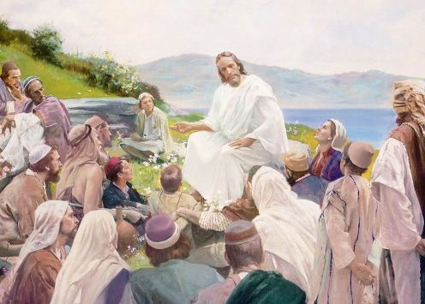


How Does God Speak to Mankind Today?
Hebrews 1:1
John 12:50
Matthew 7:28-29
Hosea 8:12
John 16:13
2 Peter 1:21
Acts 2:1-4
Ephesians 3:3-4
1 Corinthians 2:9-10

Slide 10
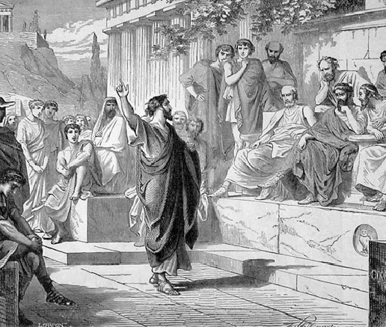
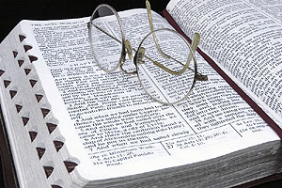
How Does God Speak to Mankind Today?
SPOKEN INSPIRATION | WRITTEN INSPIRATION
“Holy men of God spoke as they were moved by the Holy Spirit” (2 Peter 1:21) | “By revelation . . . I have . . . written . . . when you read you may understand . . .” (Ephesians 3:3-4)
The Pattern MUST be followed (Hebrews 8:5) whether . . .
“They continued steadfastly in the apostles’ doctrine” ~ Acts 2::42

Slide 11
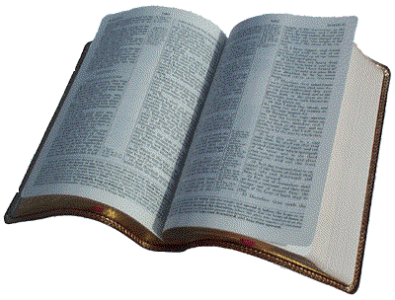
All Authority in Religion is either from . . .
From Men
Parents
Conscience
Human Wisdom
Traditions / Custom
Religious Leaders / Preachers
The Majority
Brethren / Periodicals
Creeds & Manuals
Other Churches
The Good that Results
TRUTH
ERROR
All Scripture is given by inspiration of God, and is profitable for doctrine, for reproof, for correction, for instruction in righteousness, that the man of God may be complete, thoroughly equipped for every good work. (2 Tim 3:16-17)

Slide 12

An Investigation of Authority!
Our Next Study,
Warnings From God!
Where do we go from here?

