Slide 2
John 2:13-17
¹³ Now the Passover of the Jews was at hand, and Jesus went up to Jerusalem. ¹⁴ And He found in the temple those who sold oxen and sheep and doves, and the money changers doing business. ¹⁵ When He had made a whip of cords, He drove them all out of the temple, with the sheep and the oxen, and poured out the changers’ money and overturned the tables. ¹⁶ And He said to those who sold doves, take these things away! Do not make My Father’s house a house of merchandise! ¹⁷ Then His disciples remembered that it was written, Zeal for Your house has eaten Me up.

Slide 4
“not lagging in diligence, fervent in spirit, serving the Lord”
(Rom 12:11).
“Because zeal for Your house has eaten me up, and the reproaches of those who reproach You have fallen on me” (Psa 69:9).

Slide 5
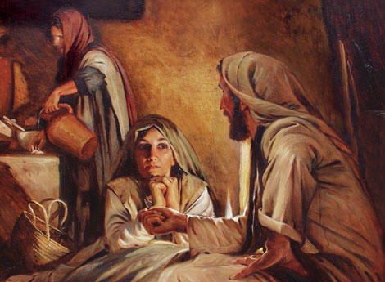
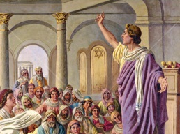
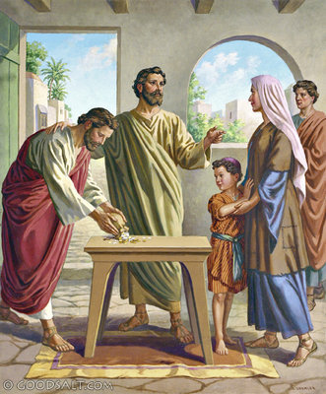
But one thing is needed, and Mary has chosen that good part, which will not be taken away from her (Lk 10:42)
Apollos . . . an eloquent man and mighty in the Scriptures . . . and being fervent in spirit . . . (Acts 18:24-25).
. . . I boast of you to the Macedonians . . . and your zeal has stirred up the majority (2 Cor 9:2)
Joses, who was also named Barnabas by the apostles (which is translated Son of Encouragement) . . . (Ac 4:36)
I call to remembrance the genuine faith that is in you, which dwelt first . . . (2 Tim 1:5)
“Because zeal for Your house has eaten me up, and the reproaches of those who reproach You have fallen on me” (Psa 69:9).

Slide 6
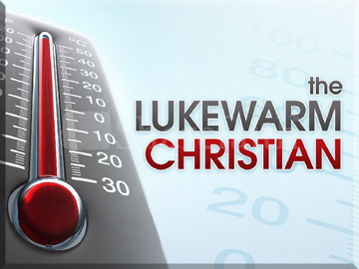
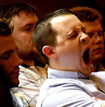
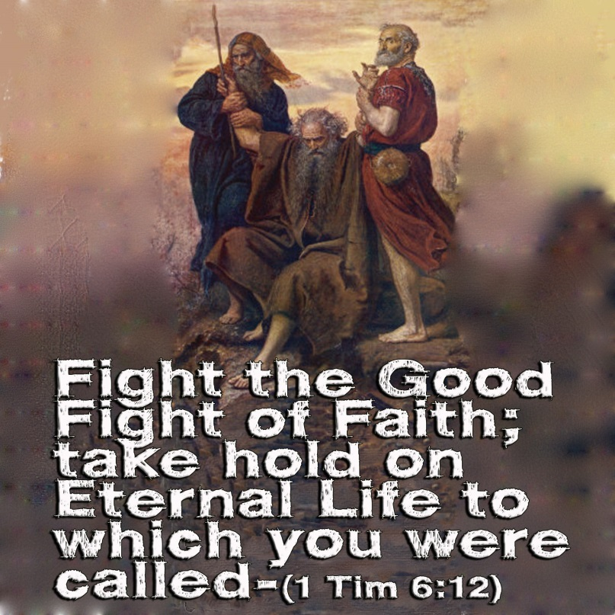
So then, because you are lukewarm, and neither cold nor hot, I will vomit you out of My mouth (Revelation 3:16).
Tepid (spiritual lethargy—lazy sluggish, indifferent)
Without spiritual enthusiasm
“I will vomit you
out of My mouth”
(Rev 3:16)

Slide 7
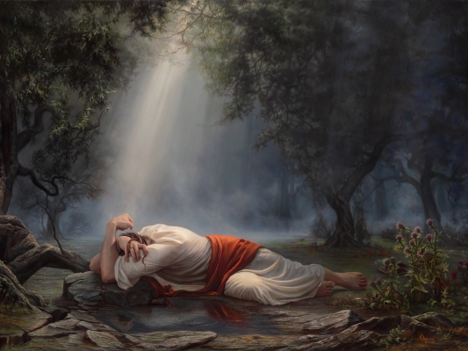
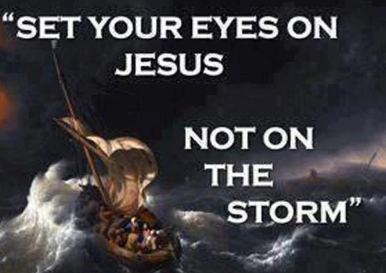
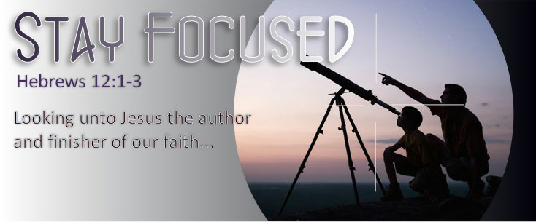
My Soul Is Exceedingly Sorrowful
Keep your focus upon Christ (Heb 12:2)
Keep busy in the Lord (1 Cor 15:58)
Look beyond sorrows/ grief (Col 3:1-2)
Interact with fervent believers (Heb 10:24)

Slide 8
True Zeal is:
For this reason I also suffer these things; nevertheless I am not ashamed, for I know whom I have believed and am persuaded that He is able to keep what I have committed to Him until that Day (2 Tim 1:12)
Doing Right
Living Right
Being Dependable
Serving Others
Always abounding in God’s work
“Because zeal for Your house has eaten me up, and the reproaches of those who reproach You have fallen on me” (Psa 69:9).

