Slide 2
John 20:24-29
²⁴ Now Thomas, called the Twin, one of the twelve, was not with them when Jesus came. ²⁵ The other disciples therefore said to him, we have seen the Lord. So he said to them, unless I see in His hands the print of the nails, and put my finger into the print of the nails, and put my hand into His side, I will not believe. ²⁶ And after eight days His disciples were again inside, and Thomas with them. Jesus came, the doors being shut, and stood in the midst, and said, peace to you! ²⁷ Then He said to Thomas, reach your finger here, and look at My hands; and reach your hand here, and put it into My side. Do not be unbelieving, but believing. ²⁸ And Thomas answered and said to Him, my Lord and my God! ²⁹ Jesus said to him, Thomas, because you have seen Me, you have believed. Blessed are those who have not seen and yet have believed.
²⁴ Now Thomas, called the Twin, one of the twelve, was not with them when Jesus came. ²⁵ The other disciples therefore said to him, we have seen the Lord. So he said to them, unless I see in His hands the print of the nails, and put my finger into the print of the nails, and put my hand into His side, I will not believe. ²⁶ And after eight days His disciples were again inside, and Thomas with them. Jesus came, the doors being shut, and stood in the midst, and said, peace to you! ²⁷ Then He said to Thomas, reach your finger here, and look at My hands; and reach your hand here, and put it into My side. Do not be unbelieving, but believing. ²⁸ And Thomas answered and said to Him, my Lord and my God! ²⁹ Jesus said to him, Thomas, because you have seen Me, you have believed. Blessed are those who have not seen and yet have believed.

Slide 4
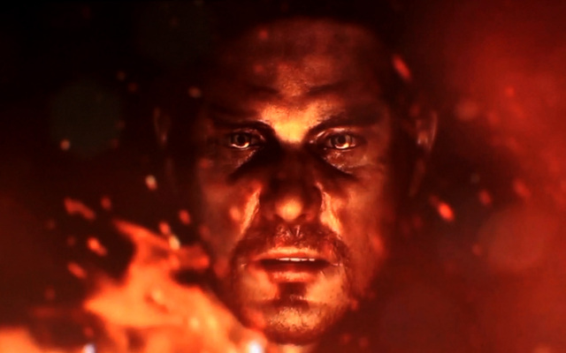
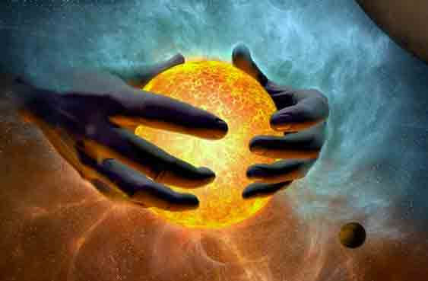
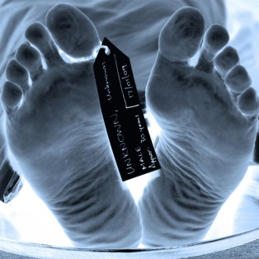
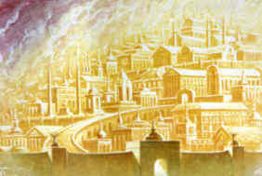
Why I am a Christian
Not because I decided I
wanted to go to heaven
Not because I discovered
that the world bears distasteful fruit
Not because of
a fear of hell
Not because of
impressive arguments
SIN
Blessed are those who have not seen and yet have believed.
John 20:29

Slide 5
Why I am a Christian
Shackled with the “cords of sin” (Prov 5:22)
A “slave to sin” (Romans 6:6, 16)
Shackled by a heavy burden, beneath a load of guilt and shame . . .
Sin reigns in one’s mortal body (Romans 2:12)
“Nothing good” dwells in us (Romans 7:17)
“Poisoned by bitterness and bound by iniquity” (Acts 8:23)
O wretched man that I am! Who will deliver me from this body of death? (Romans 7:24)

Slide 6
Society was reminding me:
I must look good, feel good, and be good.
I will always be inadequate.
I must earn God’s approval (works/suffering).
Love
SIN
Forgiveness
Acceptance

Slide 7
Why I am a Christian
Why I am a Christian
God is Love ~ 1 John 4:8
God so loved ~ John 3:16
God receives sinners ~ Luke 15:1-2
It is by Grace ~ Ephesians 2:8
Shackled by a heavy burden, beneath a load of guilt and shame . . .

Slide 8
Why I am a Christian
Because of who God is:
A Loving Father Who Waits, Watches and Welcomes
Because of Who Jesus is:
The Sacrifice for my sins, has the words of eternal life
Because of who I am:
A Sinner needing love, forgiveness and acceptance

